Slide 1


Welcome to Key Stage 2
Learning Together, Learning for Life

Slide 2
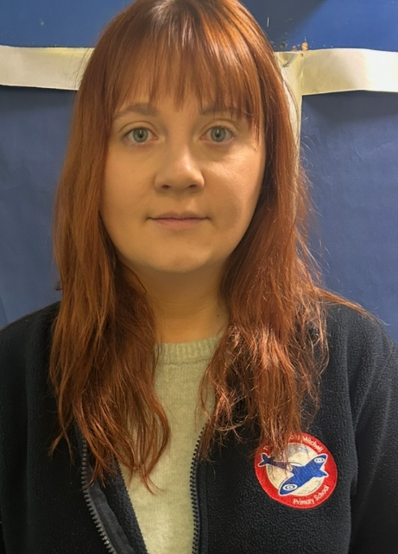
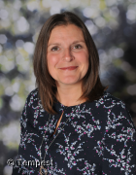
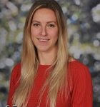
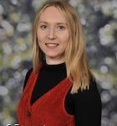
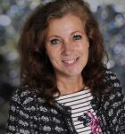
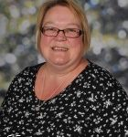
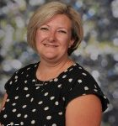



We are Year 3 and 4…

Slide 3
Teaching as a mixed Year 3 and 4 class…
The curriculum for Year 3 and 4 covers the same aspects of learning. In year 3, pupils are learning the skills and these are embedded and developed in Year 4.
As a result, the class will usually be taught together, with additional support or challenge provided through the task.
Where appropriate, particularly in maths, pupils may be taught through split teaching where the children will be taught things specific to their year group.

Slide 4


Our Curriculum is driven by geography and history...
In geography we will learn about the geography of our local area, our country and the wider world.
In history we will learn skills and knowledge around the concepts of chronology and change. We will focus on:
The Stone Age, The Ancient Greeks and The Potteries.
The other areas of the curriculum (art, design and technology etc.) link to these curriculum drivers.

Slide 5


Reading…
Children will take part in daily reading practise sessions called ERICA. These sessions will focus on developing your child’s fluency and comprehension.
Your child may still benefit from Little Wandle reading sessions three times a week where they will learn to decode books, read fluently with expression and to comprehend what they have read.
Your child will read to an adult 1:1 at least once every three weeks.
In Key stage 2, children are encouraged to change their own book when they have finished reading them (children are only required to read a book once instead of 3 times, when they are on white books)

Slide 6
Reading continued…
To promote the love of reading, we will visit our school library each week to select a book to take home.
Please read as often as possible with your child at home, at least 3 x per week. Children are rewarded for reading 3 times.
Please record this in your child’s home/ school links books.

Slide 7
Spellings…
Children are split into separate classrooms for Year 3 or Year 4 spelling.
Our daily spelling sessions involve learning and practising a new spelling rule, as well as practising our ‘fast 5’.
Our ‘fast 5’ spellings will be given out in Home Links books every Friday, to be tested on the following Friday.

Slide 8



Writing in Key Stage 2…
In Key Stage 2, we build on and embed all of the skills pupils have learnt in Key Stage 1.
We begin to write for different purposes, learn different sentence types and more ambitious punctuation and vocabulary.
Our writing is often linked to one of our class texts. Take a look at what we will be reading…

Slide 9

Maths…
The children are given lots of opportunities to explore new maths learning through discussions with partners and in groups; using equipment to support their understanding.
We encourage the children to represent their working out in pictures initially, before moving onto abstract methods. They will then demonstrate their depth of understanding when exploring reasoning and problem solving challenges.

Slide 10
Times Tables…
At the end of Year 4, all pupils complete a national Times Table Check where they will be expected to know and quickly recall their times tables, up to 12 x 12.
We complete this test on iPads and pupils will have 6 seconds to answer each question.
An information session will follow in the Autumn Term.

Slide 11

What helps me to learn best?
We encourage the pupils to be as independent as possible with their learning. Within each classroom, there will be a station with resources and we encourage pupils to access these.
We regularly prompt the children:
What might help you today with your learning?
What resources do we have in our classroom?
Remember you can help yourself to learn!

Slide 12
Intervention…
You may hear your child mention they have had some intervention. This sounds very formal. Please do not be alarmed.
Intervention may take place to extend children as well as support them. Or we may even just need to tackle an individual issue with your child- it does not mean we have a big issue. Our curriculum is just very personalised.

Slide 13
Homework…
Whilst we don’t set written homework, we ask that pupils:
Read at home a minimum of 3 x a week.
Please practise weekly fast five spellings.
Please practise times tables.
All of these will benefit your child in their learning.
We are currently

Slide 14
Mrs Holt - SENDCO
Supports children with additional needs
Helps teachers to plan appropriate provision and adapt any reasonable adjustments
Works with external agencies to provide quality, personalised interventions for children
Mrs Holt works closely with the MHST to support children with anxiety or low mood.
Mrs Holt is at Kingsfield on a Monday afternoon to support pupils and teachers with any referrals.

Slide 15

Visits…
Year 4 pupils are invited to attend a residential trip to Stanley Head this year!
It is taking place 11th – 13th March 2025. There will be an information evening in September/ October.
We will be going on some more exciting trips during the year. Keep an eye out for more information!

Slide 16


Slide 17
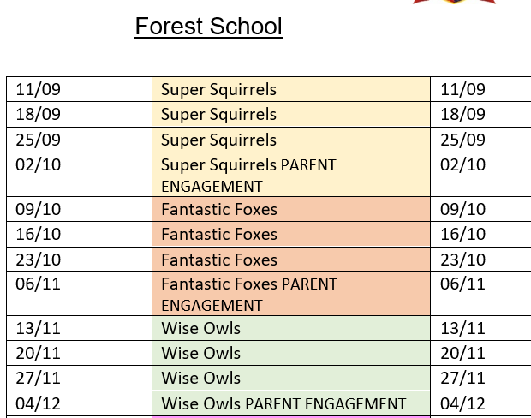
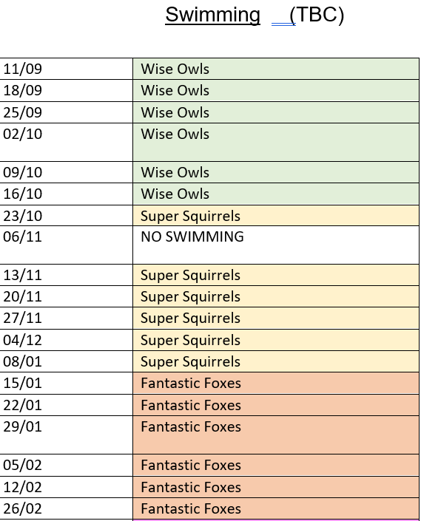

Slide 18
PE Days
Each class will have two PE sessions a week: a morning session and an afternoon session. Children need to come to school in PE kit on these days.
Wise Owls – Monday and Wednesday.
Super Squirrels – Tuesday and Wednesday.
Fantastic Foxes – Wednesday and Thursday.

Slide 19
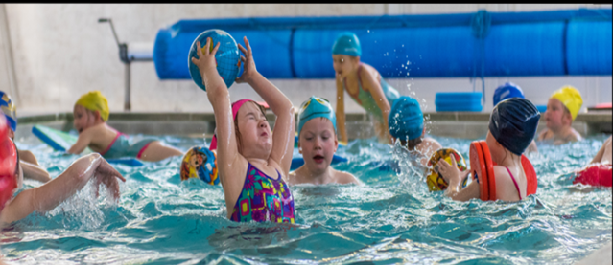
We will send out our ‘Welcome to Key Stage 2’ booklets before the end of term.
If you receive certain types of benefit you may be entitled to funding for your child in their learning. Please let us know if you are entitled to this.

Slide 20


Get involved…
We always need help in school. Hearing children read, photocopying, laminating, cutting out, going on visits, in the swimming pool-please speak to a member of staff if you think you would be able to help.
Our wonderful PTFA organise lots of events and raise lots of money for our children-they would welcome new members!

Slide 21

School Website
Letters
Policies
Newsletter – online and emailed.
E-safety
Communication to parents.
Staff – Kingsfield First School | Biddulph | Staffordshire
We will be updating our year group web page with important information so please check for any information that you may need.

Slide 22

Lines of communication…
office.kng@cflptrust.co.u
Weekly drop-in sessions are available with your child’s class teacher. This is Thursday until 4pm for all Key Stage 2 staff.
Please speak to a member of staff on the door in the morning.
If you need to leave a message you can also telephone the school office on the following number:
01782 973800
Alternatively you can email the school office on:
office.kng@cflptrust.co.uk

Slide 23


Lines of communication…

Slide 24
Any questions?

