Slide 1

Y4 Standon Bowers Residential 2025
Wednesday 5th march – friday 7th march

Slide 2
AGENDA OF THE PRESENTATION
Introduction/Purposes of the trip
What to expect (activities, accommodation, adults, meals)
What to bring (kit list, money, medication)
Communication (Twitter, mobile phones)
Logistics (travel, accommodation, forms)
Final Words/Any Questions?

Slide 3
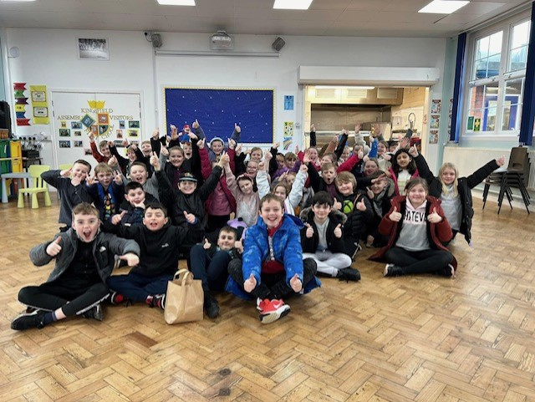
Introduction
Team-building
Independence
Resilience
Lots of fun!

Slide 4
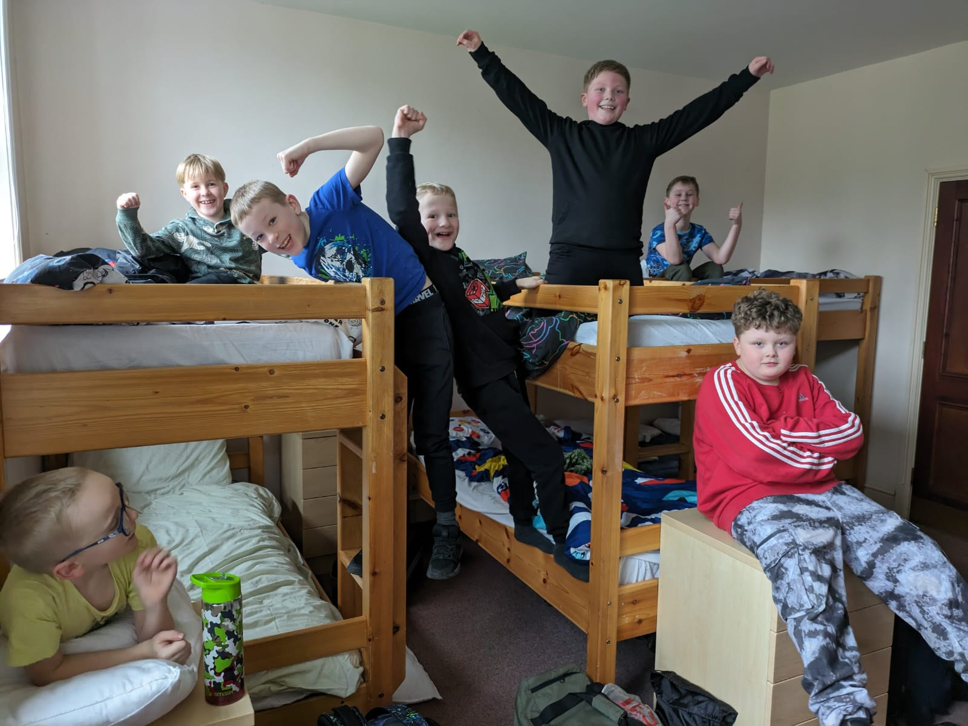
What to expect - accommodation
The staff attending are: Miss Day, Mrs Cliffe & Mrs Stevens
Dormitory Accommodation for our boys and girls – staff rooms nearby each dorm room.
There are toilet & shower facilities on every corridor.
Closer to the time, children will choose who they would like to share a room with.

Slide 5
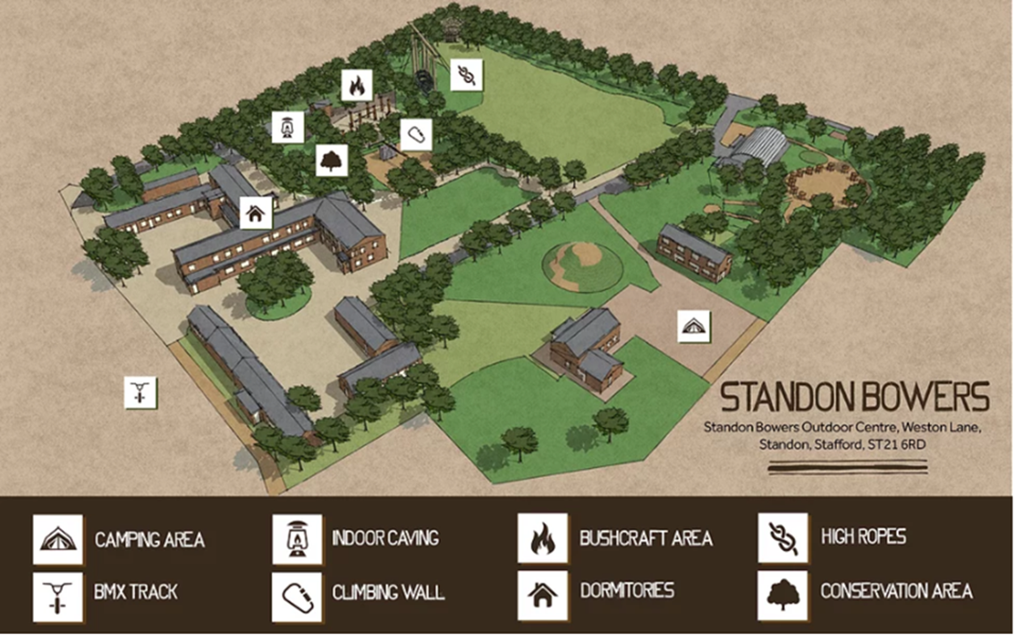

Slide 6
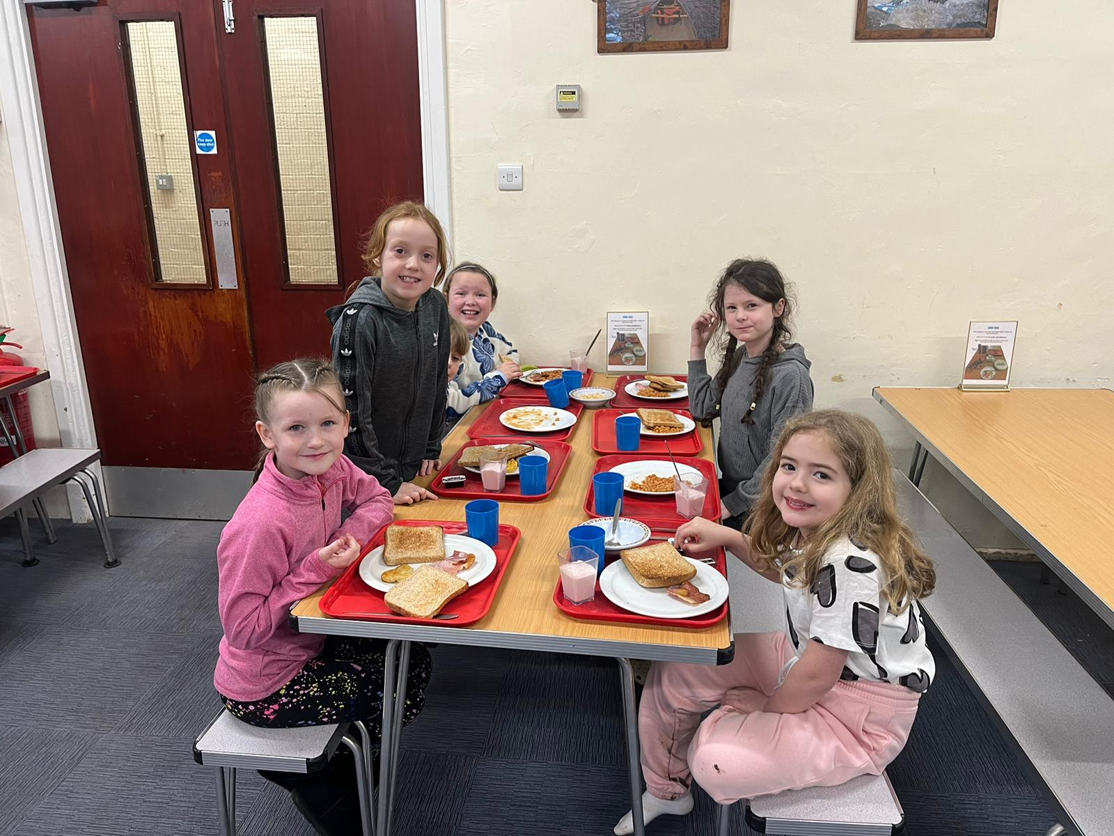
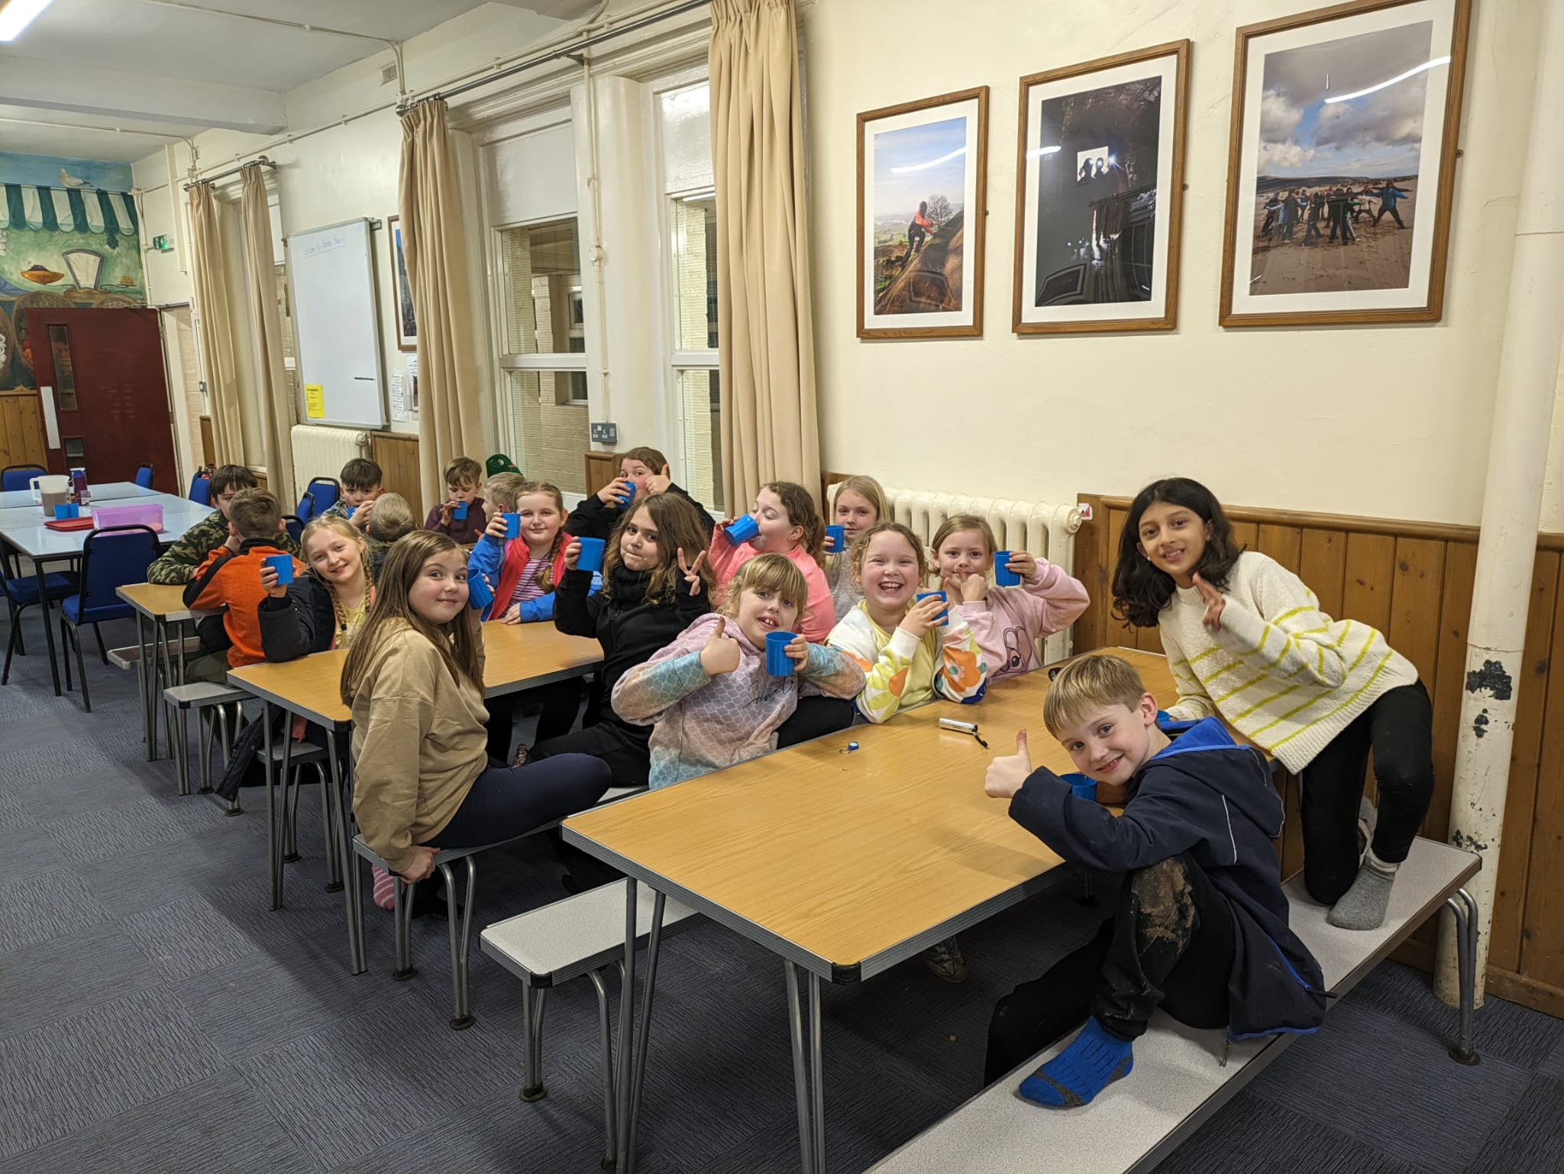
What to expect – meals
Cater for all dietary requirements.
Breakfast – a selection of hot and cold choices – cereal, toast, pancakes, sausages, beans etc.
Lunch – a packed lunch. Parents will need to provide a lunch for the first day.
Evening meal – a choice of hot options – jacket potato, meat and vegetarian.
Hot chocolate before bed!

Slide 7
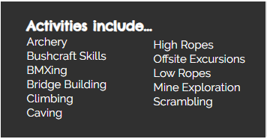
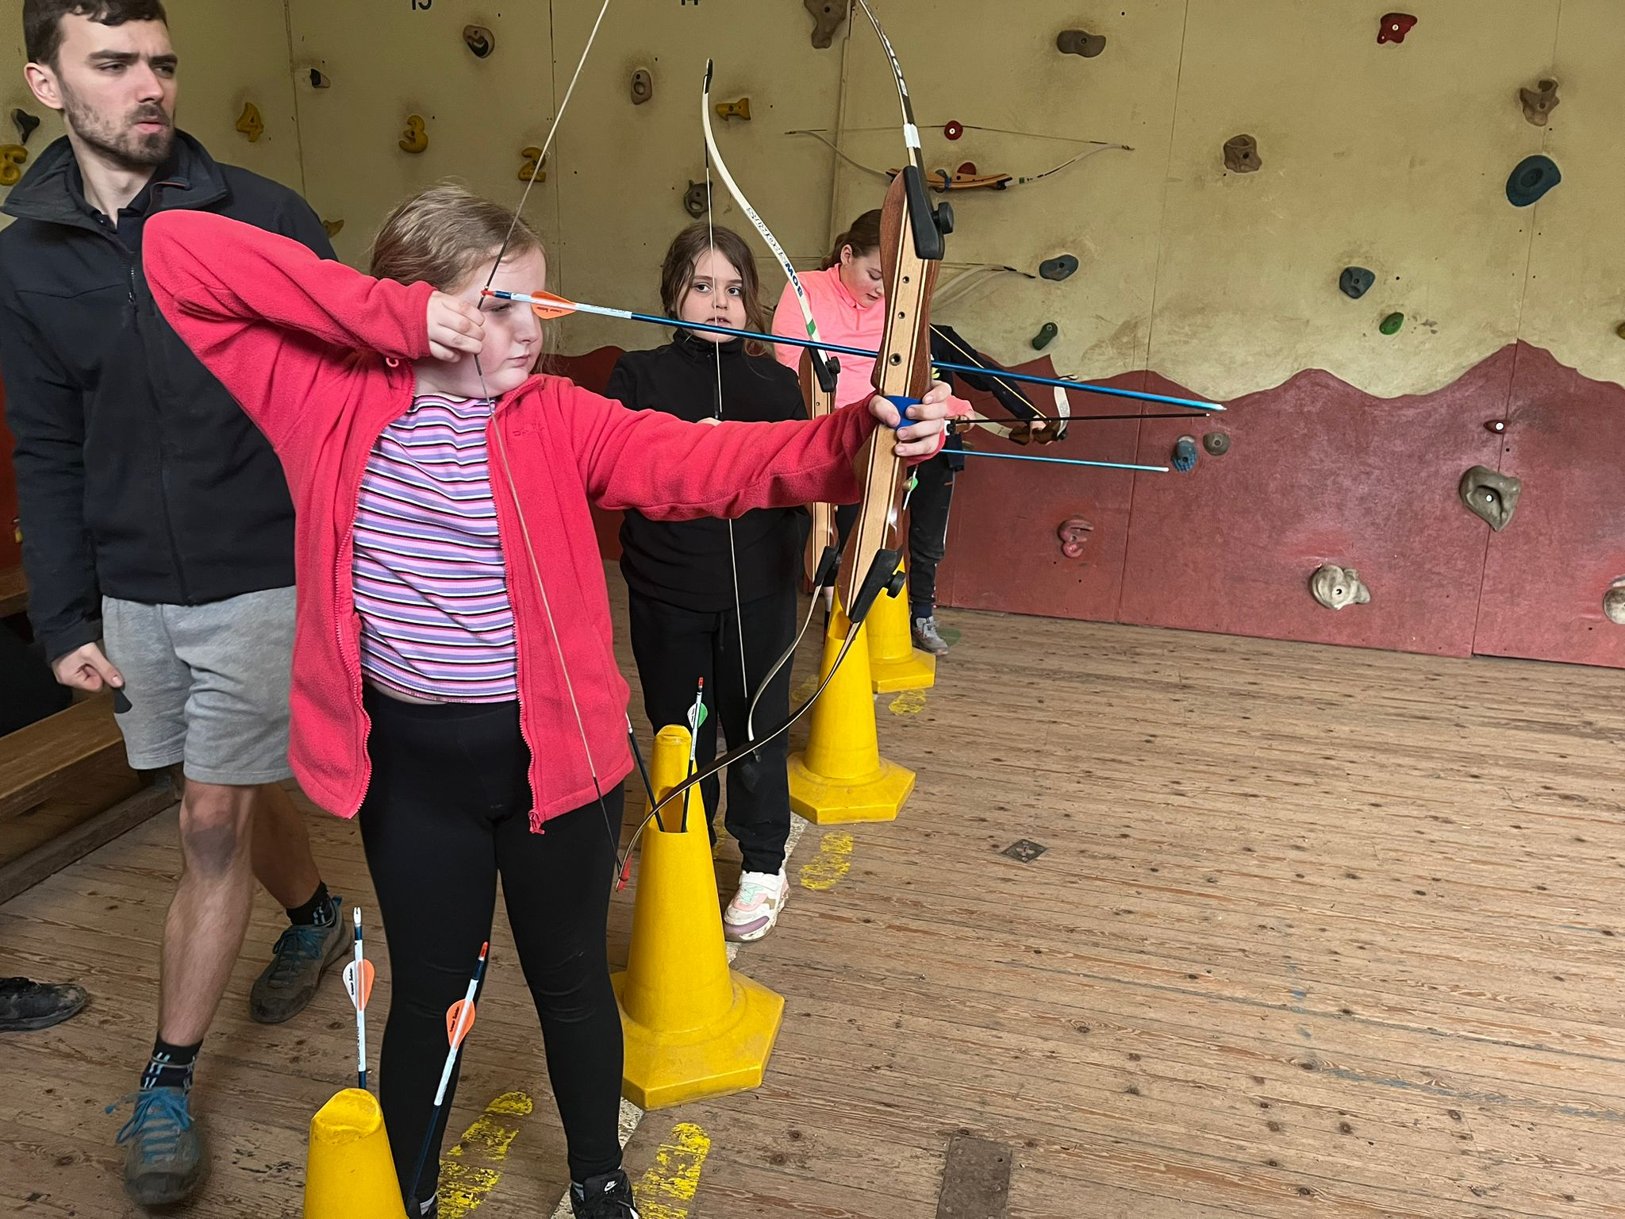
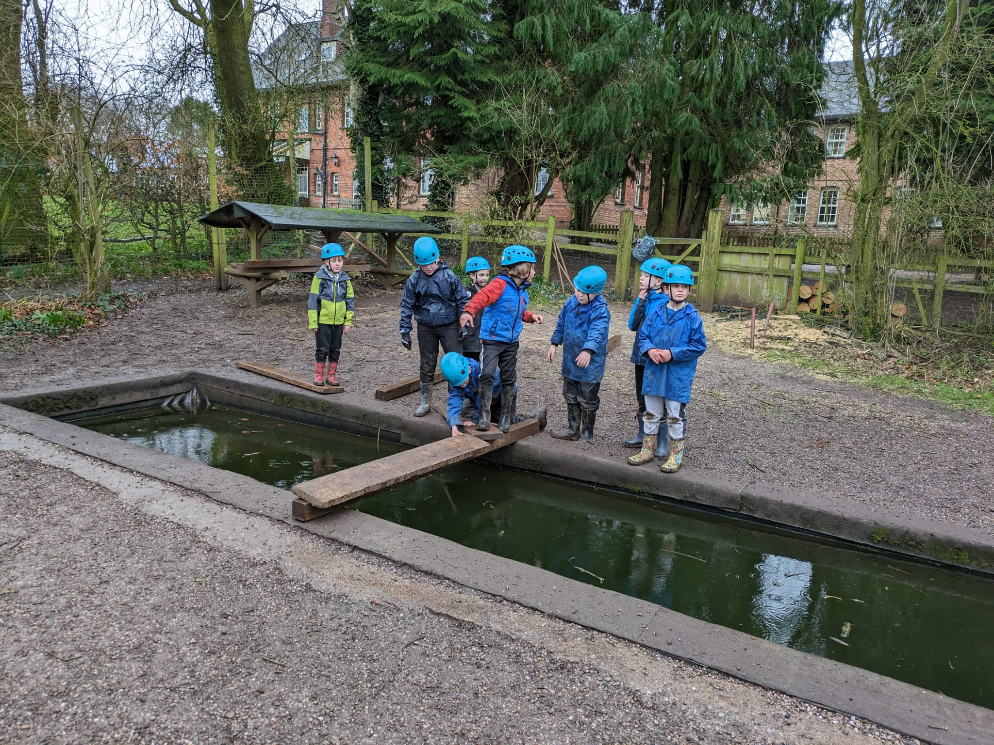

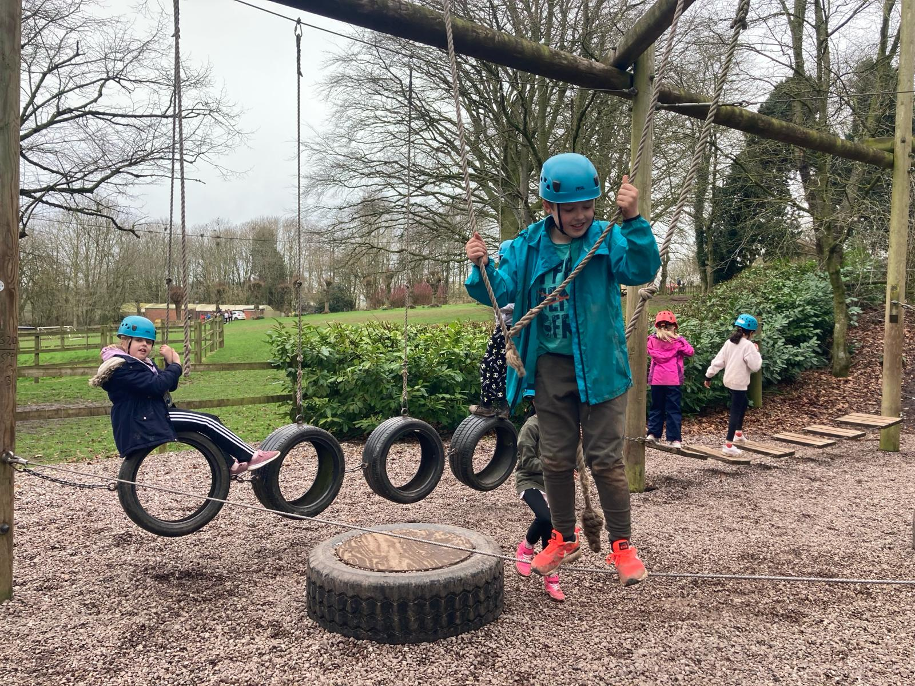
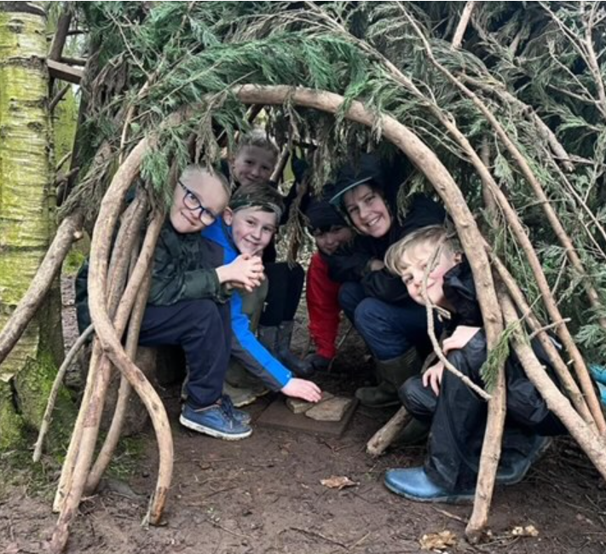
What to expect – activities!

Slide 8
What to expect – teams and duties!
Friendship groups will be combined into teams of around 6-8 and they will do their activities and their duties in these teams.
Each team will be assigned a chore for their stay – cleaning away plates, hoovering the dining room, sweeping the boot rooms etc. Children need to take pride in their environment and keep the centre tidy.
Teams get points for completing their jobs and the winning team will be announced at the end. Get practising! ☺

Slide 9
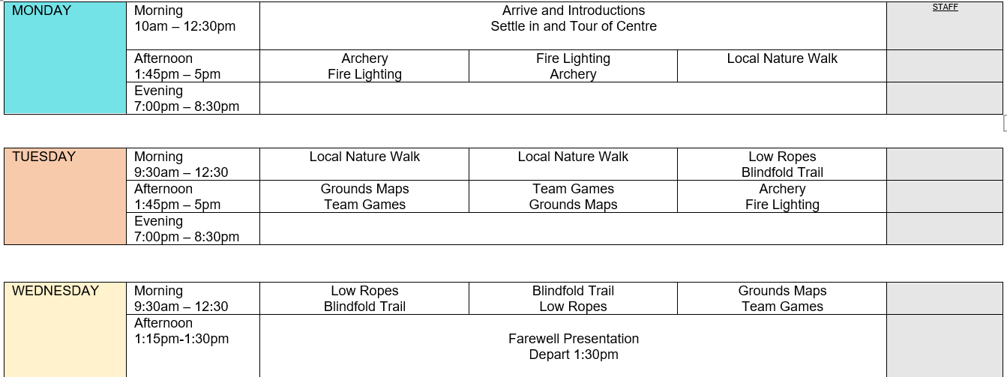
Itinerary
This is an itinerary from a previous year. Activities will differ, but there will be 3 activities during the day and an evening activity.

Slide 10
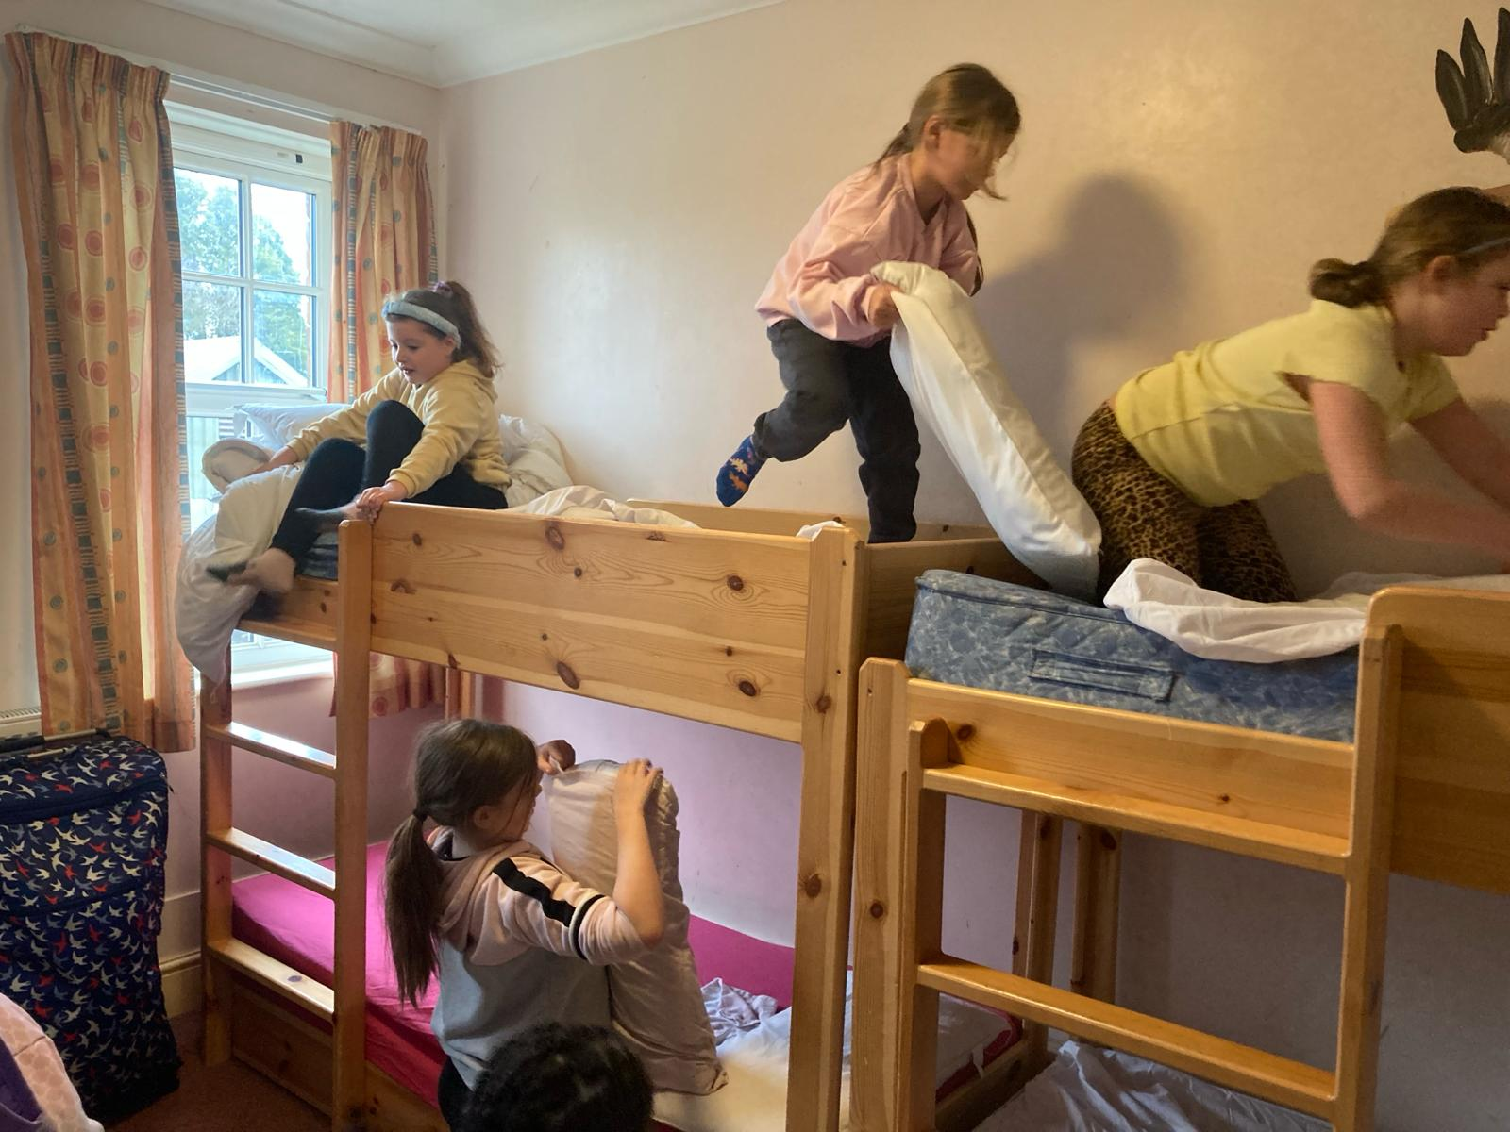
What to bring
Kit list - a detailed list will be provided closer to the time. Forest school clothes, wellies, indoor shoes, a pillow case and duvet cover.
Money – No more than £5 in a named envelope for souvenirs.
Snacks – a small snack for each evening if necessary
Medication – All parents will be required to complete a medical form 2 weeks before departure. Any medications will be kept securely by staff.

Slide 11

Payment
Initial deposit of £55.00
Monthly instalments:
-End of October - £24
End of November - £24
End of December - £24
End of January - £24
End of February - £24
Or £120 full payment

Slide 12


Communication
We will keep you updated on Facebook with lots of pictures throughout our trip!
Children aren’t permitted to take phones or any electronic devices. Staff will contact parents if necessary.

Slide 13

Upcoming dates
There will be another information meeting on Thursday 27th February at 3.15 and 5.30pm. Parents will need to attend or collect the relevant paperwork as medical forms will be given.
There is a celebration evening after we return on 13th March at 6pm where children will be awarded certificates and lots of stories will be shared. It would be great to see you there!

Slide 14


