Slide 1
Phonics in the
Early Years
Parent Workshop – 20th September 2023

Slide 2
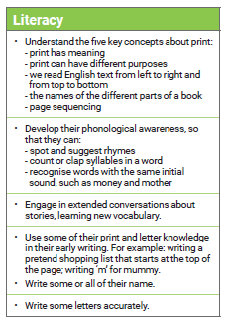
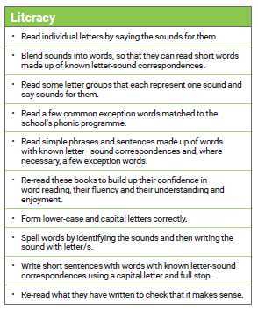
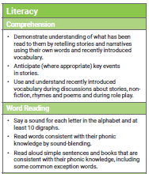
The Curriculum & Expectations

Slide 3

The foundations of reading…is phonics!

Slide 4


Foundations for Phonics
It is ALL about the pre reading skills, the speaking and listening skills done with our ears which then provides the children with solid foundations ready for ‘reading with our eyes!’
These next slides will take you through step by step of a child’s reading journey…

Slide 5
Nursery – ‘Foundations for Phonics’
The old ‘Phase 1’ phonics
Tuning into sounds
Distinguishing between different sounds
Listening & Attention

Slide 6
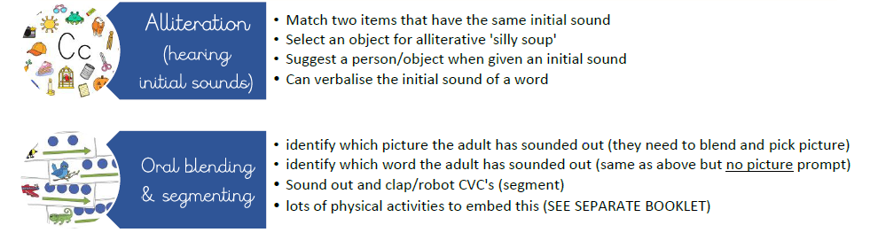
These 2 areas involve NO visual links with letters! It is all just listening, attention and speaking!
Training the brain to link sounds together to make words (oral blending - pre reading) and to break sounds up (oral segmenting - pre spelling)

Slide 7


Hearing Initial sounds
Blending & Segmenting
Hearing sounds & blending and segmenting become primary skills for reading.
It starts off as ‘oral blending and segmenting’ and then develops into just ‘blending and segmenting’ for reading and writing.
Blending and segmenting is a skill children will continually use and apply throughout their reading and writing journey!
This is where some parents start to find it a bit of a minefield! Hopefully the next few slides to help you to understand the difference between the two a little bit more!

Slide 8
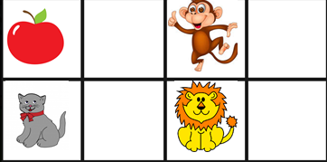
Hearing initial sounds
STAGE 1: Initial sound picture cards. Parents to model and encourage children to listen and hear the initial sound. Parents to stretch and bounce out the sounds
Stretchy (stretchy and bouncy explain in a couple of slides)
Bouncy
STAGE 2: : Still initial sound picture cards. Parents to just say the word and children to listen and hear the initial sound.
‘what can you hear in cat?’
Again model this to begin with but above is your aim!
Want the children to separate the repeated sound from the word
Want the children to hear c in cat instead of c-c-c-ccat.
‘what can you hear in c-c-c-c-c-ccat?’
Yes can you hear the c in cat?!
STAGE3: Initial sounds but without pictures or objects as prompts
Games like I spy
Use a puppet to ask them questions – what can you hear at the beginning of fish?
Stick with 1 sound to begin with. E.g all s words. (Alliteration)

Slide 9
Oral Blending
Blending is the process that is involved in bringing the sounds together to make a word or a syllable and how /c/ /a/ /t/ becomes cat.
Stage 1: Blending with Pictures
With pictures/objects in front of them
‘where is the c-a-t’ and you want them to point to the cat. You may have to repeat a couple of times for them to find it.
Stage 2:
Blending without pictures
Hide the pictures/objects from your child.
‘what picture I am looking at/hiding/thinking of? Listen… c-a-t’. and you want them to say cat without having to look at the sheet for prompting. Again you may have to repeat a couple of times for them.

Slide 10
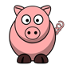
Oral Segmenting
Segmenting is a skill used in spelling. In order to spell the word cat, it is necessary to segment the word into the sounds that make it up; c-a-t.
Children will enjoy spelling if it feels like fun and if they feel good about themselves as spellers. We need, therefore, to be playful and positive in our approach – noticing and praising what children can do as well as helping them to correct their mistakes.
Hearing the sounds in a word.
For example, if the picture is a pig, your child needs to say p-i-g.
To support them with this, count the sounds, then hold fingers up and point/press as you say each sound. You may need to do it with them to start!

Slide 11

Any Questions so far?

Slide 12
Reception Phonics – Little Wandle
Phase 2 -Single letter sounds
Reading CVC words (pig, cat, lip)
Phase 3- digraphs and trigraphs
Reading words with those sounds
Phase 4- longer words

Slide 13
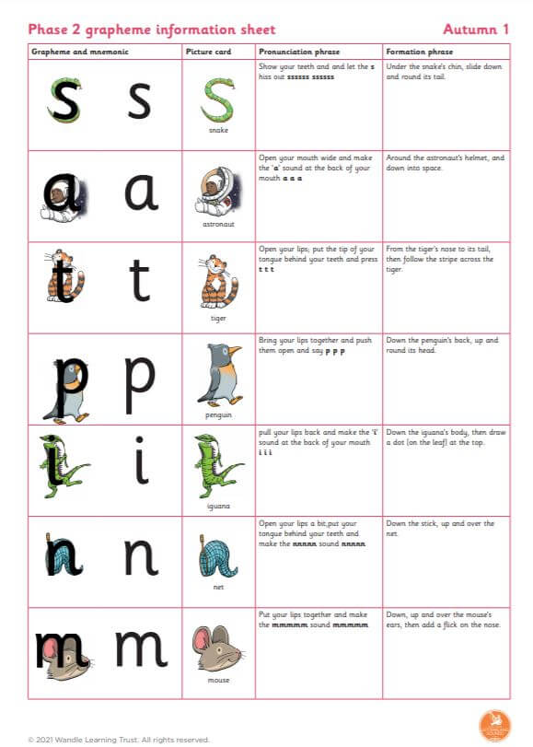
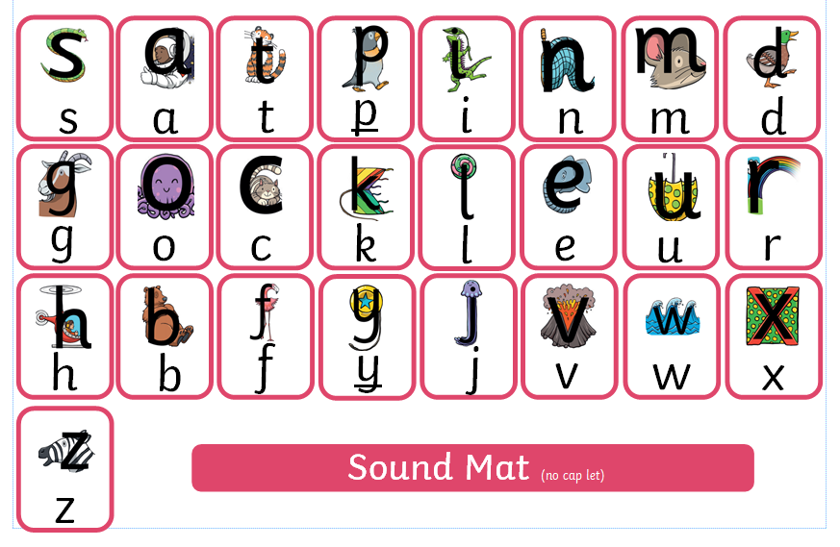

Slide 14
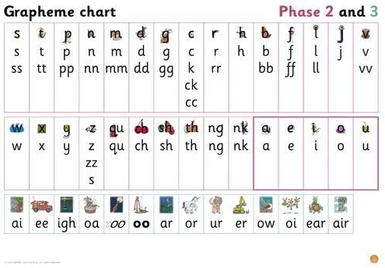
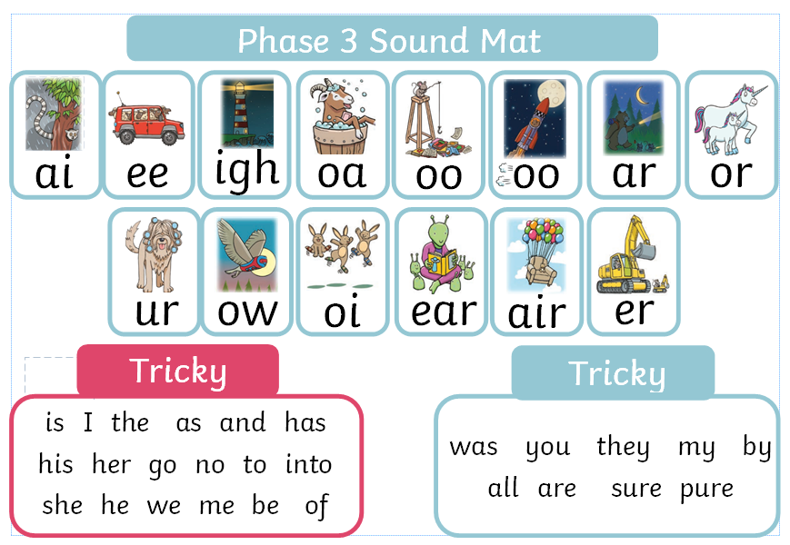
Phase 3 – expect after Christmas for reception

Slide 15


Rhyme association with each letter taught…
When we teach a letter, we teach a rhyme. This helps letter formation.
So when children are writing and can hear an initial sound, to begin with, they can use the rhyme to help form the letter.
Children will use this sound mat as a prompt to help them find and then form each letter sound they hear

Slide 16
Terminology
Phoneme
Split vowel digraph
Grapheme
Blend
Digraph
Segment
Trigraph
Notes:
Explain what each word means – use our glossary to help: https://www.littlewandlelettersandsounds.org.uk/resources/my-letters-and-sounds/getting-started/

Slide 17
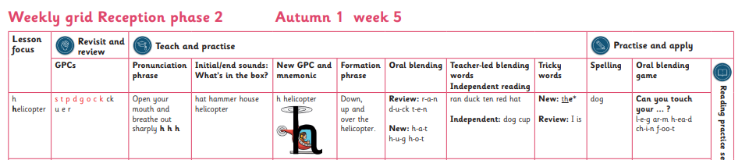
Example lesson
Blending for reading –now reading with our eyes!

Slide 18
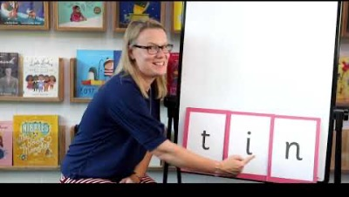
How we teach blending…

Slide 19

Spelling and how we teach it…
Say the word.
Segment the sounds.
Count the sounds.
Find them on a mat.
Write them down.
Notes:
Model the process on a flipchart for the parents to see.

Slide 20
Links with Home & Reading Books
Information will be shared weekly about what we have taught
Soon children in reception will be coming home with either a phonic pack or decodable reading book.
Majority will come home with a phonic pack – building those pre reading skills to create a positive start with reading books

Slide 21
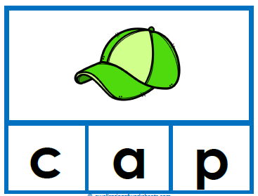
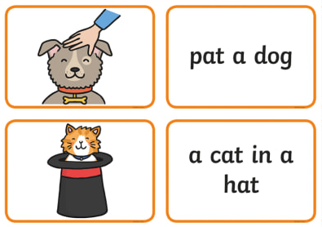
What are Phonic Packs??
Blending (Bronze)
Sorting initial sounds (Bronze)
Zap those gaps sheet (letter recognition)
Reading words (Silver)
Reading captions (Gold)
Each pack comes with instructions stuck in the home school links books
Then onto books….
Little Wandle Phase 2 / Pink Books – start of the book banding system
Little Wandle Phase 3 / Red books, yellow books apply phase 3 sounds
May have a Lilac Book as their physical book to handle independently

Slide 22

Forget after this session what you are supposed to do?
Already lots of really useful resources and a demonstration video too
- looking to increase these! Keep a watch out! https://www.kingsfield.staffs.sch.uk/curly-caterpillars/
Each pack comes with instructions stuck in the home school links books ☺

Slide 23
Links with Little Wandle and reading books – Reception Children
Starts in a few weeks time – 2 to 3 reads a week
Most will be on wordless books but reading single words linked directly to the text
Some may be on books with words because they can confidently read CVC words
Flashcards really helpful – make sure own or buy https://collins.co.uk/collections/little-wandle-letters-and-sounds-revised-phonics-flashcards
MORE INFORMATION will come out nearer the time

Slide 24
Home School Links Book
Getting them soon!
Share reading book or the phonics pack done with your child – please record so we know if you have done it and we can celebrate with your child as well as change the pack on a weekly basis.
Any concerns, please speak to us don’t write it in the HSL book
Every 6 weeks we will write a teacher review in the HSL book

Slide 25

Any questions?
Thank you for coming!
Feedback questionnaire will go out later, it would be much appreciated if you can fill it in! Nice and quick!

