Slide 1


Welcome to Key Stage 2
Learning Together, Learning for Life

Slide 2
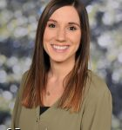
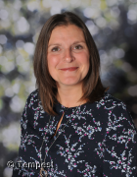
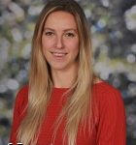
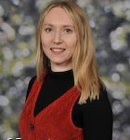
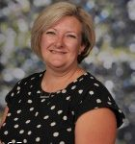
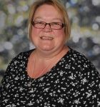
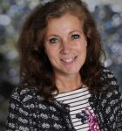



We are Year 3 and 4…

Slide 3
Teaching as a mixed Year 3 and 4 class…
The curriculum for Year 3 and 4 covers the same aspects of learning. In year 3, pupils are learning the skills and these are embedded and developed in Year 4.
As a result, the class will usually be taught as a key stage, with additional support or challenge provided through the task.
Where appropriate, pupils may be taught as separate year groups.

Slide 4


Our Curriculum is driven by geography and history...
In geography we will learn about the geography of our local area, our country and the wider world.
In history we will learn skills and knowledge around the concepts of chronology and change. We will focus on The Stone Age, Ancient Greeks and how homes have changes over time.
The other areas of the curriculum (art, design and technology etc.) link to these curriculum drivers.

Slide 5


Reading…
Children will take part in daily reading practise sessions called ERICA. These sessions will focus on developing your child’s fluency and comprehension.
Your child may still benefit from Little Wandle reading sessions three times a week where they will learn to decode books, read fluently with expression and to comprehend what they have read.
Your child will read to an adult 1:1 at least once every three weeks.

Slide 6
Reading continued…
To promote the love of reading, we will visit our school library each week to select a book to share.
Please read as often as possible with your child at home. Remember to record this in your child’s home/ school links books.

Slide 7
Spellings…
Our daily spelling sessions involve learning and practising a new spelling rule, as well as practising our ‘fast 5’.
Spelling of the common exception words is a big focus across the school.
Our ‘fast 5’ spellings will be given out every Friday to be tested on the following Friday.

Slide 8



Writing in Key Stage 2…
In Key Stage 2, we build on and embed all of the skills pupils have learnt in Key Stage 1.
We begin to write for different purposes, learn different sentence types and more ambitious punctuation and vocabulary.
Our writing is often linked to one of our class texts. Take a look at what we will be reading…

Slide 9

Maths…
The children are given lots of opportunities to explore new maths learning through discussions with partners and in groups; using equipment to support their understanding.
We encourage the children to represent their working out in pictures initially, before moving onto abstract methods. They will then demonstrate their depth of understanding when exploring reasoning and problem solving challenges.

Slide 10
Times Tables…
At the end of Year 4, all pupils complete a national Times Table Check where they will be expected to know and quickly recall their times tables, up to 12 x 12.
We complete this test on iPads and pupils will have 6 seconds to answer each question.
An information session will follow in the Autumn Term.

Slide 11

What helps me to learn best?
We encourage the pupils to be as independent as possible with their learning. Within each classroom, there will be a station with resources and we encourage pupils to access these.
We regularly prompt the children:
What might help you today with your learning?
What resources do we have in our classroom?
Remember you can help yourself to learn!

Slide 12
Intervention…
You may hear your child mention they have had some intervention. This sounds very formal. Please do not be alarmed.
Intervention may take place to extend children as well as support them. Or we may even just need to tackle an individual issue with your child- it does not mean we have a big issue. Our curriculum is just very personalised.

Slide 13
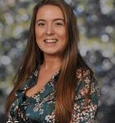
Miss Mohring - SENDCO
Supports with children with additional needs.
Helps teachers to plan appropriate provision and adapt any reasonable adjustments.
Works with external agencies to provide quality, personalised interventions for children.
Miss Mohring works closely with the MHST to support children with anxiety or low mood.

Slide 14
Homework…
To read at a home a minimum of 3 x a week.
Please practise weekly fast five spellings.
Please practise times tables.
Over the year, different teachers will set various homework tasks, to be completed in homework books.
We are currently

Slide 15
Visits…
We just love a trip!
Look out for more exciting letters about the planned visits for this year!
Year 4 pupils will be invited to attend a residential trip to Standon Bowers. Dates will be confirmed and an information evening will take place in the Autumn Term.

Slide 16


Slide 17

School Website
Topic maps
Homework
Policies
Newsletter – online and emailed.
E-safety
Communication to parents.
Staff – Kingsfield First School | Biddulph | Staffordshire
We will be updating our year group web page with important information so please check for any information that you may need.

Slide 18
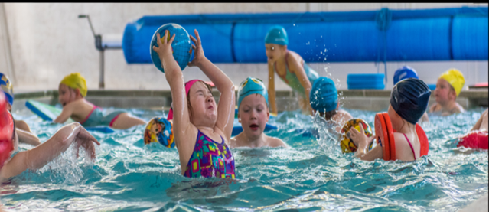
We will send out our ‘Welcome to Key Stage 2’ booklet in September with information of your child’s PE day and dates for swimming and Forest School sessions.
If you receive certain types of benefit you may be entitled to funding for your child in their learning. Please let us know if you are entitled to this.

Slide 19


Get involved…
We always need help in school. Hearing children read, photocopying, laminating, cutting out, going on visits, in the swimming pool-please speak to a member of staff if you think you would be able to help.
Our wonderful PTFA organise lots of events and raise lots of money for our children-they would welcome new members.

Slide 20

Lines of communication…
Weekly drop-in sessions are available with your child’s class teacher. Days will be confirmed.
Please speak to a member of staff on the door in the morning.
If you need to leave a message you can also telephone the school office on the following number:
01782 973800
Alternatively you can email the school office on:
admin@kingsfield.staffs.sch.uk

Slide 21

Lines of communication…

Slide 22
Any questions?

