Slide 1


Welcome to Key Stage 1
Learning Together, Learning for Life

Slide 2
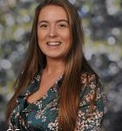
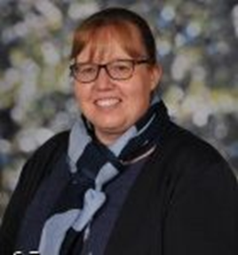
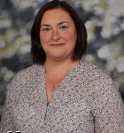
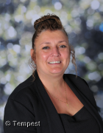
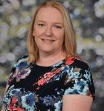
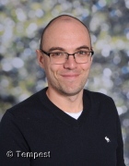



We are KS1

Slide 3
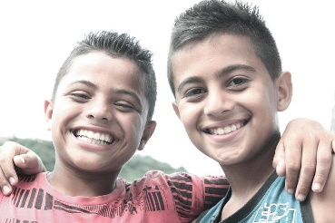
Attendance
Good attendance
Punctuality
Forming good habits

Slide 4


Our Curriculum is driven by geography and history
In geography we will learn about the geography of our school, the countries of the United Kingdom, the surrounding seas and seaside resorts.
In history we will learn skills and knowledge around the concepts of everyday life/ culture, legacy. We will focus on topics such as Victorians and The Great Fire of London
The other areas of the curriculum (art, design and technology etc link to these curriculum drivers.

Slide 5


Little Wandle
Reading
Children will take part in reading practise sessions three times a week to learn to decode books, read fluently with expression and to comprehend what they have read.
Their Little Wandle book will then be allocated every Monday and collected every Thursday.
To promote the love of reading, we will visit our school library each week to select a book to share.
Please, please read as often as possible with your child at home. Remember to record this in your child’s home/ school links books.

Slide 6
Post Little Wandle
Reading
Children will have a book band book, this will listened to by an adult in school at least once a fortnight and we ask that the children read ideally each night, but at least 3x per week.
Book Band books are to be read 3x to develop fluency, prosody and comprehension.
Alongside this, they will complete ERICA (Everyone Reading In Class Altogether) 4/5 times per week and then we teach further reading skills in small group reads
(guided reading).

Slide 7
Phonics
Phonics is taught daily in school. We follow the Little Wandle scheme. Each week we will upload a learning sheet to the website that summarises our learning in school, so you can support your child at home.
We practise breaking words down into sounds (sound talking) and putting them back together (blending). We then encourage the children to read words fluently, by blending the sounds in their head.

Slide 8
Phonics Screening
A national initiative to assess year 1 children. It is nothing to worry about!
They will be completed by your child’s class teacher in class time next June.
It will check all of the letters and sounds your child has learnt during Reception and Year 1.
It is to check their reading skills and ability to segment and blend sounds.
There will be a meeting in the Spring term to share ways to support your child at home for Year 1 parents.

Slide 9
Year 2 Assessments
Assessment is ongoing throughout the year.
At the end of Year 2 there is a formal assessment to measure where the children are at the end of Key Stage One nationally (SATS)
Children will be tested on reading comprehension, maths paper and an arithmetic paper.
Children will also be formally assessed on their writing and will also be assessed in science.
To be administered during May 2024.

Slide 10




Writing in KS1
In Year 1 the main focus of our English lessons will be to write sentences correctly. We will enjoy lots of fabulous stories to inspire our writing.

Slide 11




Writing in KS1
In Year 2 writing will be extended so the children use skills to entice their reader such as adjectives, adverbs etc. We also begin to write for different purposes such as letters, poems, fact files etc.

Slide 12
Spellings
Spellings will be linked to our phonics work/spelling rule and year group common exception words.
Spelling of the common exception words is a big focus across the school. These words can be found in your child’s Home School Links Book.

Slide 13

The children are given lots of opportunities to explore new maths learning through discussions with partners and in groups; using equipment to support their understanding.
We encourage the children to represent their working out in pictures and then demonstrate their depth of understanding when exploring reasoning and problem solving challenges.
In Year 1 the children are encouraged to know their addition and subtraction number facts to 20 and will work with numbers up to 100.
In Year 2 the children will be using addition, subtraction, multiplication and division knowledge to work with numbers up to 100.
Maths

Slide 14
Intervention
You may hear your child mention they have had some intervention. This sounds very formal. Please do not be alarmed.
Intervention may take place to extend children as well as support them. Or we may even just need to tackle an individual issue with your child- it does not mean we have a big issue. Our curriculum is just very personalised.

Slide 15
Miss Mohring - SENDCO
Supports with children with additional needs
Helps teachers to plan appropriate provision and adapt any reasonable adjustments
Works with external agencies to provide quality, personalised interventions for children
Miss Mohring works closely with the MHST to support children with anxiety or low mood.

Slide 16
Homework
To read at home a minimum of 3 x a week.
We will reward this in school with various incentives.
Please practise our weekly phonics sounds using the weekly Little Wandle sheet.
Please practise number bonds to 10 and 20.
We are currently

Slide 17
Visits
We just love a trip!
Look out for more exciting letters about the planned visits for this year!

Slide 18
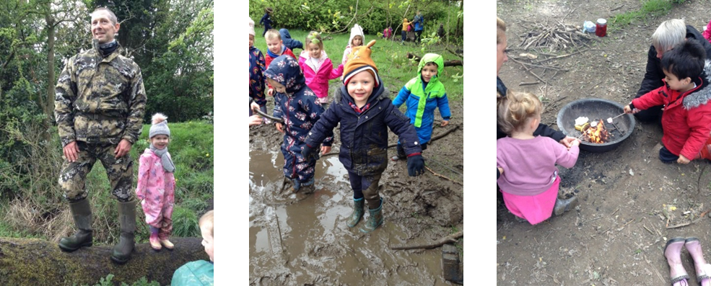
Forest School
Children benefit from working in a team and it improves their communication and confidence. It also helps with their problem solving skills.
Forest school sessions will be on a Thursday afternoon with Mr Fox. We will confirm the dates in September.

Slide 19

School Website
Homework
Policies
Newsletter
E-safety
Letters
Safeguarding
Food menu
Staff – Kingsfield First School | Biddulph | Staffordshire
We will be updating our year group web page regularly with important information so please check for any information that you need.

Slide 20
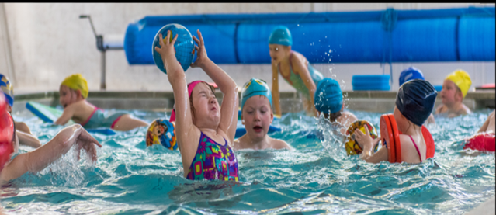
We will send out our ‘Welcome to KS1’ flyer in September with information of PE/ swimming days, routines and expectations.
If you receive certain types of benefit you may be entitled to funding for your child in their learning. Please let us know if you are entitled to this.

Slide 21


Get involved…
We always need help in school. Hearing children read, photocopying, laminating, cutting out, going on visits, in the swimming pool-please speak to a member of staff if you think you would be able to help.
Our wonderful PTFA organise lots of events and raise lots of money for our children-they would welcome new members.

Slide 22


Slide 23

Lines of communication…
KS1’s drop in is on a Monday between 3.20 and 4pm.
Please speak to a member of staff on the door in the morning.
If you need to leave a message you can also telephone the school office on the following number:
01782 973800
Alternatively you can email the school office on:
admin@kingsfield.staffs.sch.uk

Slide 24

Lines of communication…

Slide 25
Any questions?

