Slide 1



Welcome to Nursery
We are Clever Caterpillars

Slide 2


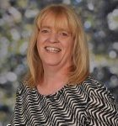
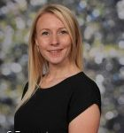
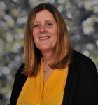
We are
Clever Caterpillars
Mrs Tomlinson
Miss Matthews
Miss Hill

Slide 3

Attendance
Good attendance
Punctuality
Forming good habits

Slide 4

Times of the day
Nursery will be received and dismissed from the door near the drive
15hour morning nursery times:
Morning
8.45am arrive
11.45am pick up
Afternoon
12.15- 3.15
30 hour morning nursery times:
8.45am arrive
3.15pm pick up

Slide 5
Toilet Training
Please inform member of staff if your child is not yet toilet trained
Typically we expect children to be toilet trained by the time they start Nursery with us.
‘Learn to use the toilet with help, and then independently.’ This is taken from the development matters age birth to three.
Age 3-4 curriculum it is expected that they are independent.
Please, if your child is still in nappies or pull ups take the opportunity to toilet train them before September.
Consistency is key!
Once you start don’t stop. Only put them in a pull up at night, other than that pants all the way!
Worried about the car? top tip- put a puppy pad in the car seat, if they have an accident the seat will be dry underneath!

Slide 6
EYFS Curriculum
The Early Years Curriculum has recently changed, this is the first change since 2012. Here are the new areas of the curriculum and the new stages of child development.
Personal, social and emotional development.
Communication and language.
Physical development.
Literacy.
Mathematics.
Understanding the world.
Expressive arts and design.
Birth to 3 years / 3 and 4 years / The Reception Year

Slide 7
EYFS Curriculum
Your child will be assessed in all areas throughout the year through independent work and adult observations.
We create an enabling environment (indoor and outdoor) where the children make their own choices and can challenge themselves when they are ready too.
Over the course of the year, the structure of the day may change to prepare children for Reception.
We keep a writing journey for your child to showcase their mark making & writing achievements, all other assessments are done using our online platform ‘Evidence Me’

Slide 8


Behaviour expectations and rewards
In Nursery we use a number of strategies to promote positive behaviour.
We use verbal praise, stickers and praise certificates.
We also follow the whole school policy of the traffic light system and the house point system.
Children will be rewarded for positive behaviour and outstanding learning by moving onto bronze, silver and gold!
Sanctions will be put in place for challenging behaviour.

Slide 9


Reading
To promote the love of reading, we will visit our school library each week to select a book to share.
Please read as often as possible with your child at home. Remember to record this in your child’s home/ school links books.

Slide 10
Phonics
Phonics is taught daily in school. We follow the Little Wandle scheme.
We practise listening for sounds at the start of words, finding things that start with the same sound, breaking words down into sounds (segmenting) and putting them back together (blending). We also learn what the letter sound looks like (grapheme).

Slide 11

The children are given lots of opportunities to explore new maths learning through discussions with partners and in groups; using equipment to support their understanding.
We use Ten town to introduce numbers to 5.
In Nursery we explore weight, length, shapes and capacity too.
Maths

Slide 12
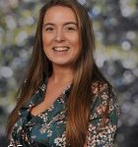
Miss Mohring - SENDCO
Supports with children with additional needs
Helps teachers to plan appropriate provision and adapt any reasonable adjustments
Works with external agencies to provide quality, personalised interventions for children
Miss Mohring works closely with the MHST to support children with anxiety or low mood.

Slide 13
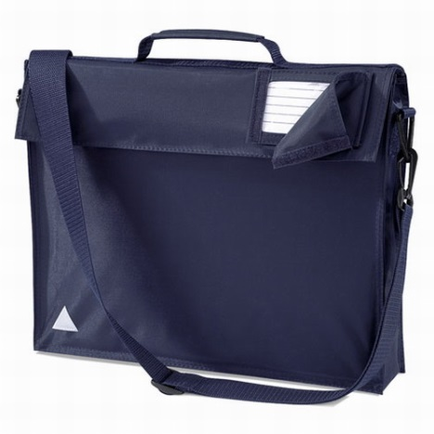
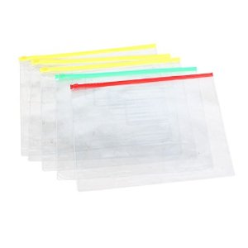
Book Bags and Zipper files
Your child will receive a home school links book and a zipper file with their name on. Please can these come to school everyday along with the book bag. Important letters and information may be put in your Child’s zipper/ book bag so please check regularly.

Slide 14
Lunchtime
Nursery can order a hot dinner or bring a packed lunch.
There is a charge for hot dinner which is currently £2.83.
In Summer there is the option of sandwiches on the menu.
The menu is on the website.

Slide 15




P.E
P.E takes place each week. We will confirm which day in September.
We would like the children to come into school in their School PE kit, Clothing must comply with the school uniform colours. School PE kits can be purchased from smart uniform.
Please name all clothing.

Slide 16



Snack & Water bottles
The children can access a snack area that is in the classroom throughout the day. It is up to your child to decide when they would like their snack. They help themselves to a piece of fruit. This promotes independence and some of the curriculum areas such as health and self care & self confidence and self awareness.
Water bottles
Water bottles should only have water in them as this is school policy, children can access their water bottles at any point during the school day! Please name them.

Slide 17
Visits
We just love a trip!
Look out for more exciting letters about the planned visits for this year!

Slide 18
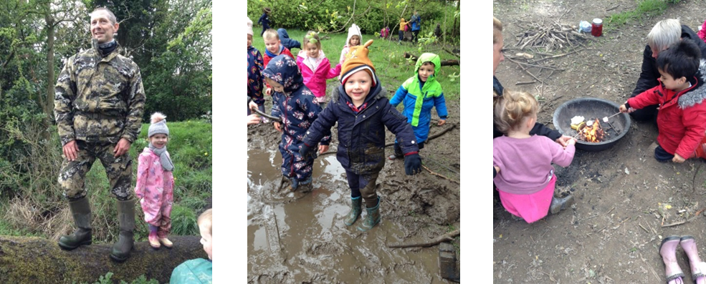
Forest School
Children benefit from working in a team and it improves their communication and confidence. It also helps with their problem solving skills.
Forest school sessions will be on a Friday morning with Mr Fox. We will confirm the dates in September.

Slide 19
School Website
Topic maps
Homework
Policies
Newsletter – online and emailed.
E-safety
Communication to parents.
We use Microsoft Sway to keep you informed of what is going on each week.

Slide 20


Get involved…
We always need help in school. Hearing children read, photocopying, laminating, cutting out, going on visits, please speak to a member of staff if you think you would be able to help.
Our wonderful PTFA organise lots of events and raise lots of money for our children-they would welcome new members.

Slide 21

Lines of communication…
Please speak to a member of staff on the door in the morning.
If you need to leave a message you can also telephone the school office on the following number:
01782 973800
As mentioned before – a weekly sway is sent out from EYFS – we will communicate all important information and reminders on here, please make sure you read it each week to keep up to date ☺
It is sent as a link via a text message!

Slide 22
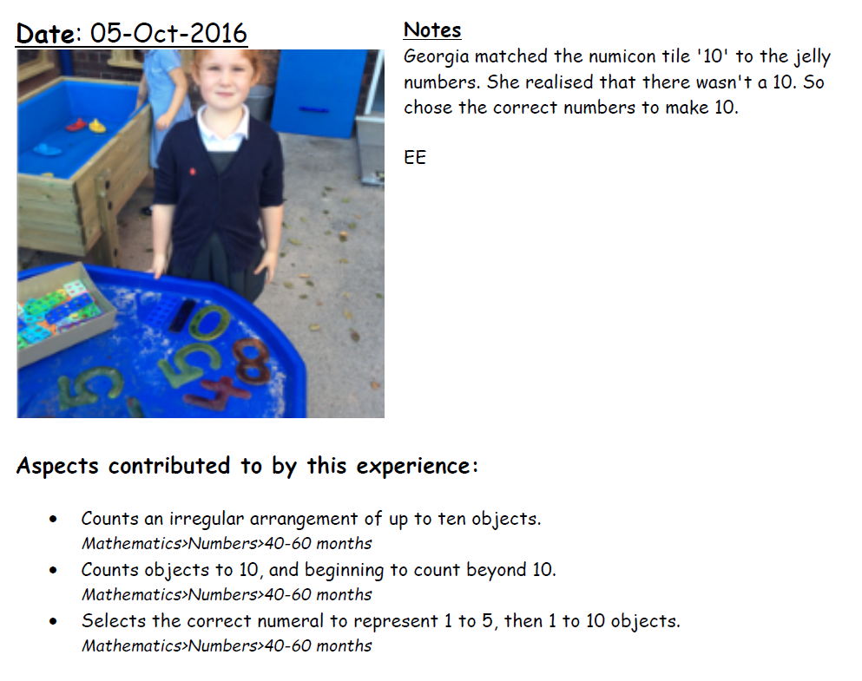

Evidence Me ….
Evidence Me is an online learning journey that staff use to record observations and photographs of the children when they meet objectives from the curriculum.
In September we are going to run an evidence me 'set up' meeting!

Slide 23
Any questions?

