Slide 1


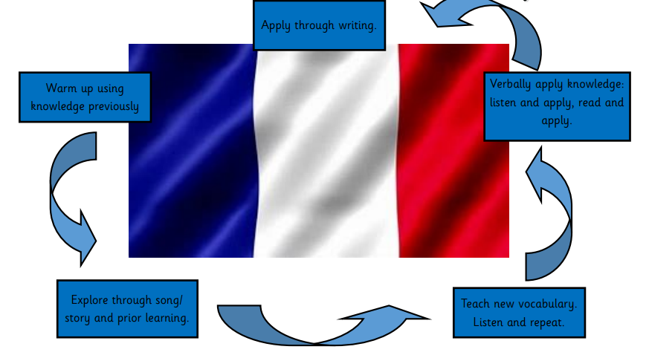
Modern Foreign Languages
Unit Pathway

