Slide 1
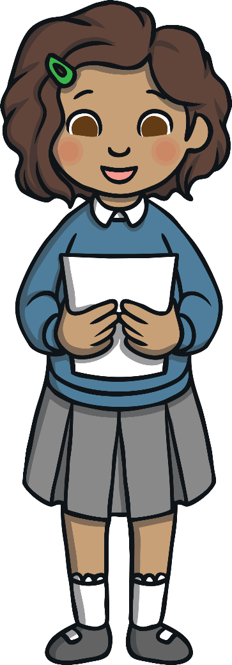
What Is Poetry?
Poetry is written by a poet.
Sometimes, poems have rhyming words in them.
Poetry is meant to be read aloud.

Slide 2
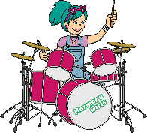
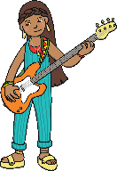
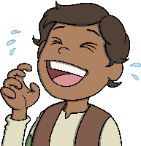
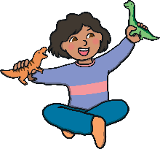
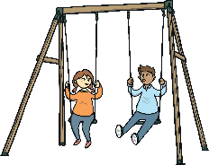
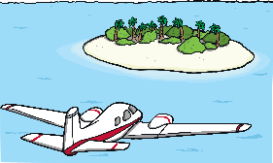
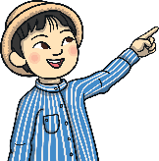
Rhyming Words
Some poetry has rhyming words at the end of lines. When words rhyme, they start with different sounds, but sound the same at the end of the words. So ‘cat’ rhymes with ‘bat’ and ‘hot’ rhymes with ‘lot’.
Can you match up these rhyming words?
sun
band
joke
bit
ring
fun
poke
hit
swing
land

Slide 3
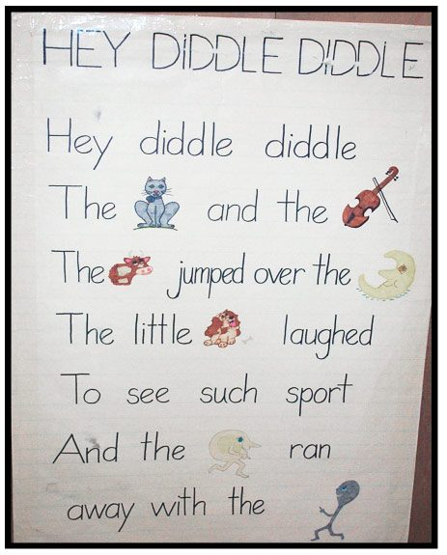

Slide 4
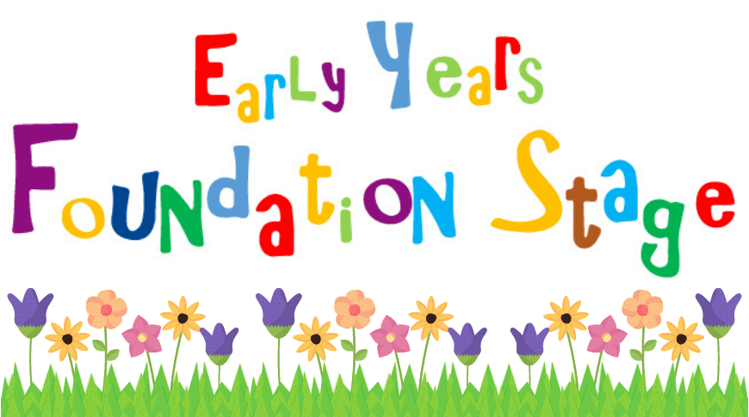

Slide 5
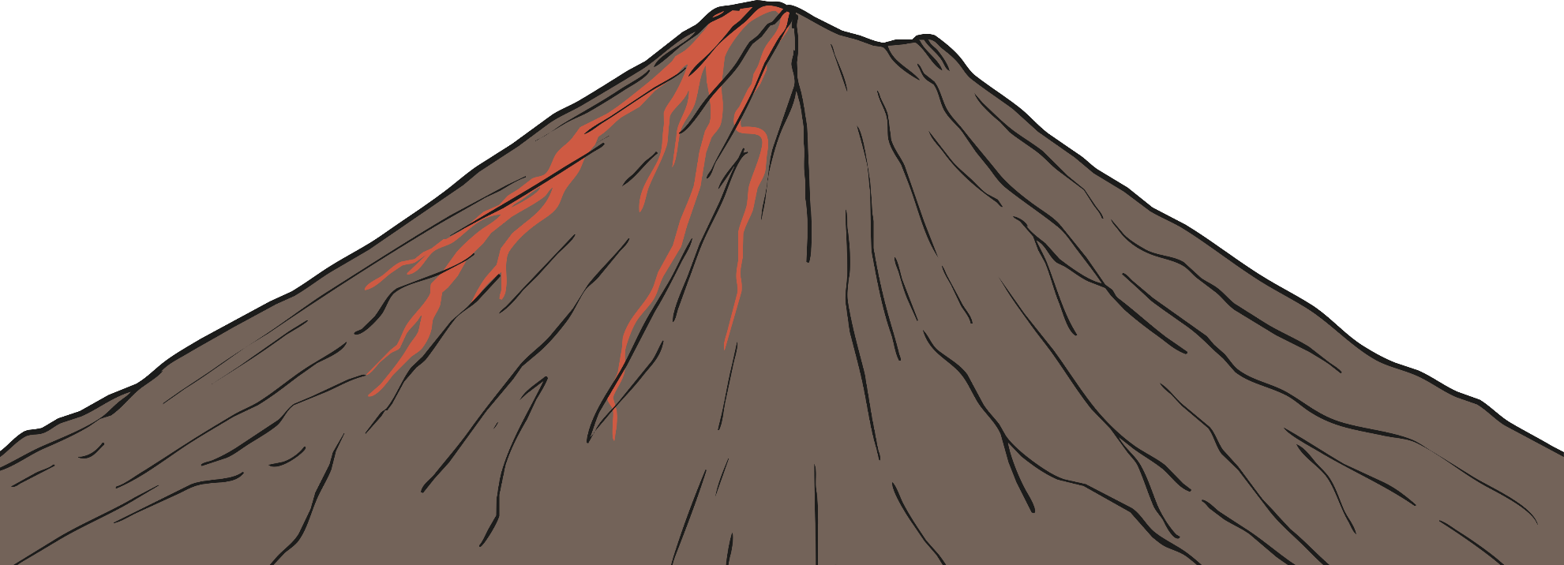
Shape Poetry
Shape poems are written in the shape of the thing the poem is about. Look at this poem.
?
What is the shape of the poem?
?
Does it have rhyming words at the end of lines?
A
huge rock
that rumbles
and roars, wrecking
the ground all around it.
It shoots; sizzling, steaming, scorching lava
like a monster spitting out hot liquid into the air.
Like a smoking dragon, it finally starts to calm down.
The chaos stops and it goes back to being a deadly and dangerous rock.

Slide 6
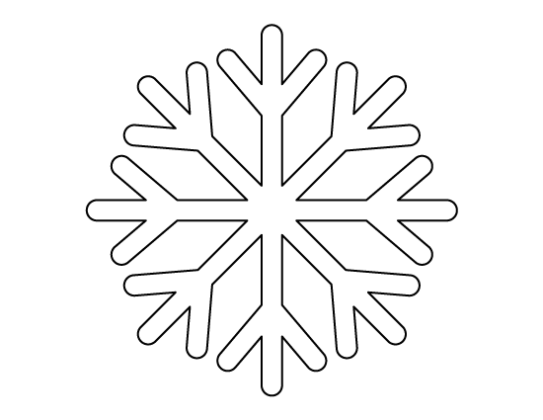
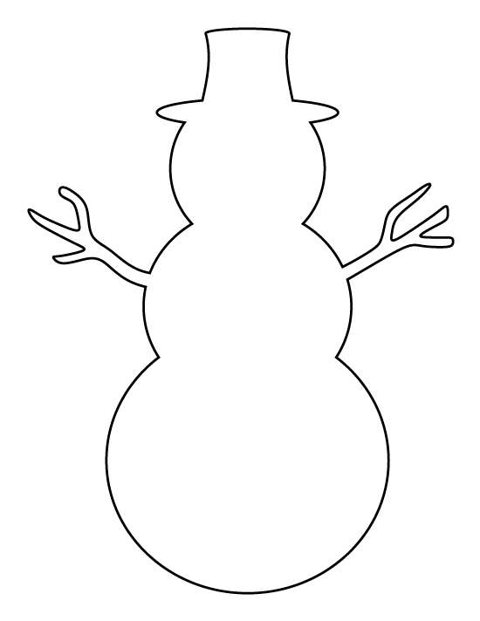

Slide 7
Cinquain Examples
What is each poem about?
Birthday
Happy, fun-filled
Playing, eating, dancing
Come and celebrate it with me
Party!
Summer
Hot and sunny
Lazing, slurping ice creams
Passport, suitcase, boring airport
No school!
My pet
Fluffy, wriggly
Licking faces, chewing
Never stops chasing his own tail!
Puppy

Slide 8
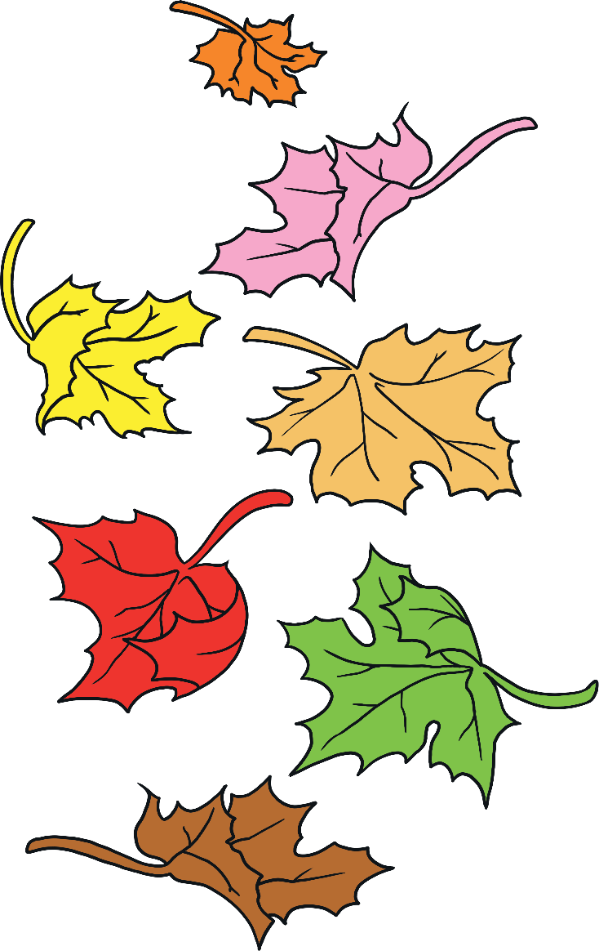
What is a Haiku?
Here’s another…
Winter is coming.
Snow will be arriving soon.
We should rake the leaves.

Slide 9
Riddles

Slide 10
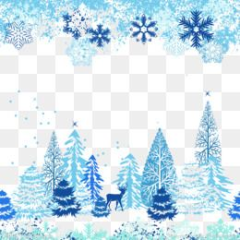
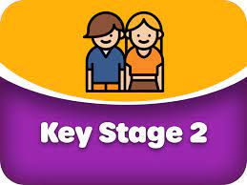
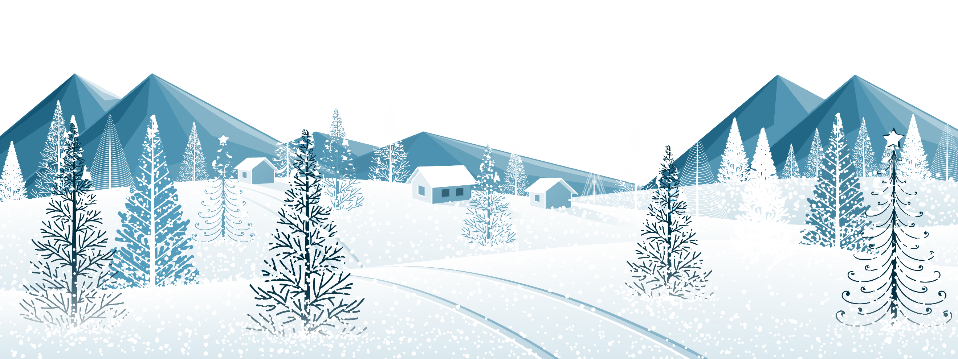
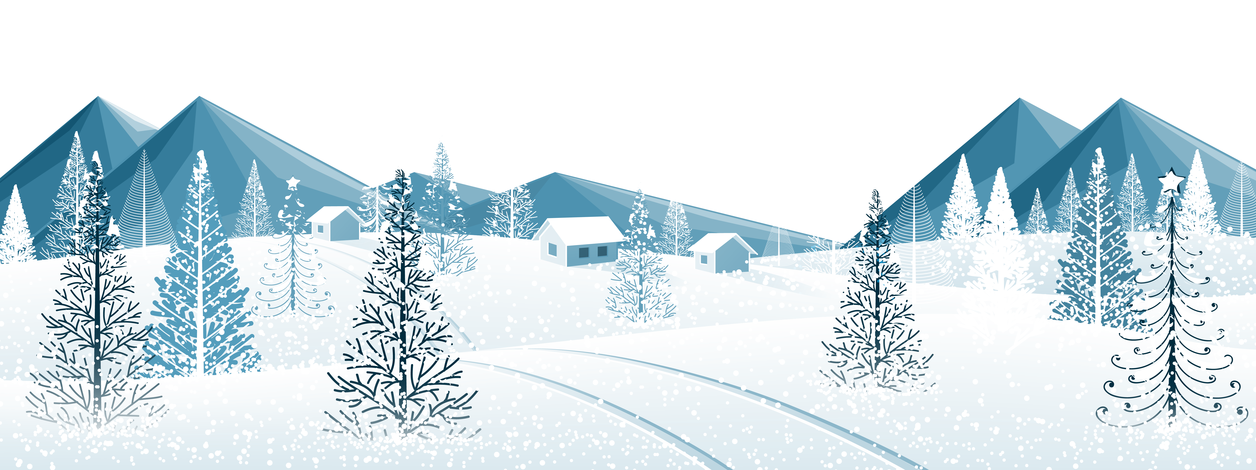

Slide 11
Remember to try your best and complete your homework task.
Homework due in by
Thursday 26th January

