Slide 1
Love your neighbour
RE Assembly and Homework launch
24.4.23

Slide 2
Who is my Neighbour?

Slide 3
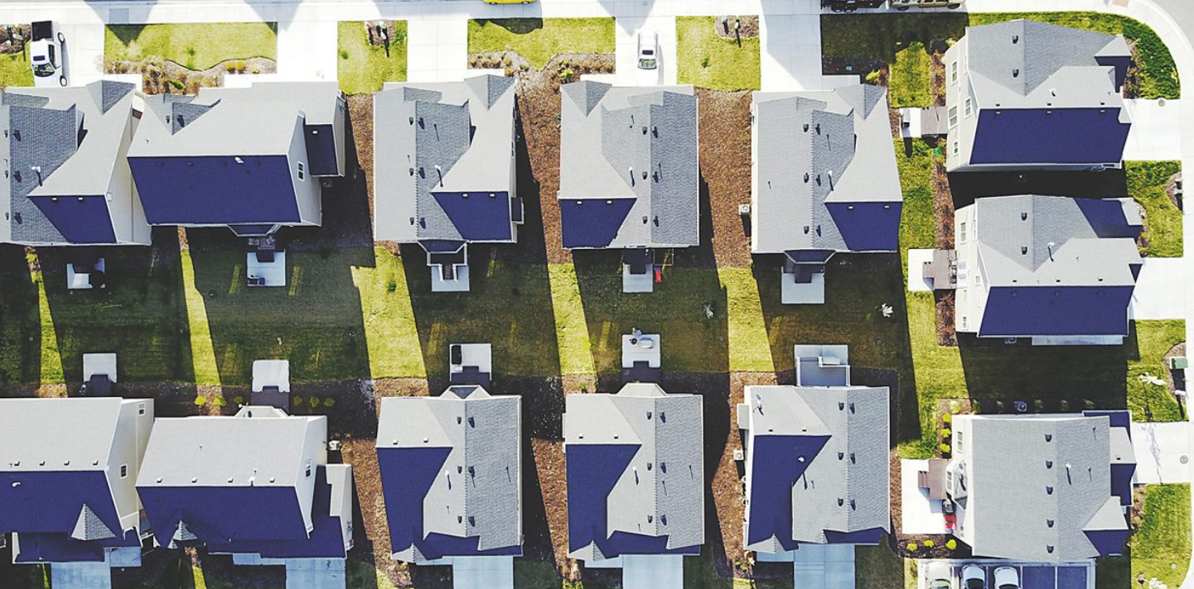

Slide 4
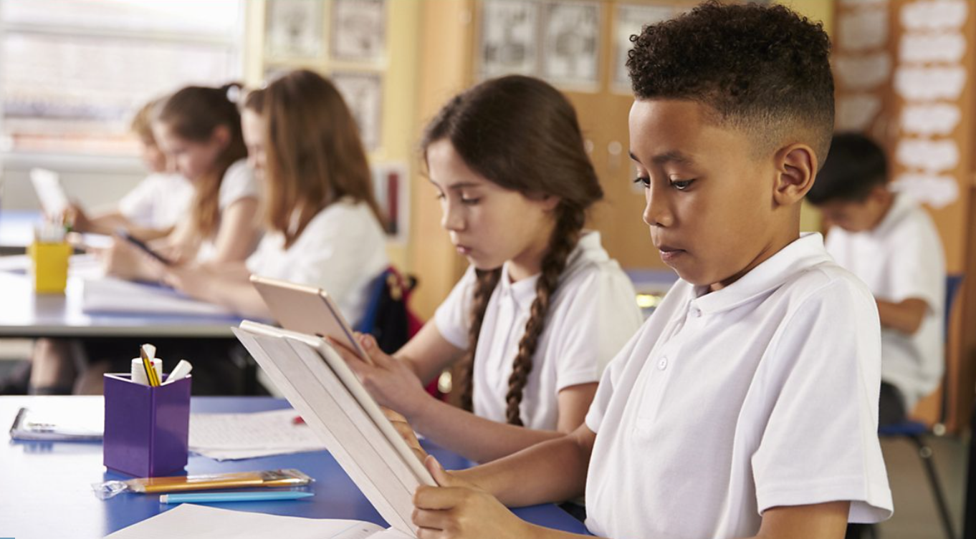

Slide 5
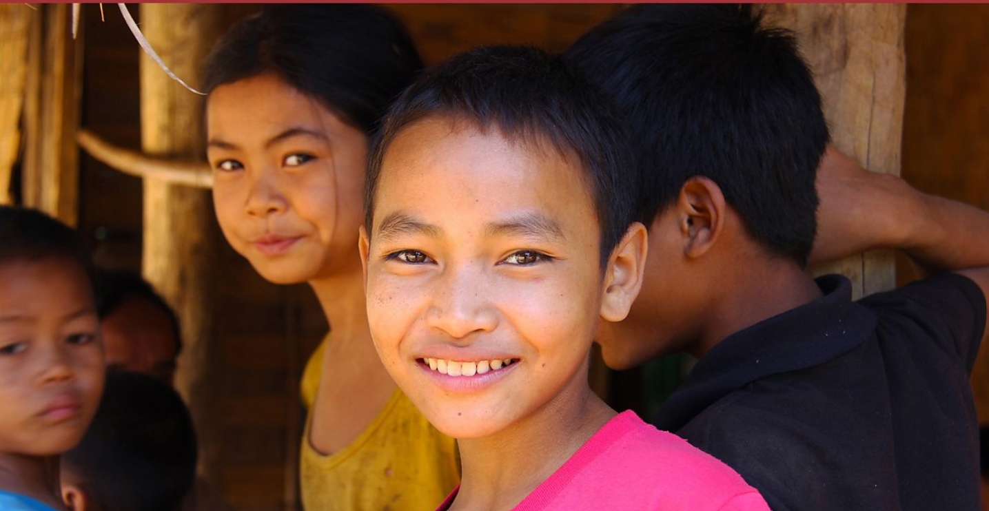

Slide 6
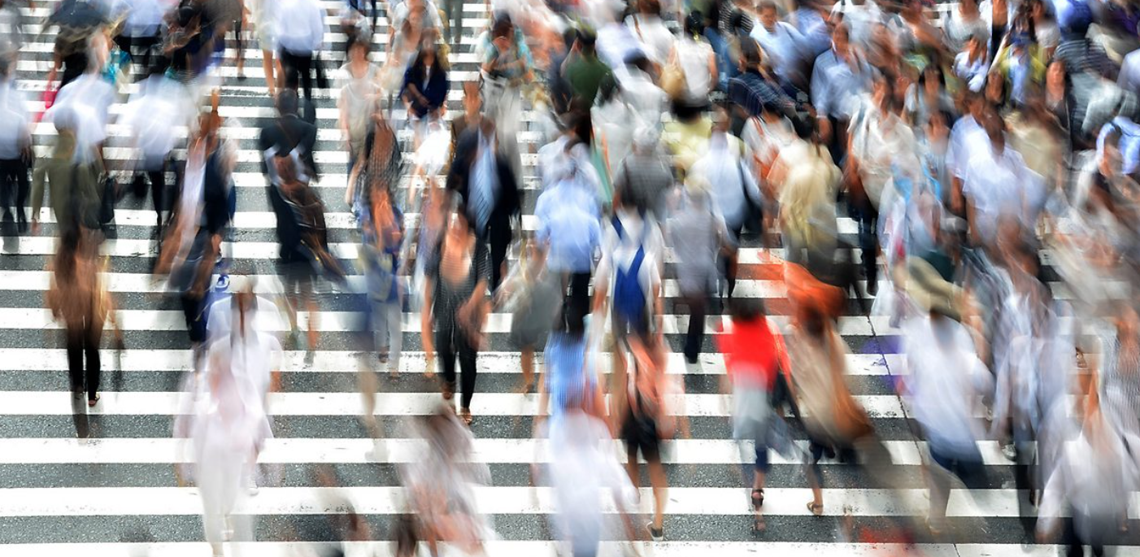

Slide 8
This story is a version of one from the Bible told by Jesus...
https://www.bbc.co.uk/teach/school-radio/assemblies-ks1-ks2-slideshow-the-good-samaritan/zww4r2p

Slide 9
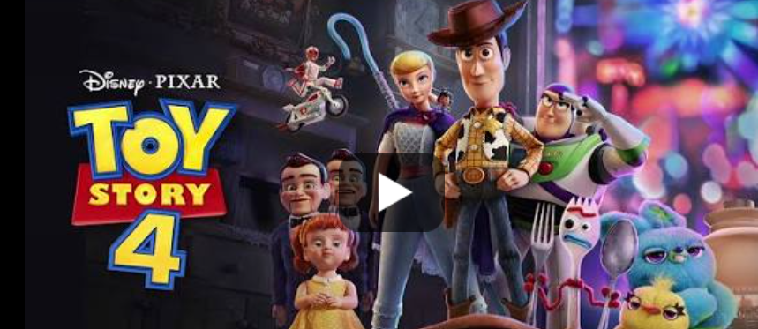
In the clip we saw a stranger helping someone. The man in hospital did not expect the man to help because of how he looked but he called for help and saved the man.
So who is your neighbour?
A neighbour can be anyone.
You’ve got a friend in me
https://www.youtube.com/watch?v=DNZUKm0ApEM

Slide 10
Homework
This week for homework think about how you could help someone. It could be someone you know or even a stranger. (remember to check with a grown up first)
When you have thought of how you can help someone, draw a picture of you helping, or write about it or even take a photo!
It is due in 5th May 2023

