Slide 1
Sleep workshop for parents and carers
Beate Benton
Children & Young People Wellbeing Practitioner
Accredited Sleep Practitioner
Mental Health Support Team

Slide 2

Group expectations
The focus of today’s workshop is for us to learn about sleep, we will not be able to support you with any specific 1-2-1 advice.
You can contact your school’s Mental Health Lead- Emma Mohring- if you would like to discuss any individual concerns following today’s workshop. Alternatively, you can email myself: Mhstenquiries@combined.nhs.uk
Please only share what you feel comfortable sharing.
Please respect group confidentiality.
Please turn phones to silent and do not use any recording devices during today’s workshop.
I hope you will enjoy our workshop!
Thank you!

Slide 3
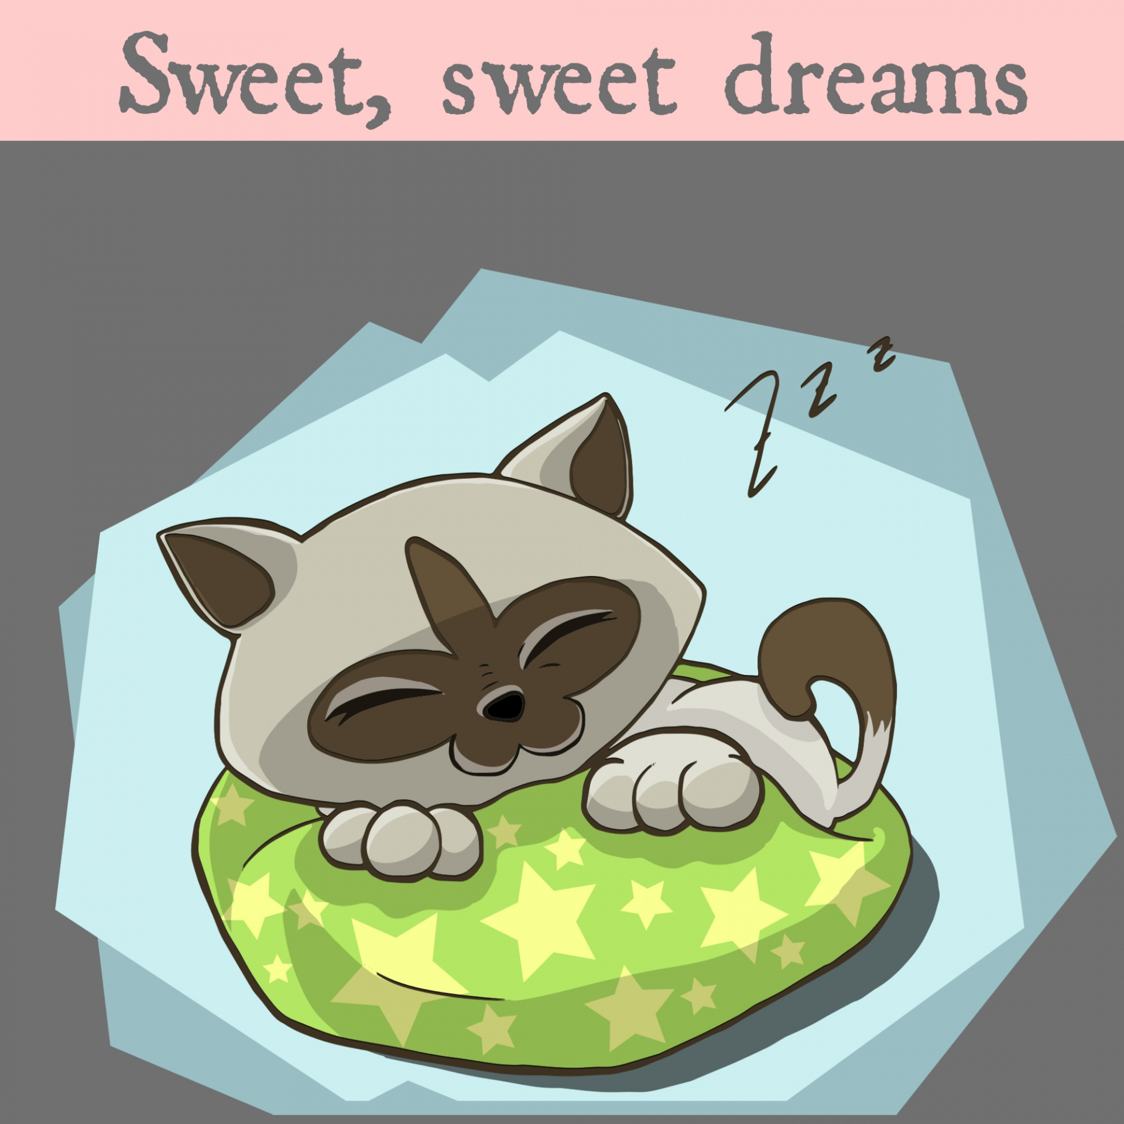
What do you associate with sleep?
Share with a partner / write bullet points on a white board!
Notes:
Quick reflection.

Slide 4

1. Brain shuts down and is inactive during sleep
2. You can train yourself to get by with less sleep
3. One in five children has sleep problems
4. Sleeping in on the weekend prevents the effects of
sleep loss during the next week
5. Sleep is needed to survive, just like food and drink
6. Loud snoring every night is normal
Notes:
Ref: Sleephealthfoundation.org.au.
Answers:
Fiction:
Fiction
Fiction
Fiction
Fact
Fiction

Slide 5

Overview:
Statistics
The Importance of Sleep – what happens during sleep
Understanding our sleep cycles and circadian rhythm
Impacts of sleep problems
Signs of sleep deprivation
Sleep and associated problems
---Break---
How to improve sleep quantity and quality
Questions, reflections and feedback
Sleep management

Slide 6

Did you know?
1 in 4 children have sleeping problems.
In 2022, 34% of children aged 7-16years had a problem with sleep 3 or more times over the week.
Sleep problems have strong links with obesity and mental health issues and are described as
a “major hidden public health problem”
Up to 90% of children with disabilities have sleeping problems
Underestimated by parents and professionals alike

Slide 7

So Why is Sleep Important?
Share your thoughts with a partner or jot down on the white board

Slide 8
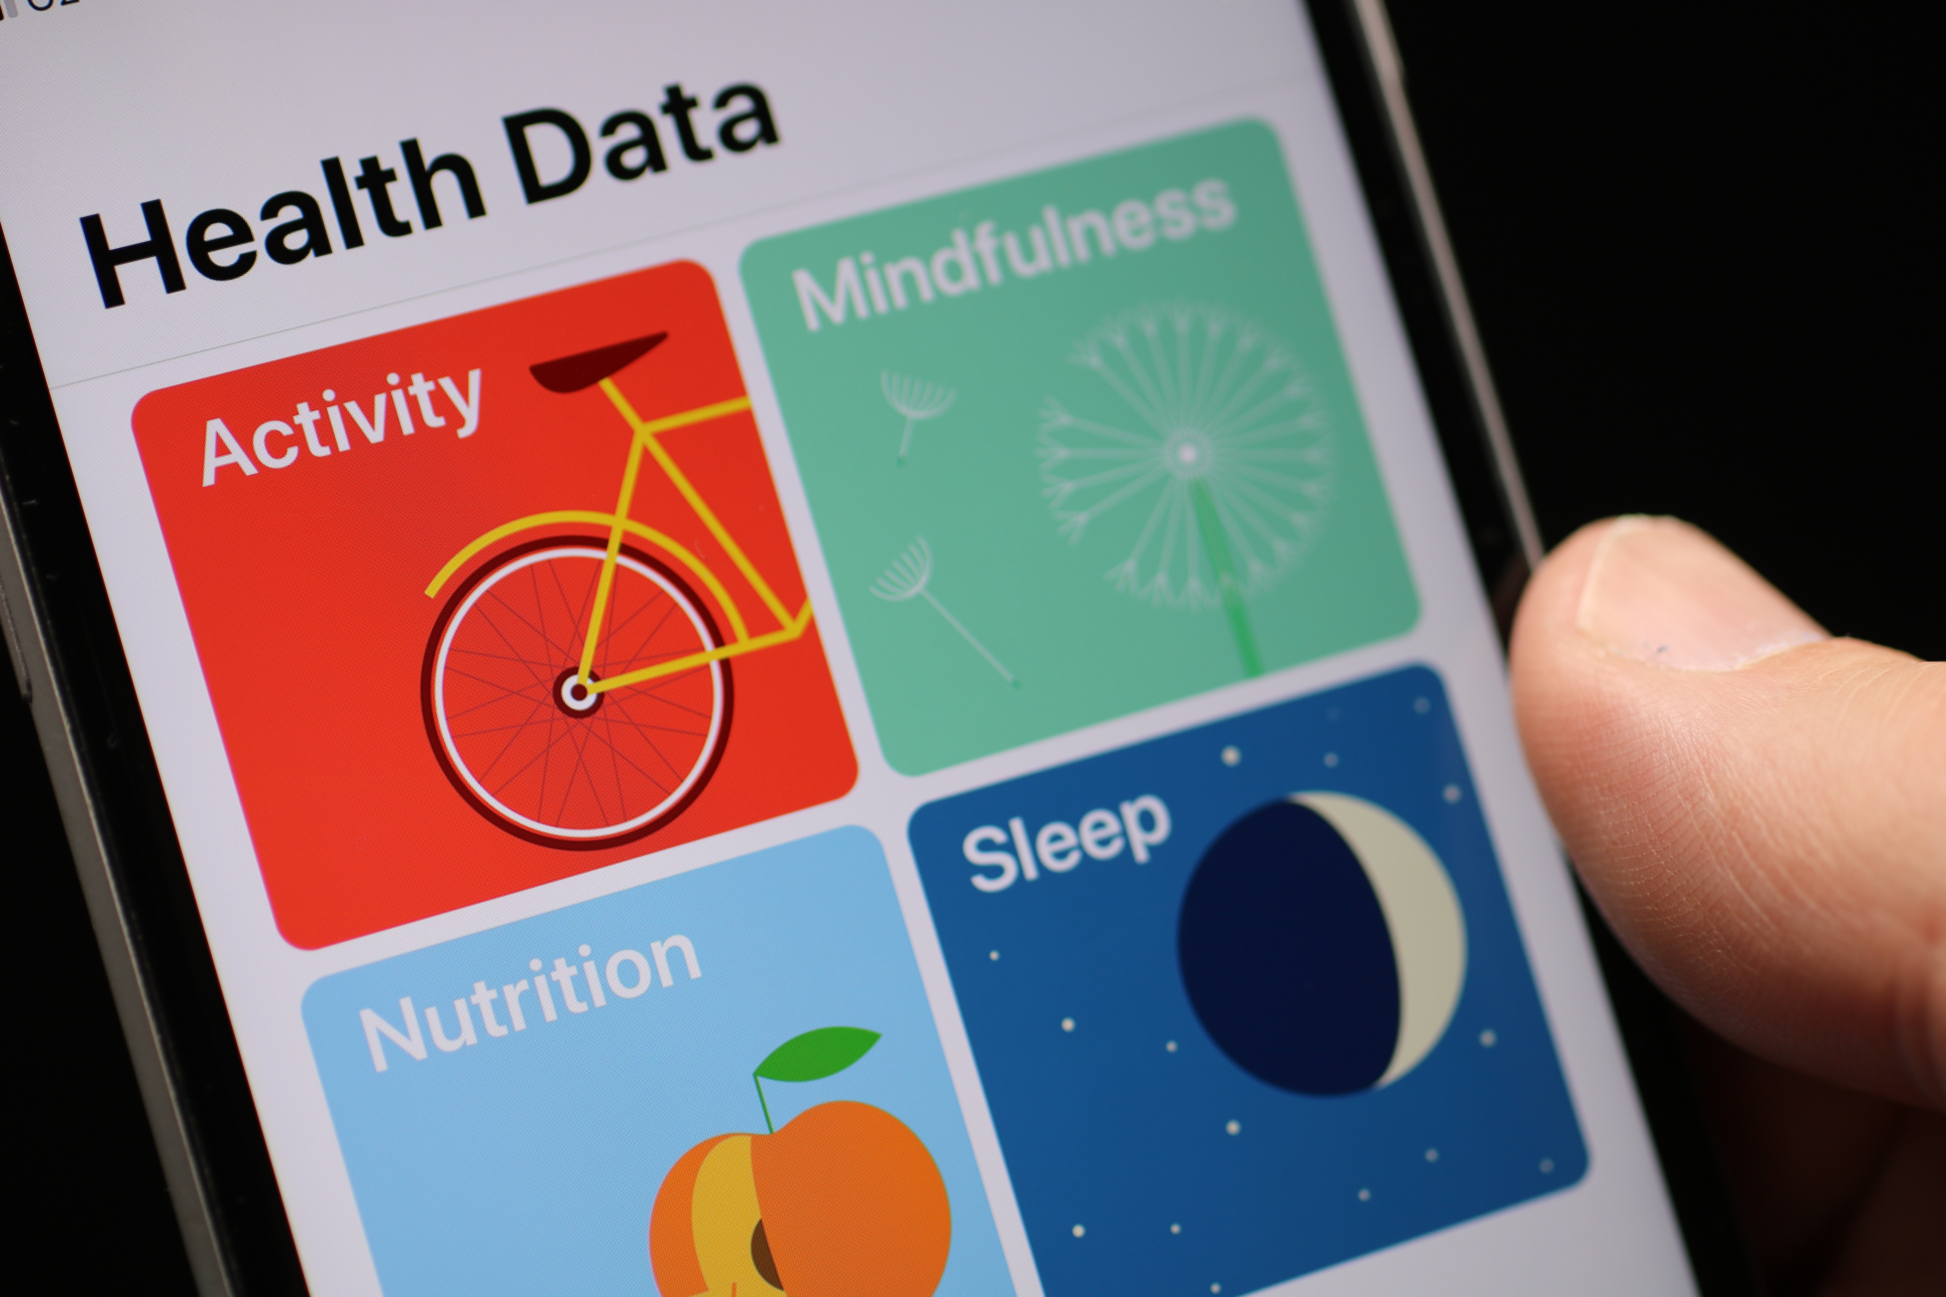
Importance of sleep
Sleep is needed to survive, just like food and water!
During sleep, the following activities takes place:

Slide 9
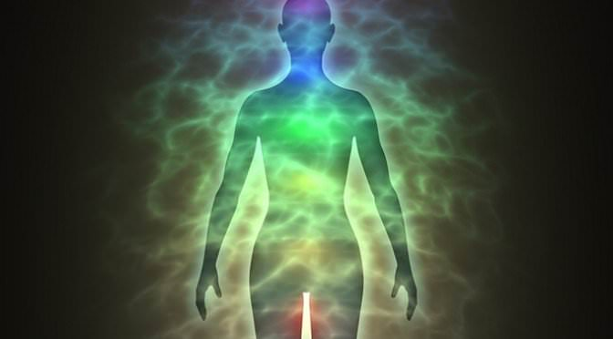
1. Energy Conservation
Sleep allows us to reduce our caloric needs by spending part of our time functioning at a lower metabolism
Research suggests that 8 hours of sleep for humans can produce a daily energy saving of 35% over complete wakefulness.

Slide 10
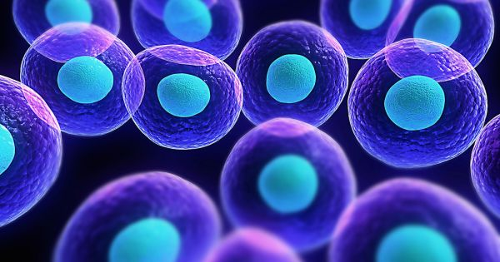
2.Restoration of Cells
The body repairs cells, restores energy and releases molecules like hormones and proteins which has an impact on immune
function, growth and metabolism, including obesity
Notes:
Research shows that not sleeping well creates an imbalance in our hunger hormones, ghrelin and leptin. High levels of ghrelin mean we are likely to eat more often and low levels of leptin mean we find it hard to recognise when we are full. Due to changes in our neural pathways in the brain, when we are tired, we are also more likely to make poor food choices , like sugary, fatty, salty and processed foods. Therefore it becomes a vicious cycle.
Impact on Immune system: It takes longer to recover from illness and fend off invaders (https://www.healthline.com/health/sleep-deprivation/effects-on-body#Immune-system
Not sleeping well hinders healthy growth and development in children and teens (muscle mass and repair of cells and tissues is compromised)

Slide 11
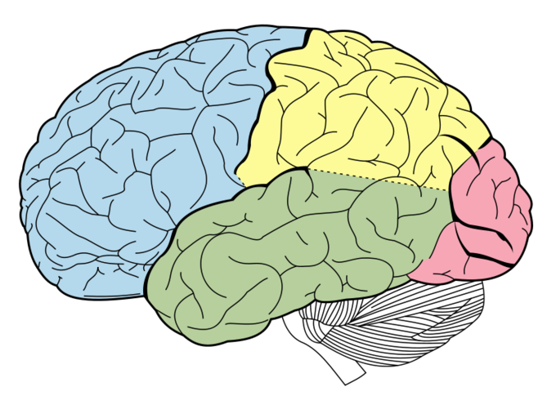
3. Brain Function
During sleep, the brain stores new information and gets rid of unnecessary information, it basically “resets”
Nerve cells communicate and re-organise, which supports healthy brain function

Slide 12
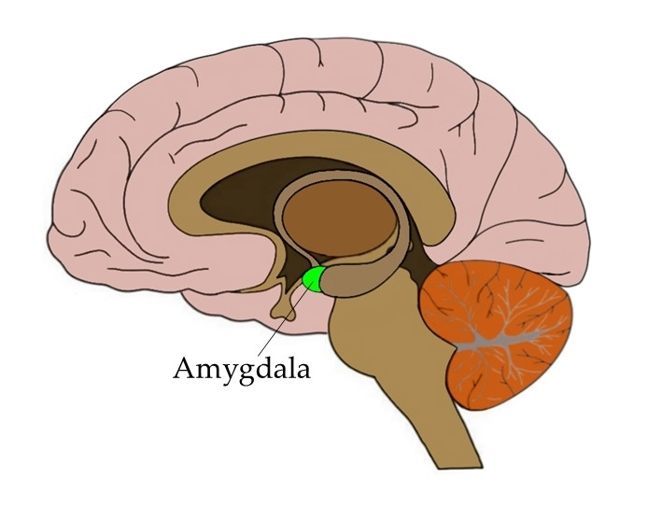
4.Emotional Wellbeing
During sleep, brain activity increases in areas that regulate emotion, thereby supporting healthy brain function and emotional stability
Research shows, that sleep and mental health are strongly linked. Sleep disturbances can contribute to the onset and progression of mental health issues, but equally mental health issues can also contribute to sleep disturbances.
Notes:
One example of how sleep can help regulate emotion occurs in the amygdala. This part of the brain, located in the temporal lobe, is in charge of the fear response. It’s what controls your reaction when you face a perceived threat, like a stressful situation.
When you get enough sleep, the amygdala can respond in a more adaptive way. But if you’re sleep-deprived, the amygdala is more likely to overreact.

Slide 13
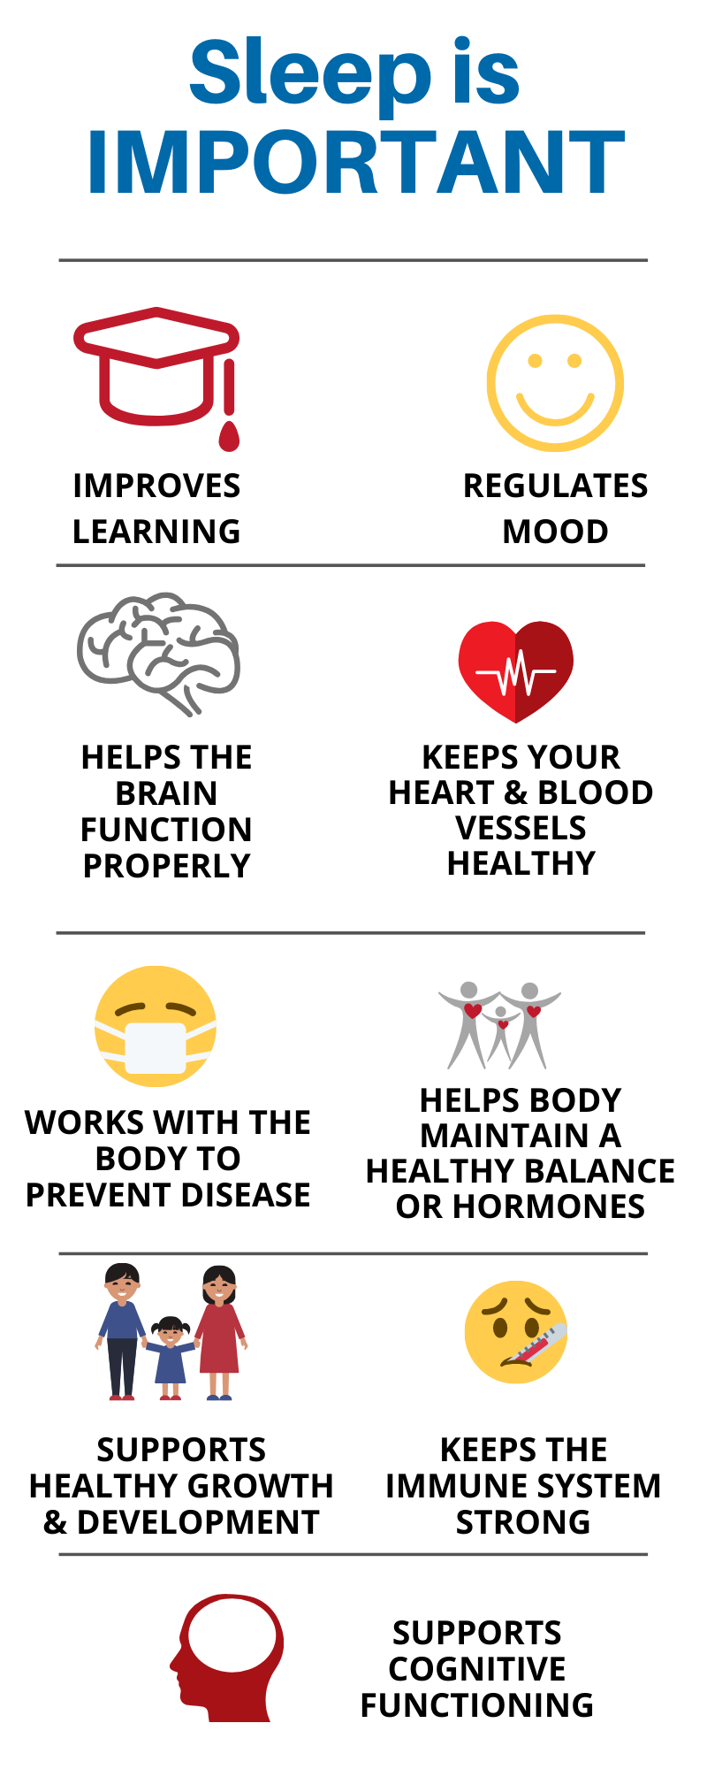

Slide 14

Understanding our sleep cycles
insert understanding our sleep cycle video

Slide 15
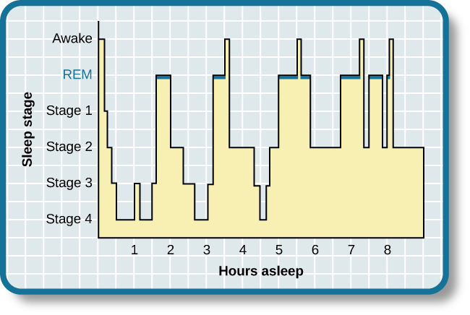
Sleep cycles
Sleep cycles change with age, especially in the first few years of our lives

Slide 16
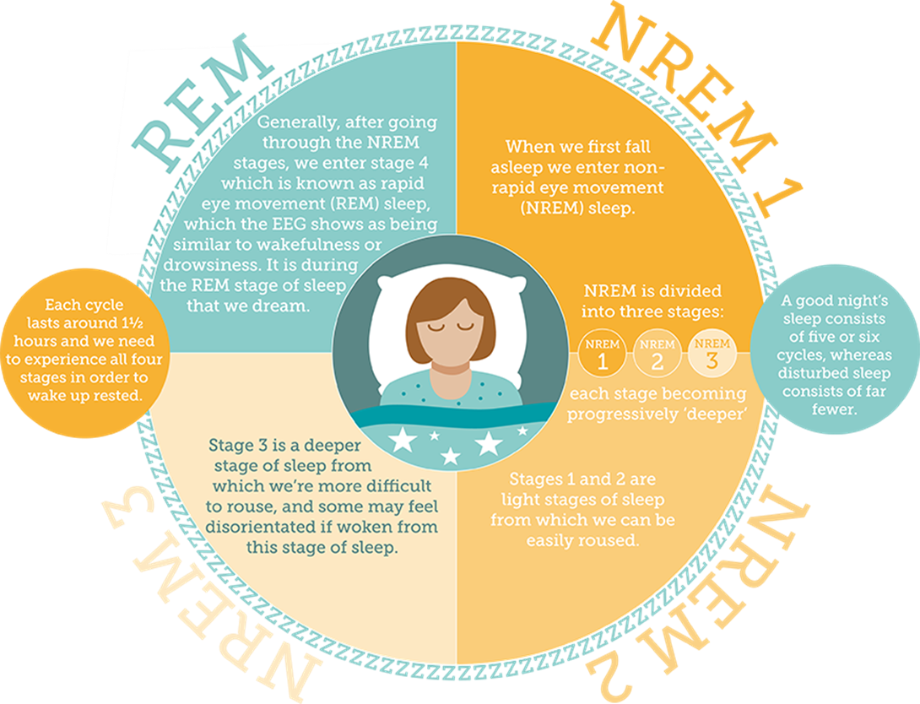
Stages of sleep
Notes:
We all sleep in cycles or “chunks” , wake after each cycle and are naturally wakeful at the end of each cycle, this is REM sleep so everybody wakes during the night.
Whether we fall asleep again depends on how we fell asleep in the first place, whatever we use to fall asleep is needed at the end of the sleep cycle, ie comfort blanket, toy,parents company, tv, night light.
Thoughts? Reflections?

Slide 17
Understanding the circadian rhythm
Circadian rhythm = internal body clock
Melatonin is a hormone that occurs naturally in our bodies during our circadian rhythm
  It is produced at night time to help us go to sleep
  Light in the morning signals to our brains to stop producing this hormone, meaning we feel less sleepy
  During adolescence, our circadian rhythm naturally shifts to later on at night, meaning that we find it hard to fall asleep earlier, and are more sleepy in the morning.
Notes:
This means for teens it is even harder to get up in the morning as their rhythm is still in a ‘dip’ meaning they feel tired. This can then be made worse by the early start of the school day, increasing feelings of tiredness if they haven’t had enough sleep.
Teens get a bad reputation but its actually their rhythms!

Slide 18
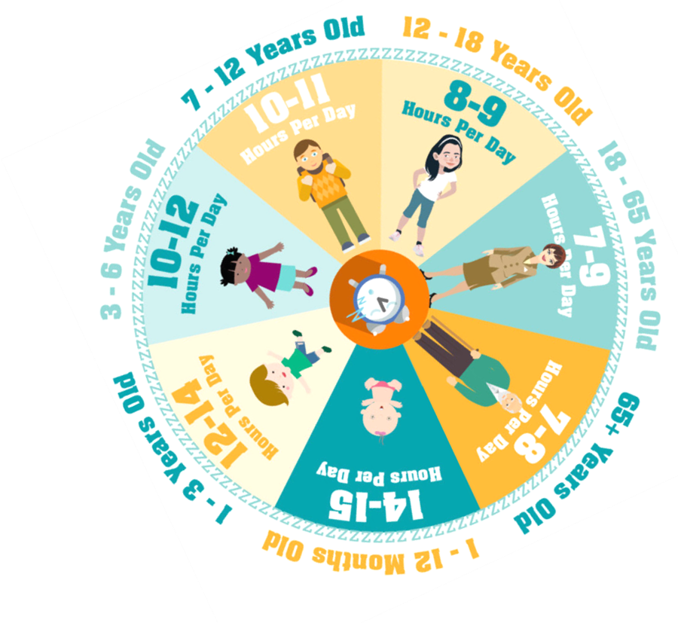
How much sleep do we need?
Notes:
Sleep cycles develop as we age, teens generally need more sleep than adults at 9 hours a night compared to 7/8

Slide 19
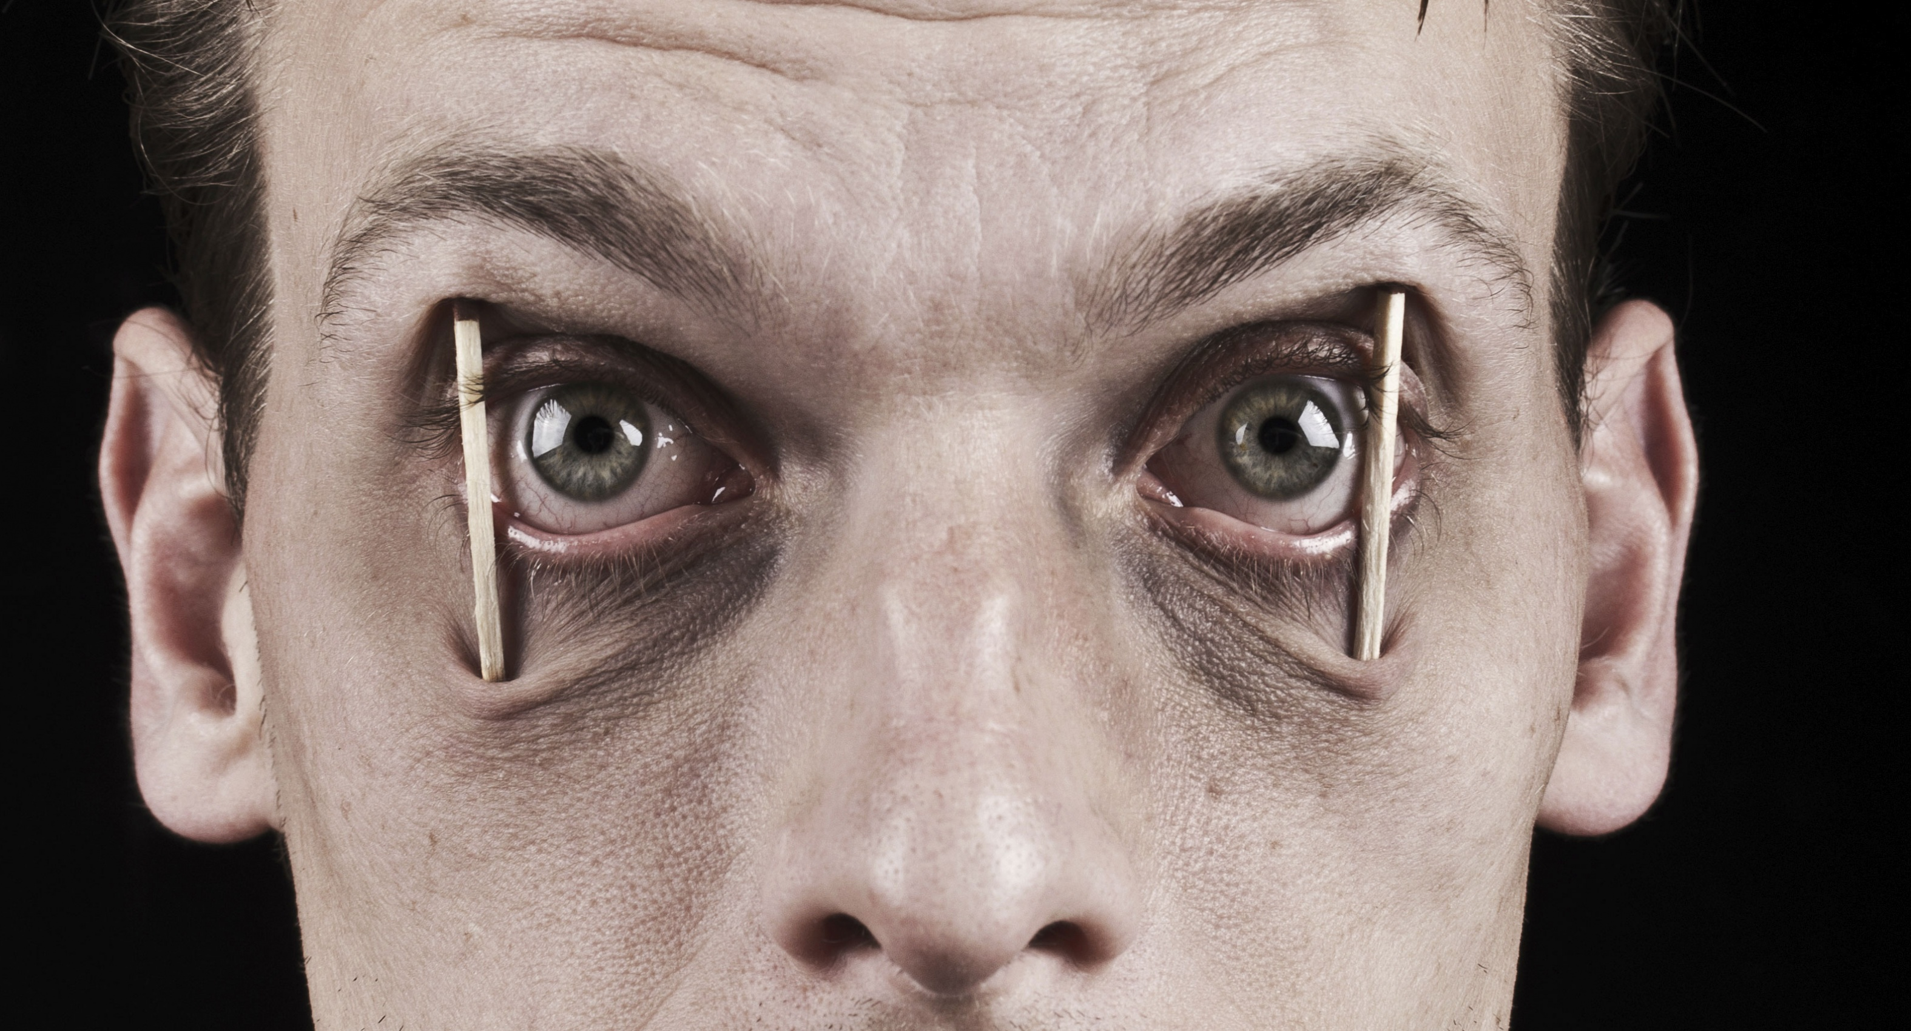
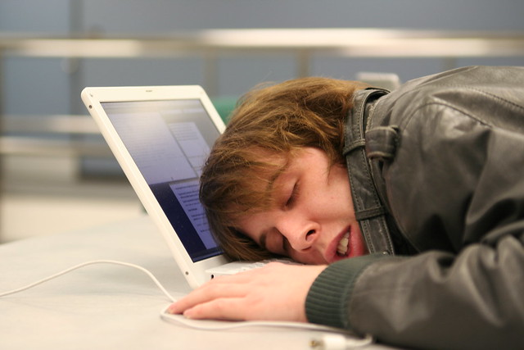
What are the impacts of sleep problems?
Jot down on the white board or share with partner
Notes:
Research suggests the regulation of SLEEP,BEHAVIOUR AND EMOTIONS are closely related. Sleep loss impairs frontal lobe function which leads to a deteriorated control of complex behaviour, attention and emotions. Children who have insufficient sleep frequently have difficulties with attention and concentration and are more likely to have behaviour problems and display with hyperactivity.
Respiratory system:OSA, obstructive sleep apnae, which leaves you more vulnerable to common cold and flu.
Sleep apnoea is a potentially serious disorder that causes breathing to repeatedly stop during sleep .It happens when the throat muscles intermittently relax and block the airway.If obstructive sleep apnoea is left untreated, it can increase the risk of developing high blood pressure ,strokes or heart attacks.
In adolescents and adults the most common cause for sleep apnoea is weight and obesity.(put with conditions?)
Sleep deprivation can make you too tired to exercise.
Impacts on growth hormone production in children and young people
.
Short- and long-term health consequences of sleep disruption
Goran Medic,^{1,2} Micheline Wille,¹ and Michiel EH Hemels^{1 Reference}

Slide 20

Research suggests that….
Sleep problems
-have adverse effects which are seen with minimal sleep deprivation (24hours)
- have potentially irreversible impact on development and learning - poor school performance
-result in emotional and behavioural effects: Tired and Wired!
-Cause attention problems and hyperactivity
-encourage risk taking behaviours (alcohol/drugs/self harm/suicidal ideation)
Notes:
“Sleep deprived kids have more behavioural problems,more academic problems, more health problems,more risk-taking behaviours and more anxiety and mood related problems” Additionally they present with more sleep terrors, nightmares,sleepwalking and bed wetting.
There is also concern about the link between too little sleep and teen self-harm and suicide risk (Susan Malone,PHD,MSN senior Research Scientist at NYU Rory Meyers College of Nursing , New York (sleeping less than 6hours per night was found to increase the risk significantly,more than 3 times
Quote by Lynellle Schneeberg, PsyD, an assistant professor at Yale School of Med, and director of the behavioural sleep program at Connecticut Children’s Medical Centre
(Healthline.com)

Slide 21
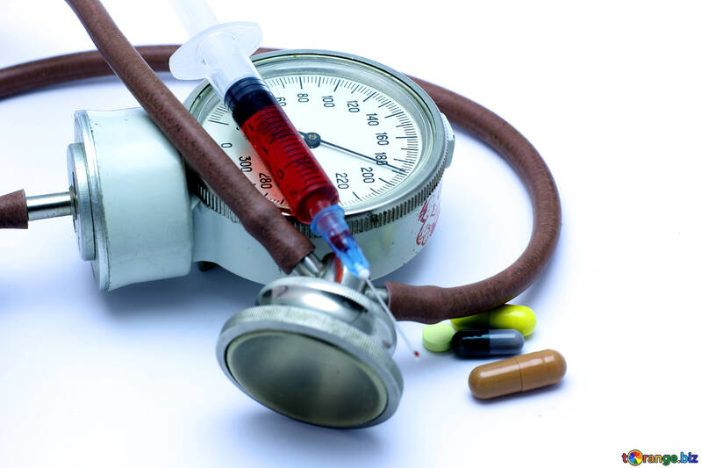
Consequences of sleep disruption:
Short-term
Long-term
Increased stress responsivity
Somatic pain and inflammation
Reduced quality of life
Emotional stress and mood disorders
Cognitive, memory and performance deficits
High blood pressure
Raised cholesterol and fat levels in blood
Risk of heart attack/disease
Type 2 diabetes mellitus
Weight related issues (obesity),some form of cancers and growth problems

Slide 22
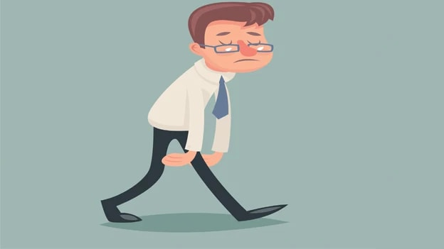
Sleep deprivation: getting less than the required amount or reduced quality of sleep:
This can develop after 24 Hours of no sleep! It can take days or weeks to recover from a bout of sleep deprivation. Just 1 hour of sleep loss requires 4 days to recover!
Notes:
Long term sleep deprivation can potentially lead to hallucinations (seeing or hearing things that are not really there)
Other psychological risks include:
Increased impulsive or risk taking behaviour
Anxiety and depression
Paranoia
Suicidal thoughts
Microsleep is encouraged , which is falling asleep for a few or several seconds without noticing which can potentially be dangerous
Reference:https://www.healthline.com/health/sleep-deprivation/effects-on-body#Central-nervous-system
Staying awake for 24 hours may cause symptoms like:
drowsiness
irritability
anger
increased risk of stress
decreased alertness
impaired concentration
brain fog
fatigue
tremors
reduced coordination
increased risk of mistakes or accidents
food cravings
puffy eyes
dark undereye circles
Ref: https://www.healthline.com/health/sleep-deprivation/sleep-deprivation-stages#timeline

Slide 23
Signs of sleep deprivation
Teenagers
Children
Excessive daytime sleepiness
Frequent yawning
Irritability, anger, hyperactivity, depression, mood swings, impatience
Impacts on decision making processes and creativity
Low self-confidence, poor impulse control
Deterioration in school attainment
temper tantrums,
the tendency to “explode” at the slightest provocation,
daytime naps,
grogginess and reluctance to get out of bed in the morning.

Slide 24
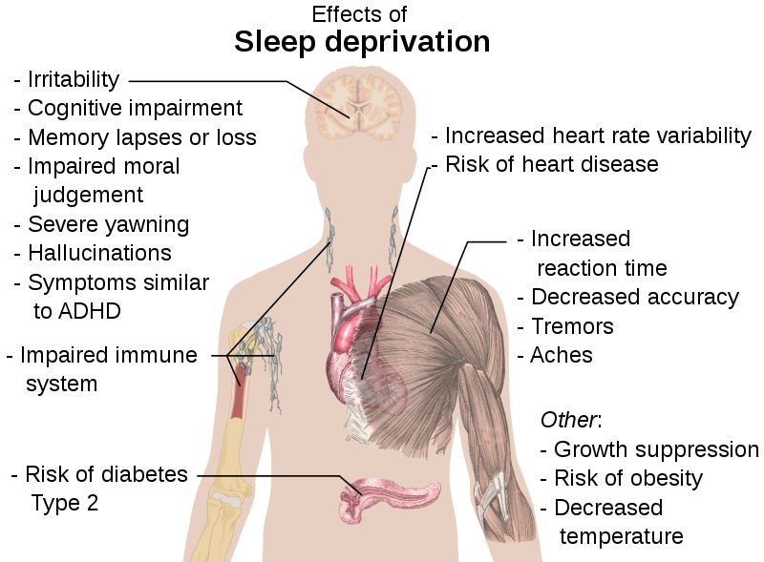

Slide 25
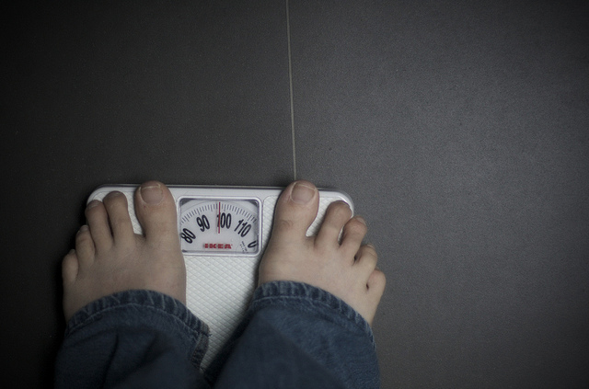
Sleep and Obesity
Research suggests,that…
Lack of sleep affects hormones which control appetite
Sleep quality and quantity at 30 months is a
predictor for obesity at seven years old.
In 5-6yr olds, sleep less than 10 hours, compared to ideal of 11 hours led to doubling of body fat
Notes:
Sleep loss creates a hormone imbalance in the body that promotes overeating and weight gain.Leptin and ghrelin are hormones that regulate appetite and when you are not getting sufficient sleep, the production of these hormones is altered in a way that creates increased feelings of hunger .Sleep deprivation is linked with growth hormone deficiency and raised cortisol (stress hormone) levels, both of which have been linked to obesity.Furthermore, insufficient sleep can impair your metabolism of food.Reduced sleep duration has been shown to cause a greater tendency to select high-calorie foods.Calories consumed late at night increase the risk of weight gain. Daytime sleepiness or fatigue may increase which in turn decreases activity levels.Research suggests that obesity may change metabolism and or sleep-wake cycles in such a way that causes sleep quality to deteriorate. (ref: www.sleepfoundation.org : Obesity and sleep 20.11.2020)

Slide 26

Sleep Problems and Medical Conditions
An illness episode can disrupt a previously good sleep pattern or may be a chronic problem
Discomfort or pain
Reflux
Epilepsy-seizures and treatment can affect sleep
Snoring-obstructive sleep apnoea
Nocturnal enuresis (bed wetting)
Restless legs (periodic limb movement disorder)
Notes:
Obstructive sleep apnoea /snoring affects 10% pre school children, 12% 4-6 yr olds. OSA affects 2% of 2-8yr olds.May be due to enlarged tonsils and adenoids and surgery may help.Common in Down syndrome (33%), also common with obesity , reduced tone eg muscular dystrophy

Slide 27
Sleep Problems and Developmental Disorders
Sleep problems prevalent in children and young people with:
Brain malformations
Visual problems
Communication problems
An ASC (Autism Spectrum Condition) who produce little or no melatonin
Notes:
How to boost melatonin:
Foods rich in melatonin: Oats, sweetcorn, tomatoes and bananas .
Foods rich in tryptophan (building block for melatonin: Cottage cheese,breakfast cereals,milk,nuts,turkey and chicken.
Anti inflammatory drugs like ibuprofen, diclofenac and electromagnetic fields (TV and computers) can deplete melatonin production.
A dark bedroom as light suppresses the production of melatonin.
.

Slide 28
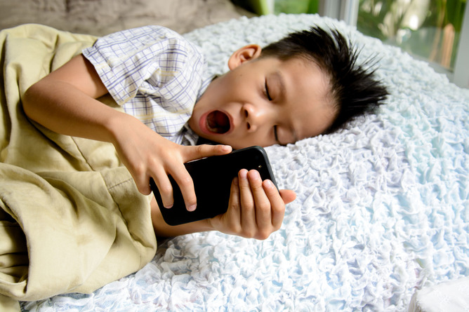
Electronic Devices and Sleep
Video games consoles, TV ,smart phones, tablets and other technology all produce blue light which can be compared to daylight and stops us from falling asleep
Notes:
A survey has shown that in the USA , an estimated 4 in 10 American adolescents take their mobile phone into bed when trying to fall asleep, 6 in 10 use a desktop or laptop computer within one hour of going to bed. Research has shown that these devices can interfere with sleep by suppressing the production of melatonin, which increases feelings of alertness when you should be winding down instead.
Electronic back-lit devices like mobile phones, tablets ,readers and computers as well as fluorescent and LED lights emit blue light which has been proven to reduce or delay the natural production of melatonin in the evening and decrease feelings of sleepiness. In addition, blue light can reduce the amount of time you spend in slow-wave and rapid-eye movement (REM) sleep, two stages of the sleep cycle that are vital for cognitive functioning. Studies confirmed that children are particularly vulnerable to sleep problems deriving from electronic devices that emit blue light, as it takes them longer to fall asleep and they do not receive enough high-quality sleep. (ref: sleep foundation 06/11/2020)

Slide 29

Social Media and Sleep
Social media is available 24/7
Fear of missing out (FOMO) very prevalent in children and young people: The constant need to check phone or similar which encourages excessive use of social media at night time as potentially not enough time during the day. The never ending desire to stay connected. Peer pressure!
2019 stats shows that 86% of 8-11 year olds,93%of 5-15yr olds and 97% of 12-15yr olds own a smart phone or tablet in the UK.
Notes:
Recent research points to the importance of social media’s effect on sleep patterns:The more time adolescents spent on screen-based activities ,like social media,web-surfing,watching TV and video clips and gaming) the more trouble they had falling asleep and the less sleep they got during the night.Those sleep issues were then lined with increased symptoms of insomnia and depression.(ref Sleep foundation 13.11.2020)

Slide 30


Slide 31
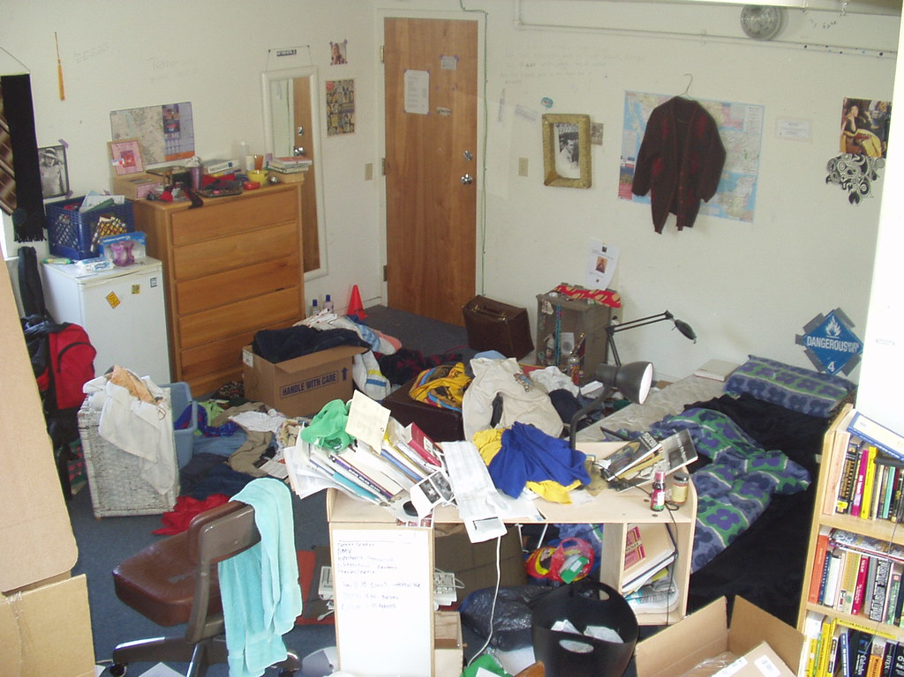
What can you do to Improve Sleep?
Share ideas with a partner or note on whiteboard

Slide 32
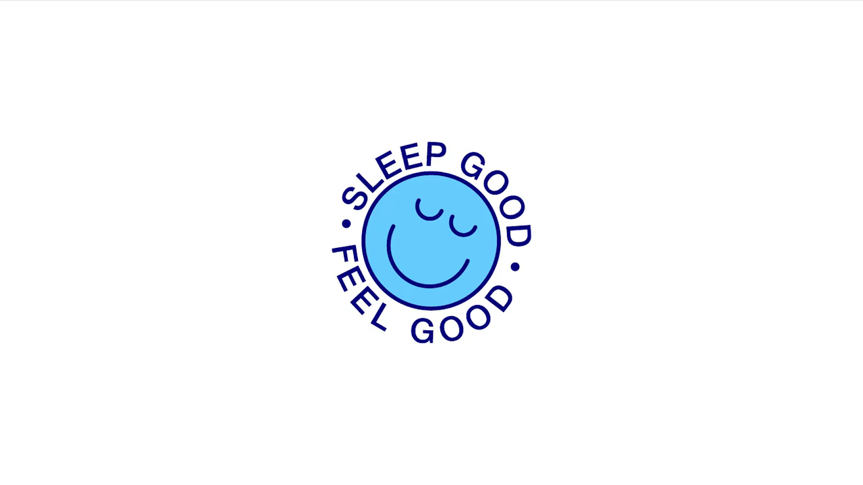
How to create the perfect sleep environment

Slide 33
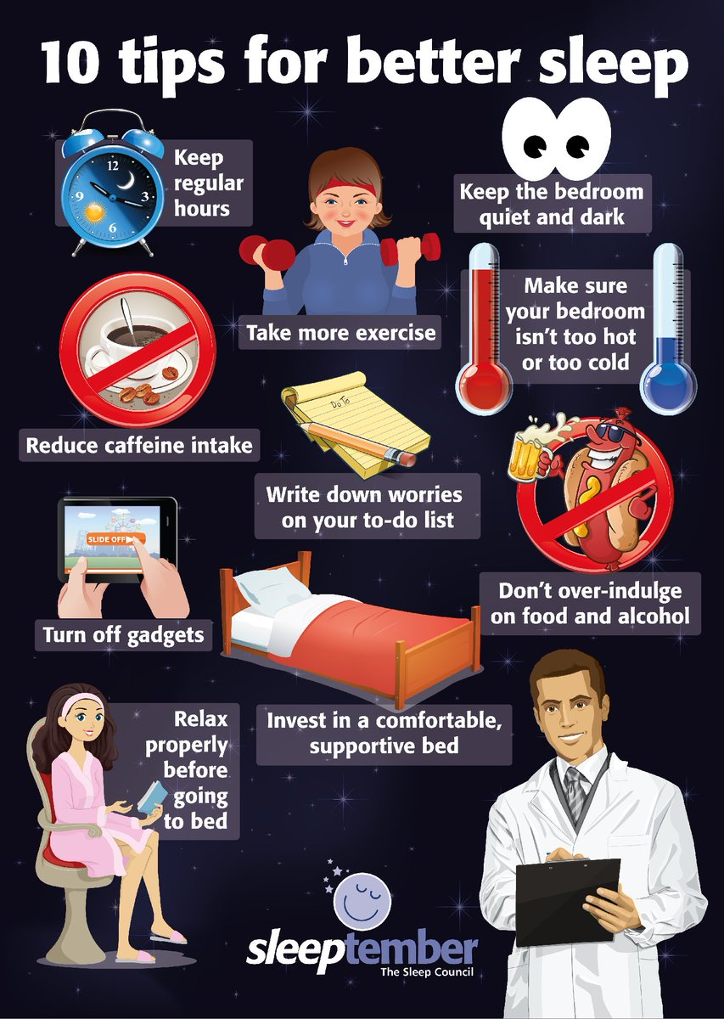
Some ideas….

Slide 34

…But also:
Be a good sleep role model- as a family!
Educate your child about the importance of sleep
Stick to a “nightly wind-down” routine
Establish guidelines/boundaries around the use
of technology/social media

Slide 35
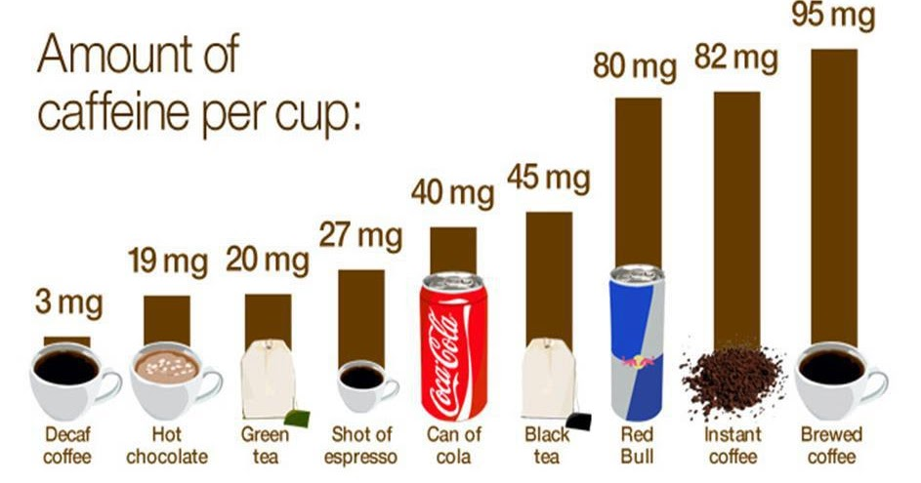
More recommendations for better sleep
1. avoid or reduce caffeine (last recommended intake around 2.00pm) as well as sugary/fizzy drinks

Slide 36
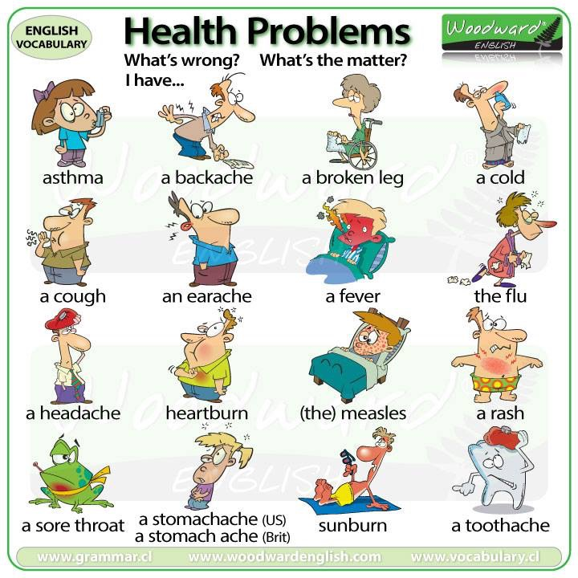
2. Ensure correct management of medical problems, long term and short term

Slide 37




3. Ensure appropriate supper/tea
- ideally 2 to 3 hours before bed time, right portion!
Did you know that some foods/drinks contain or
encourage production of melatonin?

Slide 38
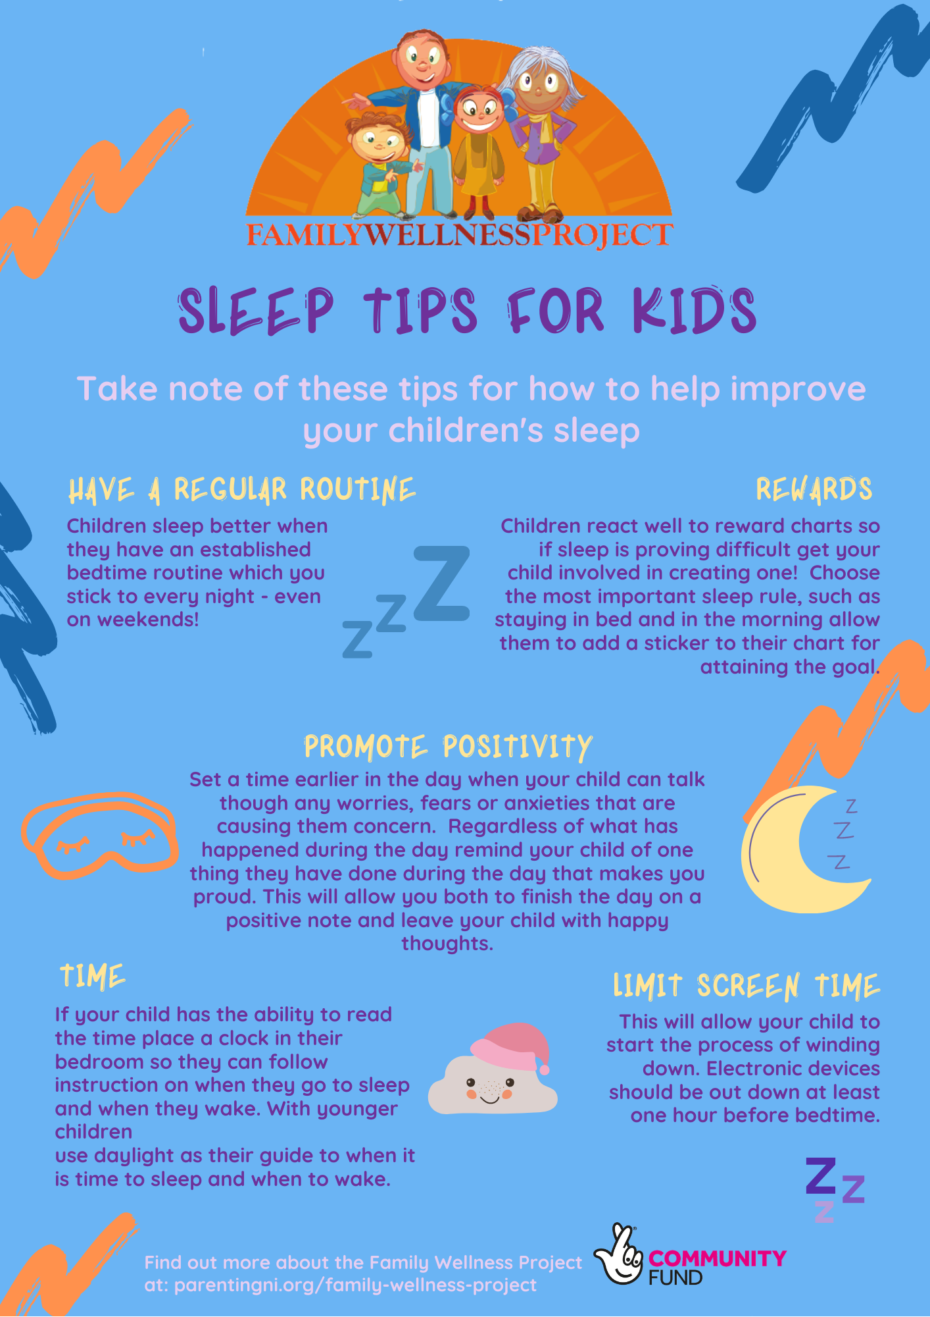
4. Follow a bedtime routine

Slide 39
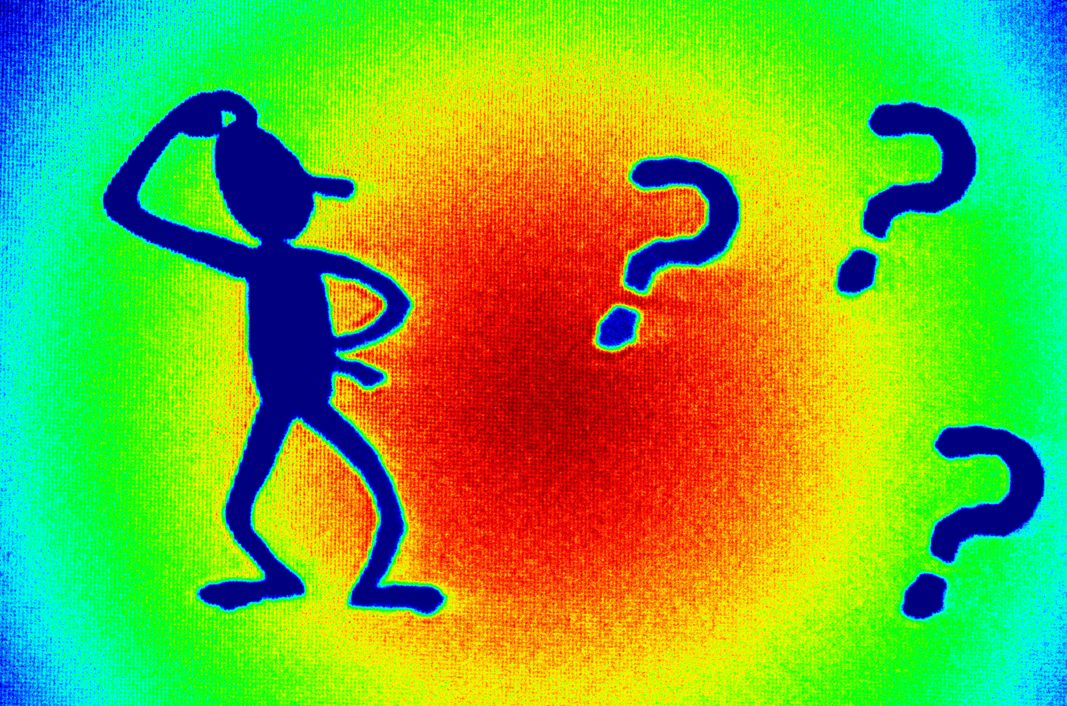
Any questions or reflections?

Slide 40

Please leave your feedback on the form!
THANK YOU! Please help yourself to leaflets

Slide 41
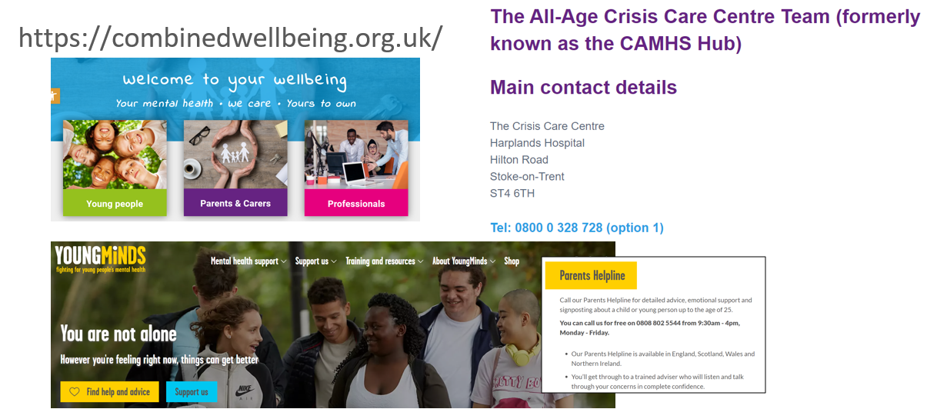

Slide 42
References:
Sleephealthfoundation.org.au
Guardian newspaper articles:
“Children's’ lack of sleep is a hidden health crisis”(30.09.2018)
“Sharp rise in hospital admissions for children with sleep disorders (06.03.2020)
Healthline.com
www.sleepfoundation.org: Obesity and
sleep,20.11.2020
Thesleepcharity.org.uk

