Slide 1

End of Key Stage 1
Statutory Assessment 2023

Slide 2

Teacher assessment
Teacher assessment is the main focus of KS1 assessment.
The assessments give a rounded view of the child.
Assessment is based on the performance of the child over a period of time not just the end of year statutory assessments.
Science is also assessed.

Slide 3


KS1 test
English reading:
2 papers
1 with text and questions combined.
1 more challenging text with the questions in a separate booklet.
All pupils are given the opportunity to take both papers.

Slide 4

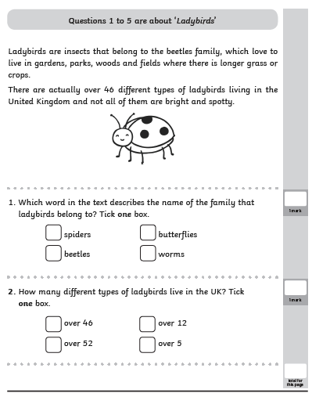
Reading paper 1

Slide 5
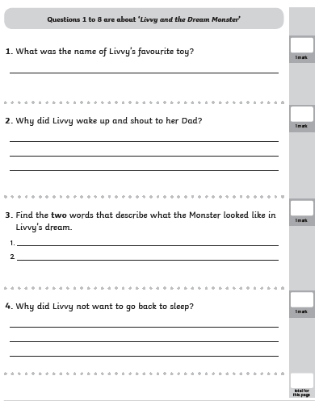
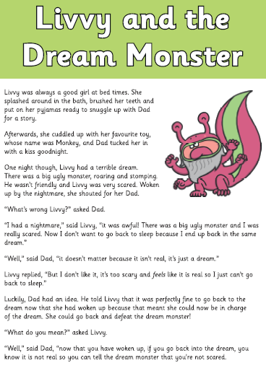
Reading paper 2

Slide 6
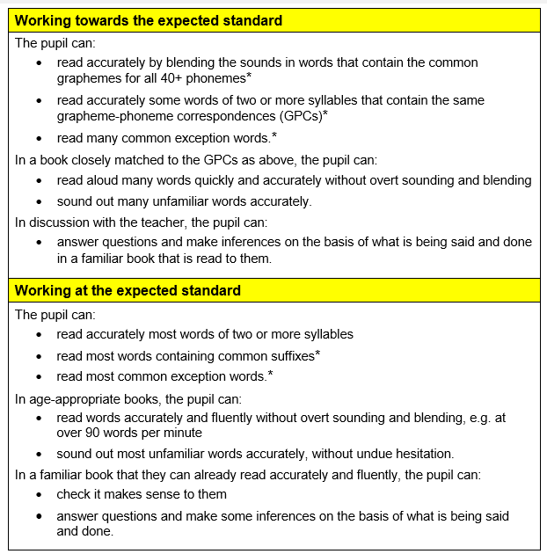



Slide 7

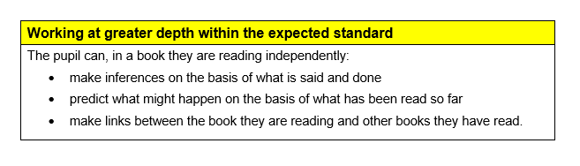

Slide 8
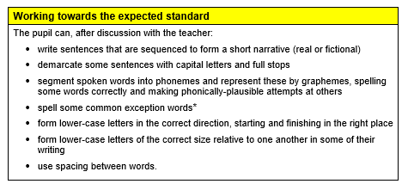
WRITING ASSESSMENT IS ON-GOING IN ENGLISH BOOKS – NO TEST PAPER

Slide 9
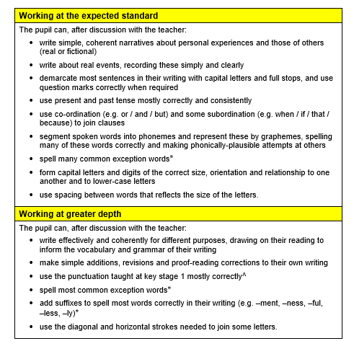


Slide 10

KS1 tests
Mathematics:
2 papers;
arithmetic
reasoning

Slide 11
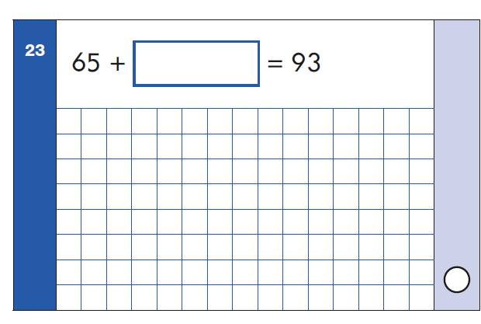
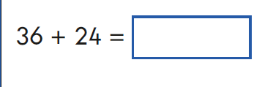
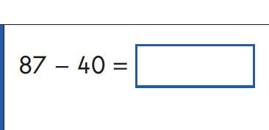
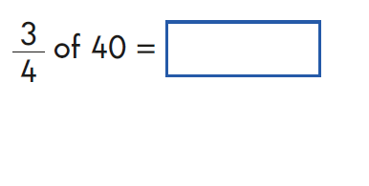
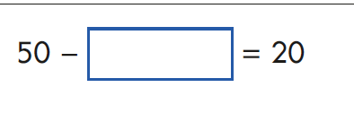

Arithmetic test

Slide 12
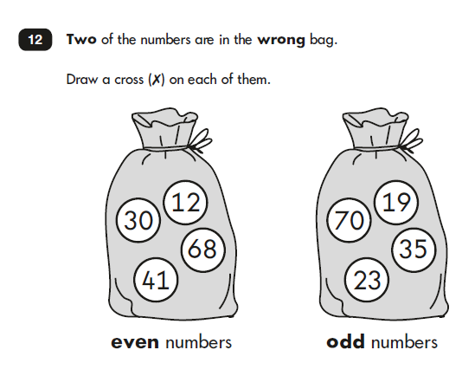
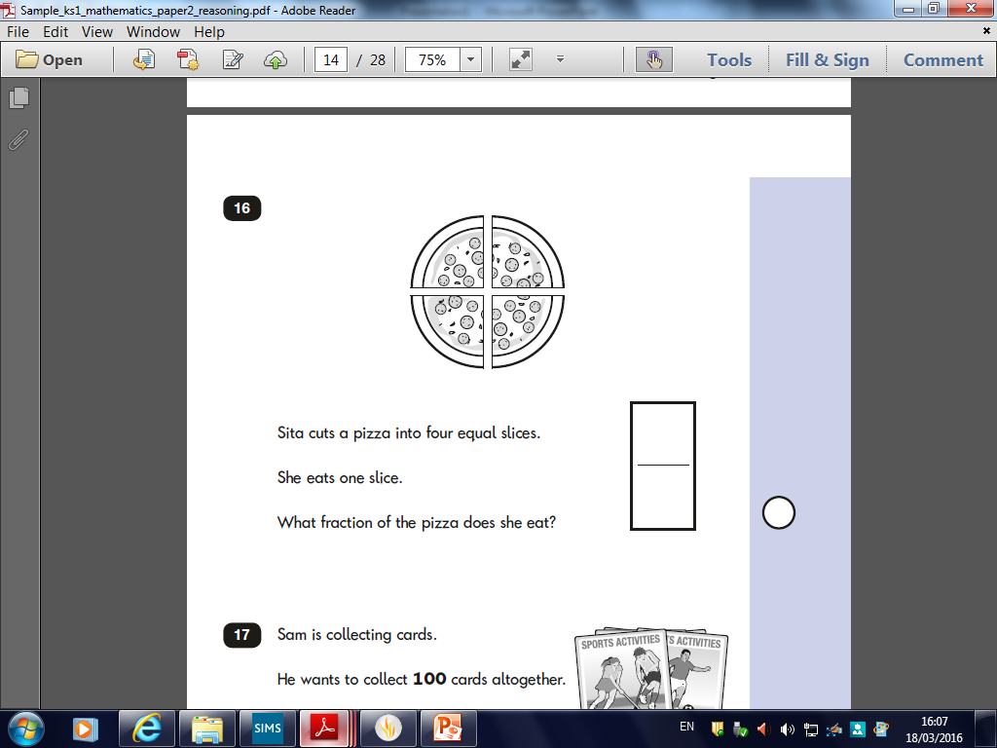
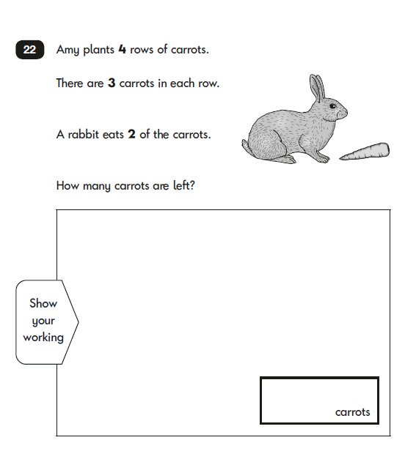
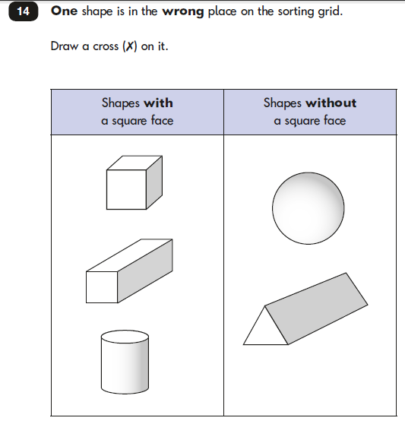
Reasoning paper

Slide 13
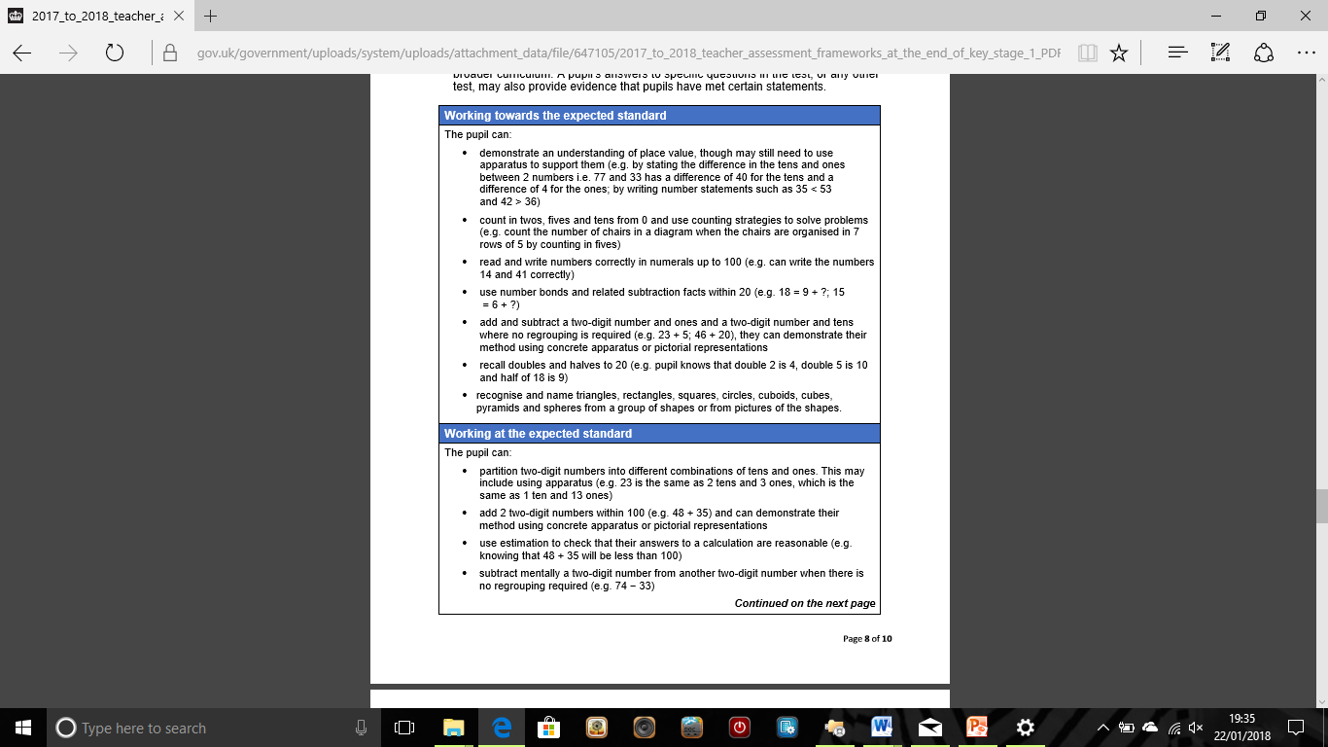

Slide 14
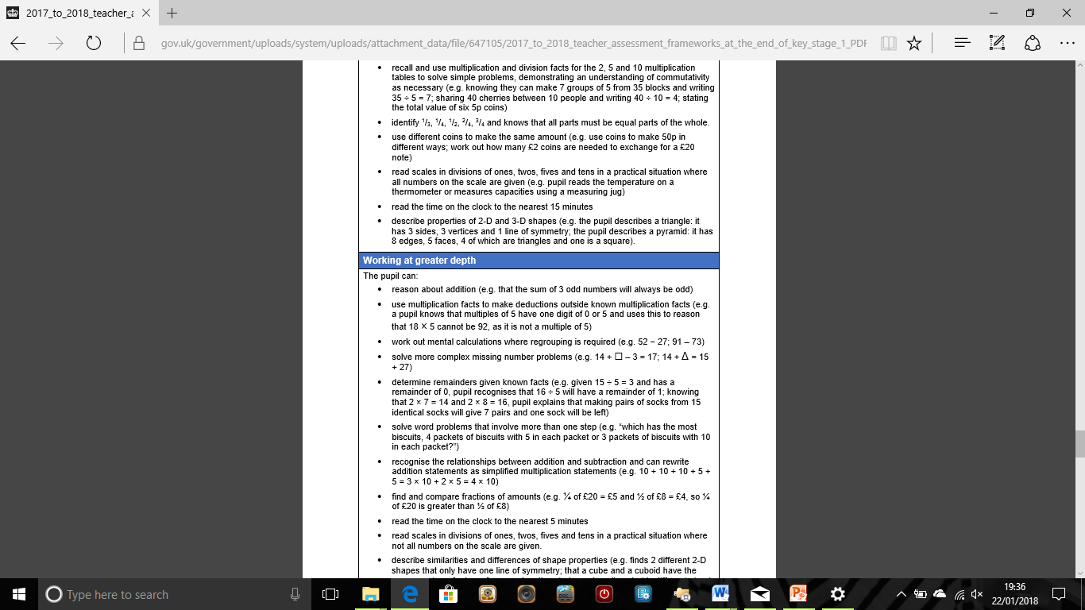

Slide 16

When will the assessments take place?
When will the tests take place?
May 2023 (over 2 weeks)
The children will sit no more than one test per day and will be given the opportunity to have a break during the test if they wish.
Tests will be carried out as informally as allowed.

Slide 17

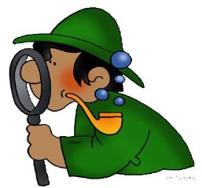
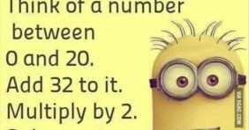


Top Tips
When reading with your child, please discuss what they have read and ask questions about the book. Find evidence in the text to support their answers.
If your child receives any maths work to complete at home encourage them to teach you how to solve the problems. (Calculation Policies in Blue Home School Links and on our website).
In your child’s homework book, please ensure that presentation is always neat because this work could be used for evidence.

Slide 18

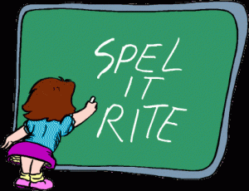
Spelling
Your child needs to be able to spell all of the Year 1 and 2 common exception words correctly in order to achieve expected.
If you need any support with this at home please see a member of staff as we are always willing to help.

Slide 19

Any questions?

