Slide 3
Fair and Unfair
What do we mean when we say something is fair?
What does unfair mean?
Why is it important to be fair?
Can you give an example of something that is unfair?
How does it make you feel when things are unfair?

Slide 4
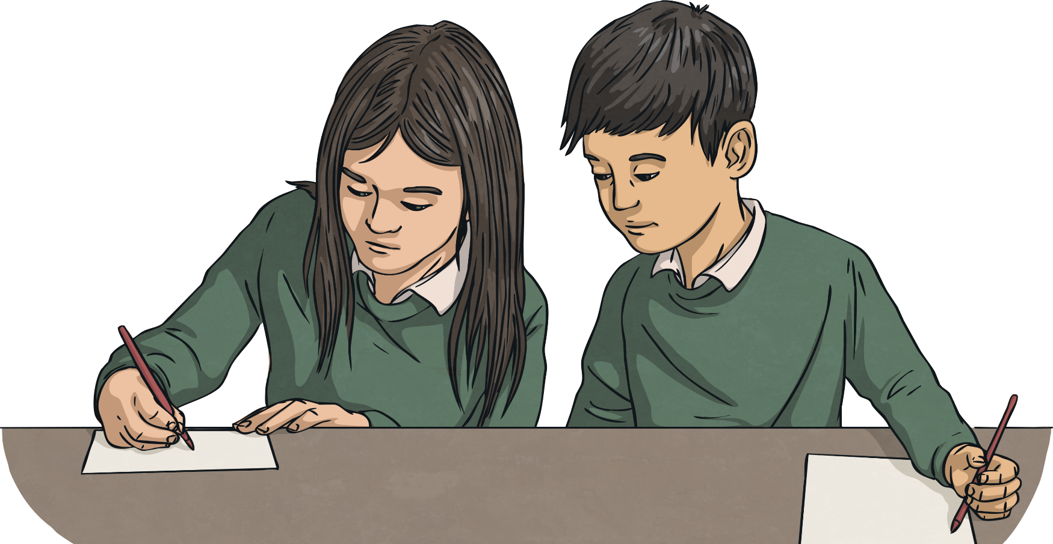
Fair or Unfair?
Children can’t go to school because they have to work.

Slide 5
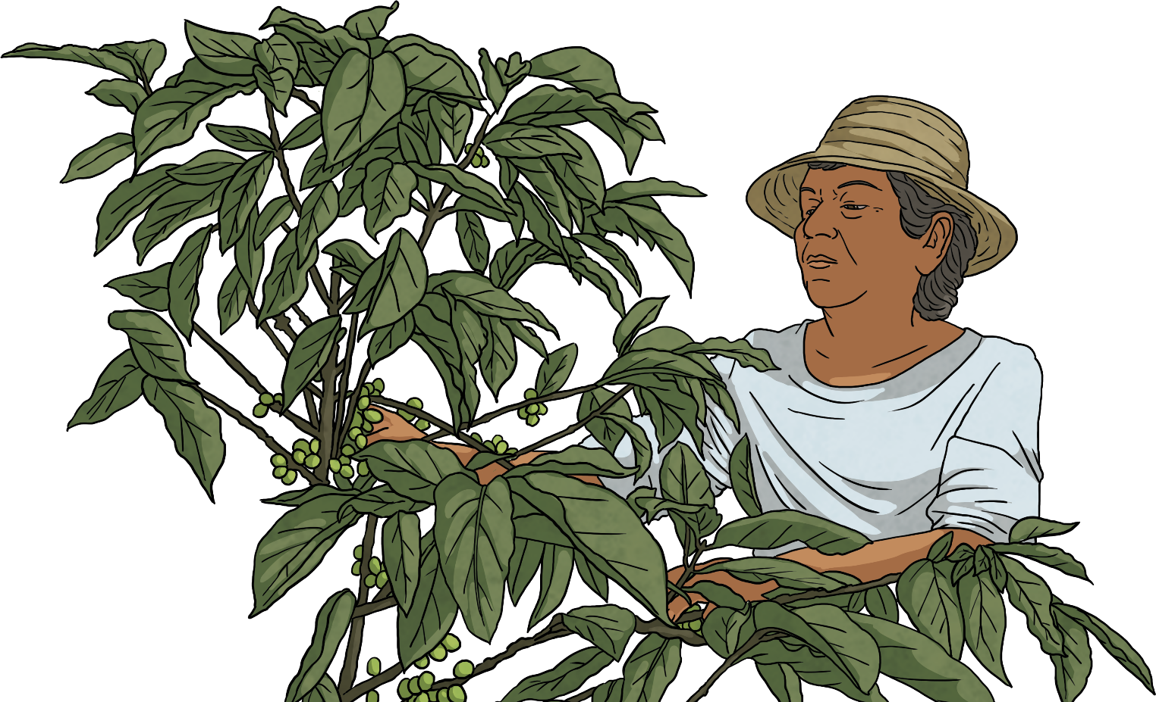
Fair or Unfair?
Farmers are paid a fair price for their produce.

Slide 6
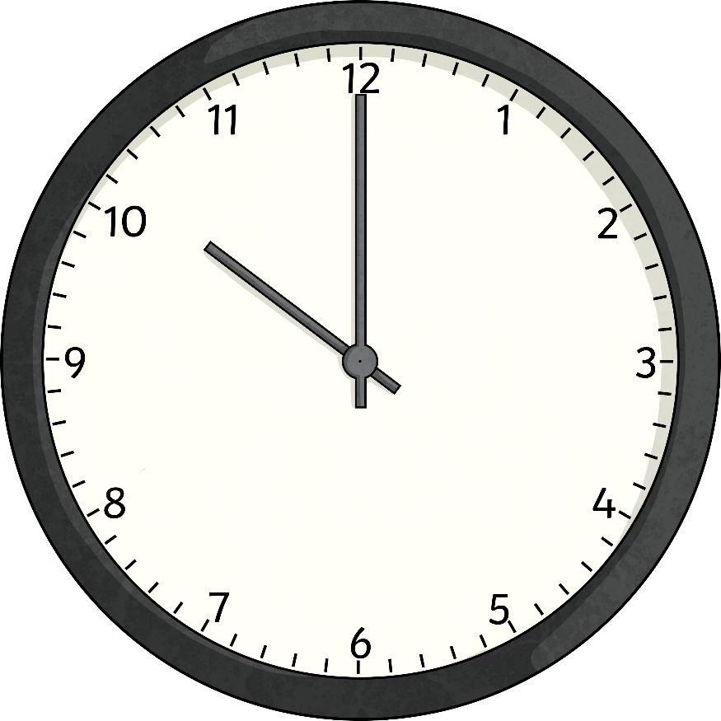
Fair or Unfair?
Workers are made to work long hours without a break.

Slide 7
Fair or Unfair?
Employees work in dangerous conditions.

Slide 8
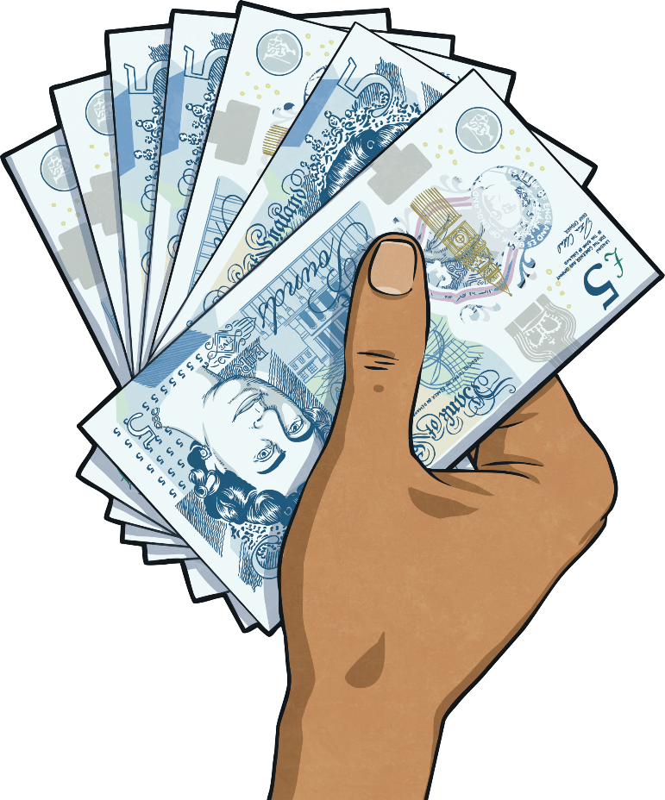
Fair or Unfair?
Men and women are paid the same for doing the same job.

Slide 9
A Fairer World
The world is not fair.
Where you are born can affect how rich and poor you are.
If you grow crops to live but no one will give you a fair price for them, that is not fair.

Slide 10
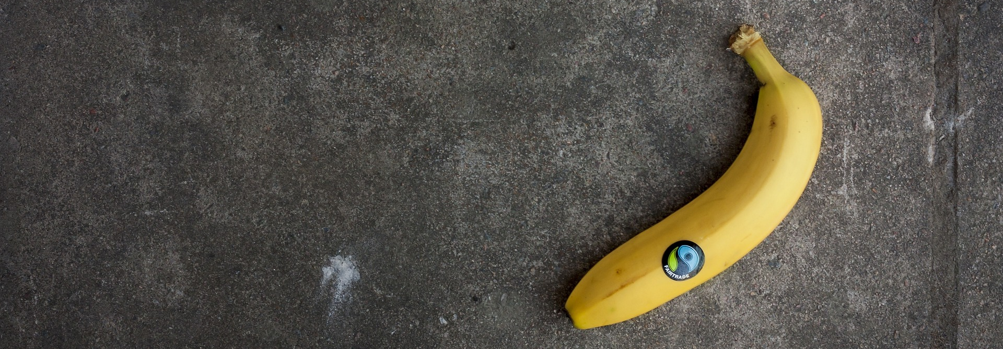
Fairtrade
The Fairtrade Foundation works in many countries across the world. It was set up to make sure farmers receive a fair price for the produce they grow and that workers have safer working conditions and a fairer wage. You may have seen products in shops with this logo on them.
This is the Fairtrade logo.
.
Products with this logo on them show that they have been traded fairly.

Slide 11
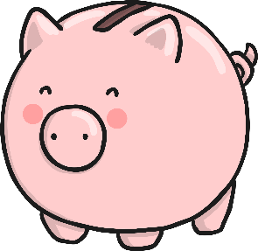
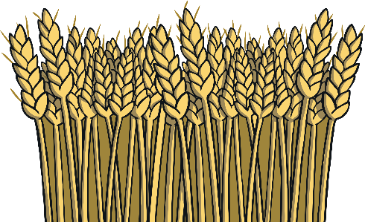
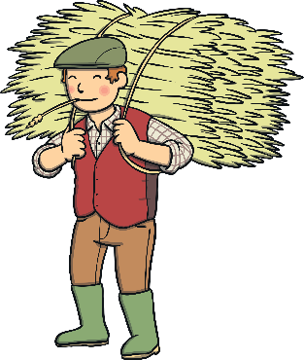
Fair Trading is About:
Workers receive better prices for crops so people can live better lives.
Extra money goes into projects that help the local community such as bicycles to get to work or wells to provide water.
Workers have better working conditions.

Slide 12
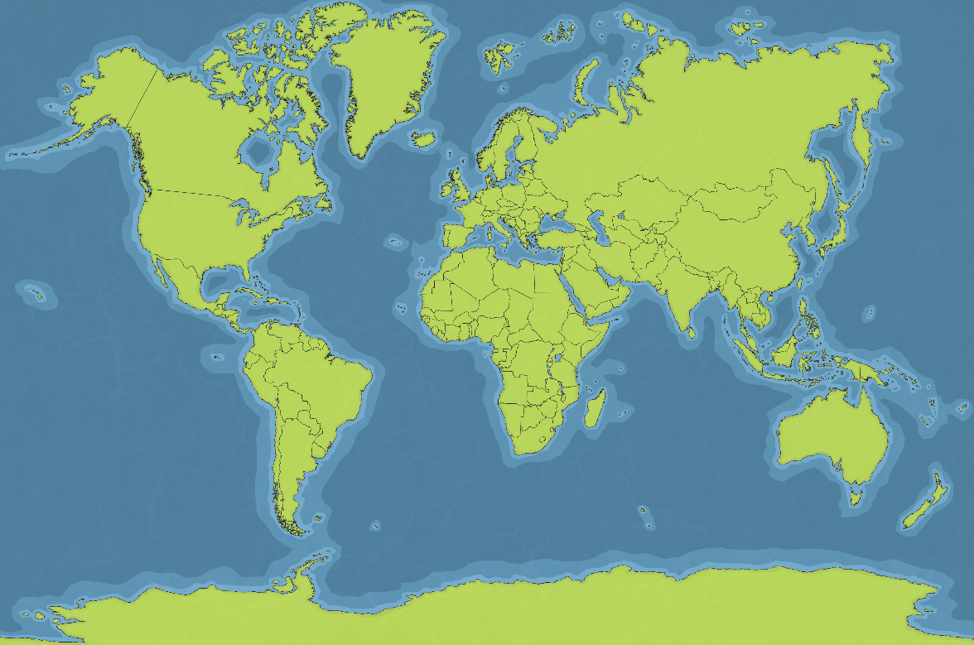
Fair Trading
Much of the produce we consume every day has been fairly traded. Before you have finished eating breakfast this morning you have depended on more than half the world.
Costa Rica
India
bananas
cotton
Guatemala
coffee
Belize
South Africa
sugar
sultanas

Slide 13
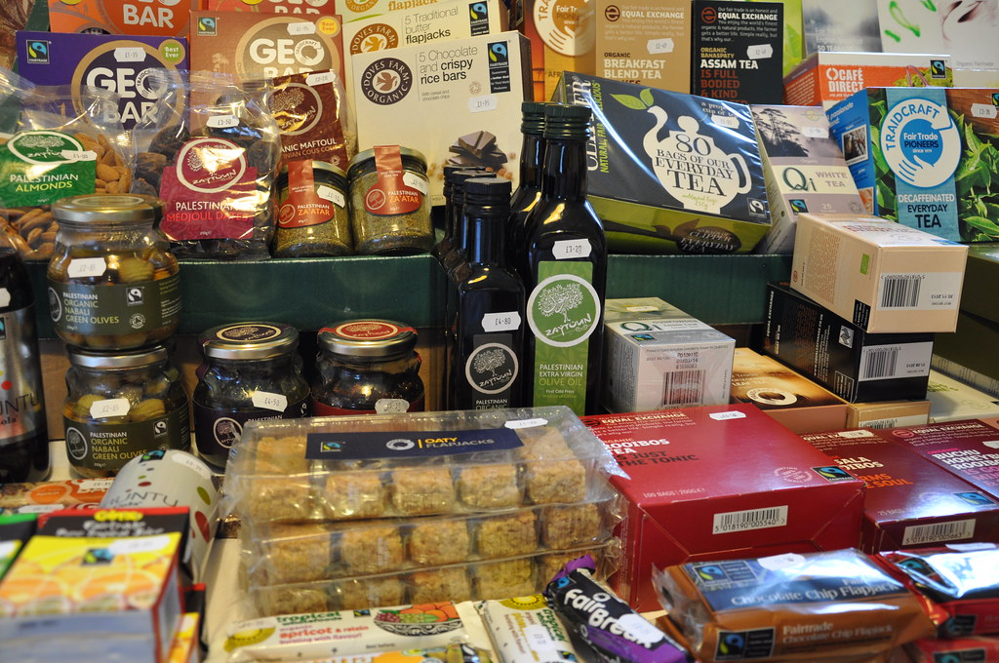
Fair Trading
Next time you go food shopping, see if you can spot any fair trading logos.
"Fairtrade Friary 29 02 2012 (8)" - "British Province of Carmelites“ is licensed under CC BY 2.0

Slide 14
What Is Fairtrade Fortnight?
Fairtrade Fortnight is a unique campaign that aims to transform the industry to ensure the people in the supply chain and the millions of struggling farmers and workers get a fair deal.
Did You Know…? One in three British bananas are fair trade but there is still a serious problem at the heart of the banana business as many farmers and workers have had their earnings cut as banana prices go down in the UK.
Supermarkets want to pay as little as possible to offer customers the lowest prices. However, this puts pressure on workers and farmers.
Fairtrade wants to make pricing work for both consumers and farmers. It is time for the government to help end these unfair prices.

Slide 15
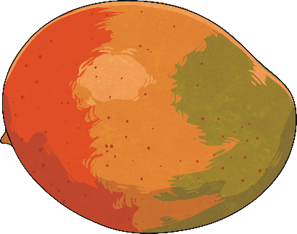
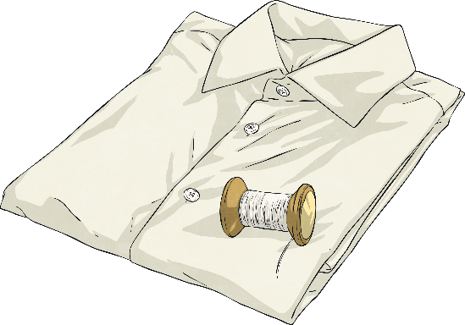
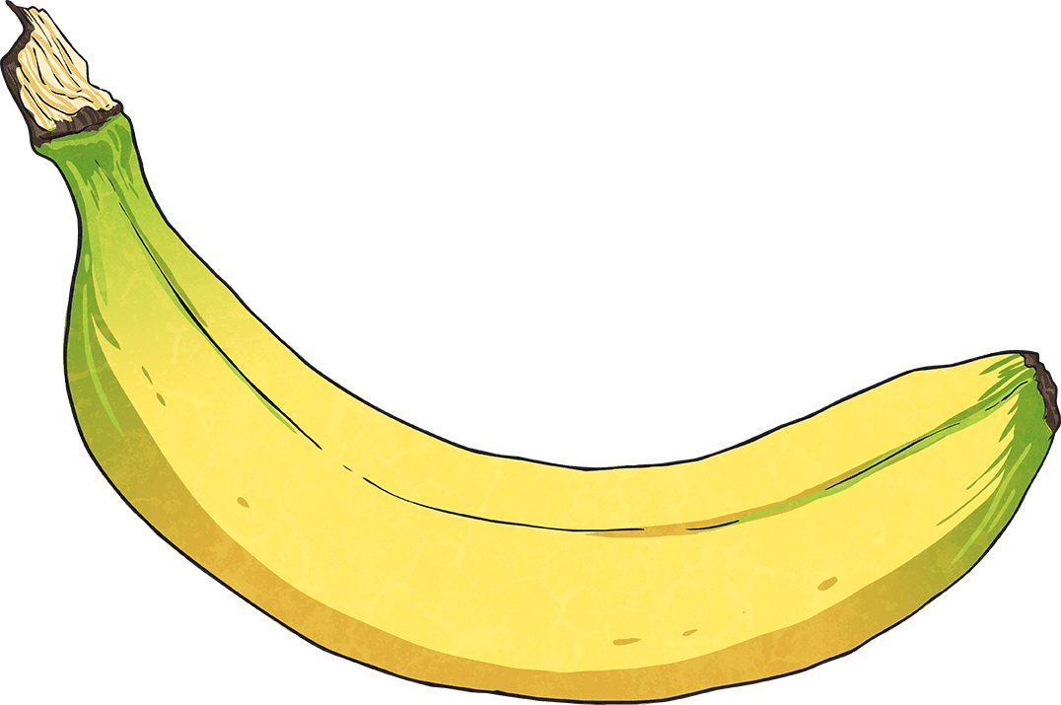
What Can You Do to Help?
Buy products that have been fairly traded. If you do this, you know that a fair price has been paid to the workers. Thousands of different fairly traded products are available to UK shoppers.
Take part in events which aim to increase awareness about fair trade.
Raise money to help this worthwhile cause.

Slide 16
Homework
KS2 Write your own lyrics about what fairtrade means to you and how it helps to protect workers and make trading fair. Write your lyrics to the tune of a nursery rhyme such as ‘twinkle twinkle little star’ or ‘Old MacDonald’.
farmers
relationships
safe
equal
fair
chocolate
pay
help
bananas
trade

Slide 17
Homework
KS1 Can you compose your own word pattern chant explaining what you know about Fairtrade. Example you will call and your class will respond;
(you) farmers struggle
(class) farmers struggle
(you) pay a fair price
(class) pay a fair price
(you) fairtrading
(class) fairtrading

Slide 18
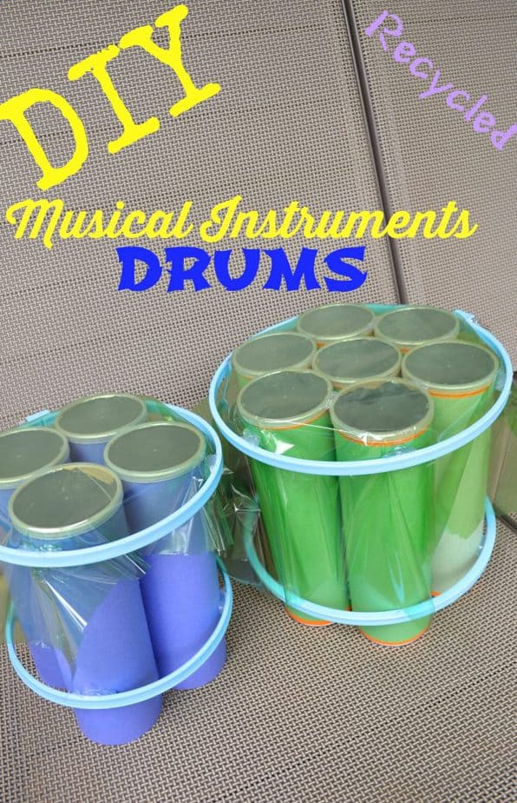
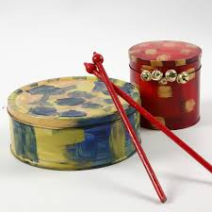
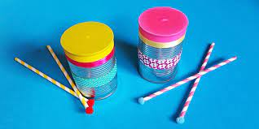
Homework
EYFS - Can you practice tapping the rhythm to the nursery rhyme ‘Old MacDonald’. Make your own drum from recycled materials to use to practice and perform in your class.

