Slide 1
Supporting a child with their worries (anxiety)
Mental Health Support Team
Adapted from Creswell & Willetts 2019

Slide 2
ANXIETY
Write down the words that come to mind when you think about anxiety.
What does anxiety mean to you and your family?
“Anxiety is defined by persistent, excessive worries that don’t go away even in the absence of a stressor. ”
Ref American Psychological Association ,2019
Notes:
Through the door activity, 5 minute discussion everyone has settled.

Slide 3
Anxiety vs Stress
Anxiety
Experienced for long periods of time
Uncontrollable worry
Does not always feel rational
May be anxious about many different things
What if???????
Stress
Experienced for shorter more distinct periods
Usually has a reason – can you think of any?
Usually has a resolution
Ref American Psychological Association ,2019 https://www.apa.org/topics/stress/anxiety-difference
Notes:
Anxiety experienced by individuals can be for prolonged periods of time.
They may not be anxious about one particular situation but many.
It is often described as prolonged periods of uncontrollable worry. Anxiety is not always for rational, tangible reasons.
Stress on the other hand is situational and usually has an explanation, and end date or a feasible solution.
Symptoms of anxiety and stress can manifest in the same way

Slide 4
What causes anxiety?
There is probably no one thing that caused your child’s anxiety, usually there are lots of things.

Slide 5
Nature - Genetics
It is thought that genetics account for one third of our tendency to suffer from anxiety!
Notes:
We inherit characteristics which make us more prone to certain anxieties, not the anxiety itself.
For example, a parent and child may both be good at playing an instrument. The child has not inherited the ability to play the instrument, but may have inherited characteristics such as the ability to easily recognise musical notes. This is related to brain function, not just good hearing!
Genetic element can be mitigated or exacerbated by environment!
Has anyone in your family had any genetic characteristics? Mental health or otherwise?

Slide 6
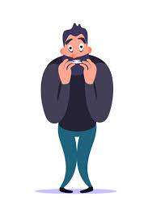
Nurture
Family & Relationships
Learned behaviours Are there worriers in the family?
Environment /Life events
Has your child experienced an event which has effected them?
Finance
Friendships
Where they live school life
Learned reactions
How do others react to anxious situations?
Notes:
Discuss sections with group – role modelling anxious behaviours
Physical, verbal and emotional role modelling from parents or significant people around the child

Slide 7
Learning to cope…..
Is it ok for your child to be anxious?
Notes:
Ask class, hands up yes/ hands up no

Slide 8
Yes!!
Children need to have the opportunity to experience situations which they find scary or uncomfortable.
This is how they build skills to cope with anxious situations
Notes:
Can you think of a time when you helped your anxious child, but in the long term it may have made the situation worse?
Give examples- scared by a dog and parent ‘rescues’ child and fear got worse due to lack of future exposure
Had a scary incident- fell off a bike but got back on

Slide 9
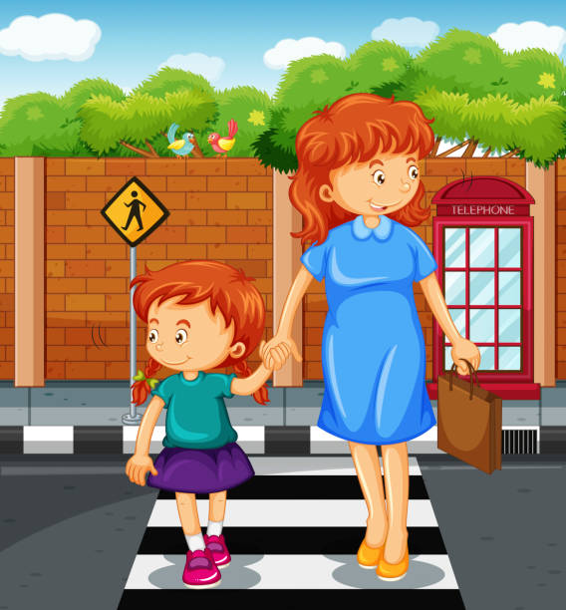
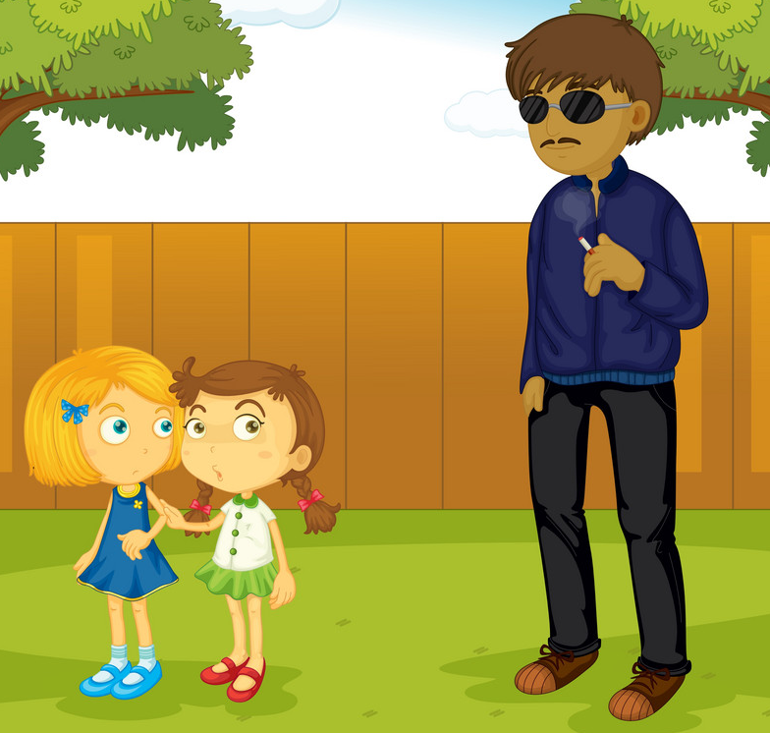
Is Anxiety useful?
Yes!!
Notes:
We need to be vary of some situations to keep us safe
We need to teach our children to be wary in some situations e.g crossing the road

Slide 10
Anxiety - prolonged, without external stressor, what if?
Stress- short term, external stressor, can be solved.
Causes- genetics, learned behaviours and reactions, life events, physical environment.
Anxiety is a normal and useful feeling that can keep us safe.

Slide 11
Notes:
10 min tea break

Slide 12
Common fears and worries experienced by children and young people……
Generalised anxiety
Many worries
What if?
Cannot stop thinking about worries
Social anxiety
Embarrassment
Judgement
Fear of peoples reactions
Separation anxiety
Problems
Separating from parent or carer
Fear of harm coming to parent/ carer or child
Notes:
Group Activity – large paper and pens
Pick on anxiety and write down the different ways this can manifest
Social- afraid to speak in class, go to school, enter new situations, meet new people, go to public places- Avoidance
Separation Anxiety- fear attending school, going to clubs, staying at friends house, going to parties- AVOIDANCE
GAD- similar to above but less avoidance

Slide 13
How do different types of anxiety effect children's day to day lives? What does your child's anxiety stop them from doing?
Notes:
Ask the one or two members of the group to feed back
Biggest problems usually caused by child anxiety are:
social life (problems with friendships)
academic performance (reduced academic achievement)
mood (more likely to become depressed).

Slide 14
Thoughts
Notes:
Anxious thinking- main theme – danger, worst case scenario
Talk through donut- thoughts/ body/ behavioural response

Slide 15
Anxious thoughts and expectations
Overestimate threat
Underestimate ability to cope
Notes:
Threat - Something bad will happen/ has happened
How to avoid/ get away

Slide 16
Behaviours
Arguing, irritable, lash out, tantrum, meltdown
Mind go blank, cant think clearly, not talking or moving, refusal
Run away, hide, defiance, avoidance
Notes:
What might these behaviours look like in your child?

Slide 17
Behaviours….
Avoidance Behaviours
Safety Behaviours
Reassurance Behaviours
Avoidance Behaviour
Safety Behaviours
Reassurance Seeking
Avoidance keeps fears going and there is never an opportunity to develop coping skills
This makes the child feel safe, but they also prevent the child from facing their fears.
This can prevent children from learning to cope independently
Notes:
Avoidance: It’s common for children (and adults!) to avoid things that we don’t like. However, avoidance teaches children that the best way to control anxiety is to avoid whatever triggers the anxious feeling. This creates a pattern of unhelpful behaviours.
By not facing worries, the person never really knows whether the feared situation is as bad as they think and prevents them from learning how to cope with it.
Safety behaviours: Children can avoid feared situations in subtle ways too, such as having support with them at all times during the worrying situation, this is known as a SB. This might include always having someone with them during the situation for support, always carrying a bag in case they are sick, covering their face when they speak or rehearsing what they are going to say before they speak. These behaviours help the child feel safe, but in fact they are preventing the child from overcoming the fear. For example, a child’s belief may lead them to think “I asked a question with time, but it was okay ONLY because my face was covered and no one could see me”.
Reassurance: Reassurance: just like avoidance, reassurance (usually from an adult) will make the child feel better. However, if a child is constantly reassurance seeking they are not updating their fear of belief but has used reassurance for a short-term relief. For example, imagine a child writing their spellings in their phone in order to have a sneaky check during a test. This means that in future, the child would not have learned how to spell these words and becomes reliant on their phones. In the same way, reassurance leads to greater dependence and can prevent children from learning how to cope independently.

Slide 18
Can you think of any physical symptoms of anxiety?
Body

Slide 19
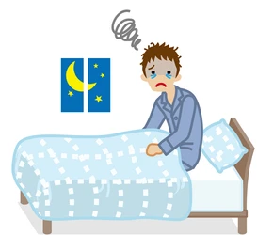
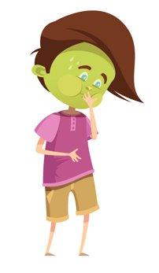
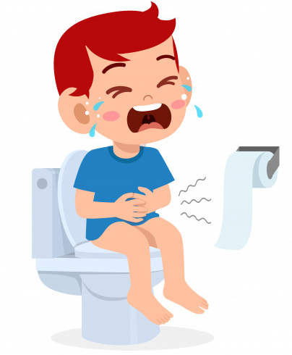
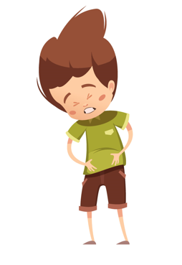
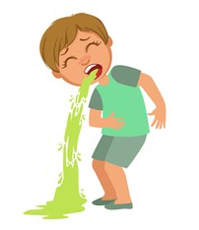
Physical symptoms of anxiety
Notes:
Ay more?

Slide 20
Physical feedback loop
Something bad will happen
Increase anxiety response
Notes:
For some people the thought will come first , then the physical response and then the anxiety behavioural response
For others the physical response will come first, this is then interpreted as ‘something bad is going to happen’ and then the behavioural response will happen.
Eg- child’s heart rate increases > interpreted as something bad IS GOING TO HAPPEN > anxiety behaviour (avoid, leave etc)
Sometimes we need to help our child manage the physical feelings and stay in a anxious situation so the though associated with that physical feeling changes.

Slide 21
Anxious thinking- worst case scenario
Behaviours- Fight/ Flight/ Freeze, can develop unhelpful safety behaviours, excessive reassurance seeking, avoidance
Physical Symptoms- many and varied
Physical feedback loop can be changed with support

Slide 22
Notes:
10 min tea break

Slide 23
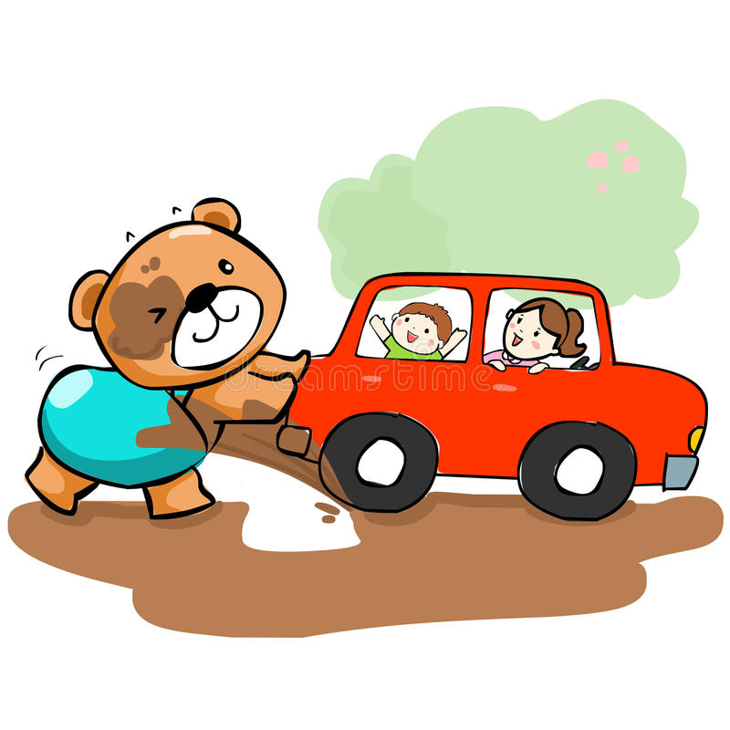
How to help
Do I need to know what caused my child's anxiety in order to help them?
Notes:
It can be helpful to know why your child anxiety started but its not essential. Think of a car stuck in the mud, you have an idea of how it got there but the most important thing is how to get it out.
The most important thing in helping your child with anxiety is understanding the maintaining factors that are keeping your childs anxiety going and working out how to make positive changes in this area.

Slide 24
Explore anxious thoughts
Notes:
Ask parents to think about an anxious situation for their child
Work through the flow chart
The ask parents to consider alternative thoughts and behaviours, how would this be different for a non anxious child/ family
Key skill- children need to learn to think about lots of alternative thoughts and behaviours

Slide 25
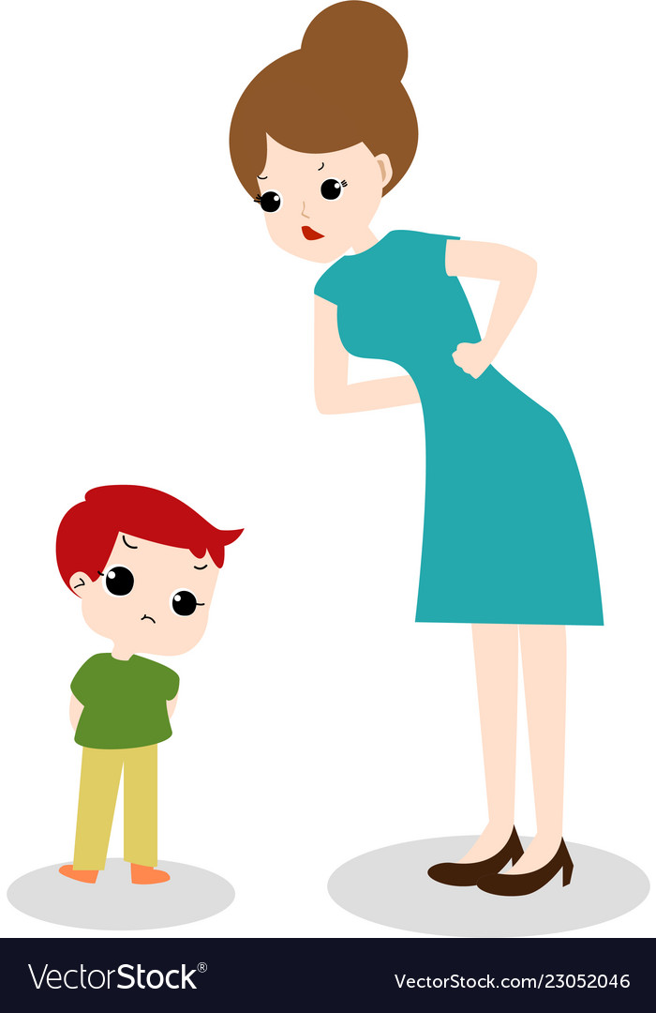
Exploring anxious thoughts with empathy
Mum - what is it that worries you about going upstairs?
Ben- I don’t want to go on my own
Mum - That must feel scary, what are you worried will happen? (empathy and curiosity)
Ben- nobody will be up there with me
Mum - and why does that worry you?
Ben- I'm worried that something will get me
Mum - is there anything in particular that you are worried will get you ? (curious)
Ben- a monster………
Mum - go upstairs and get your shoes
Ben - No don’t want to (avoidance, stroppy, argumentative)
Mum - Why not?
Ben - because I don’t want to I’m scared
Mum - don’t be silly you are upstairs all the time
Ben- No……(avoidance, argumentative, defiance)
Notes:
Sometimes a child may say “I don’t know” to everything- this can become frustrating!!
If this happens, you can offer suggestions e.g lots of children are scared of *****, is that what you are worried about?
Check that you have understood the child's fear – ok so you are worried about…….. Is that right?
Curious and empathetic questioning helps both you and the child identify what the troubling thought is.
Although its helpful, its not essential to know your child's specific anxious thoughts. Its more important to help them understand that they can cope with practice!

Slide 26
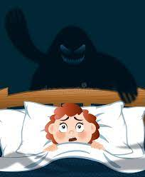
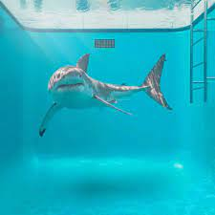
Rational?
Remember that your child's fear and behavioural response is rational TO THEM even if it is not rational to you.
Can you think of any ‘irrational’ fears that you may have?

Slide 27
Reassurance
It is important to encourage your child to think for themselves and develop problem solving skills.
Eg. Anxious thought - I will forget my homework and get in trouble at school, my teacher will be disappointed with me and I will have to a detention.
Reassurance seeking to mum - what if I forget my home work?
Answer- go to Mrs Wood and explain to her that you forgot and I will bring it in to school at lunch for you
Answer- what do you think that you could do?
Notes:
Encourage your child to think for themselves- ask questions and don’t give all the answers
Offer support to help your child figure out the problem themselves

Slide 28
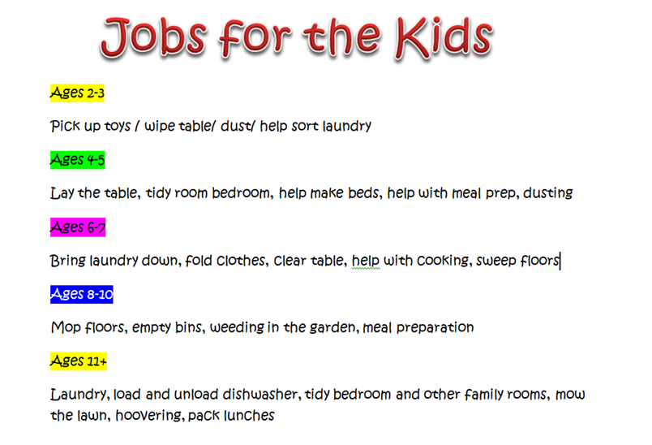
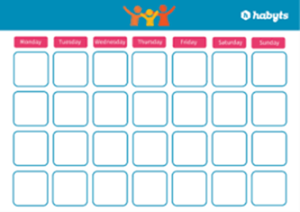
Every day independence
It is important that your child has opportunities to learn independence.
Notes:
Encouraging independence helps children learn that that they can cope with tasks and learn new things
Show your child what to do in a new task
Show confidence in your child
Hold back and let them try, help the fix mistakes afterwards with your child
Reward efforts straight away
Stay calm- you child may get upset or frustrated trying new things! If its clear that the task is to much then change it, build tasks up slowly
If they refuse, give them choices e.g do you want to go and have a shower?
when are you going for your shower? Now or after dinner?
Share your own struggles- I found it really hard to learn how to ride a bike but got it right in the end and enjoyed going out with my friends on bike rides

Slide 29
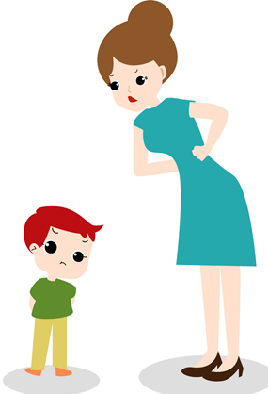
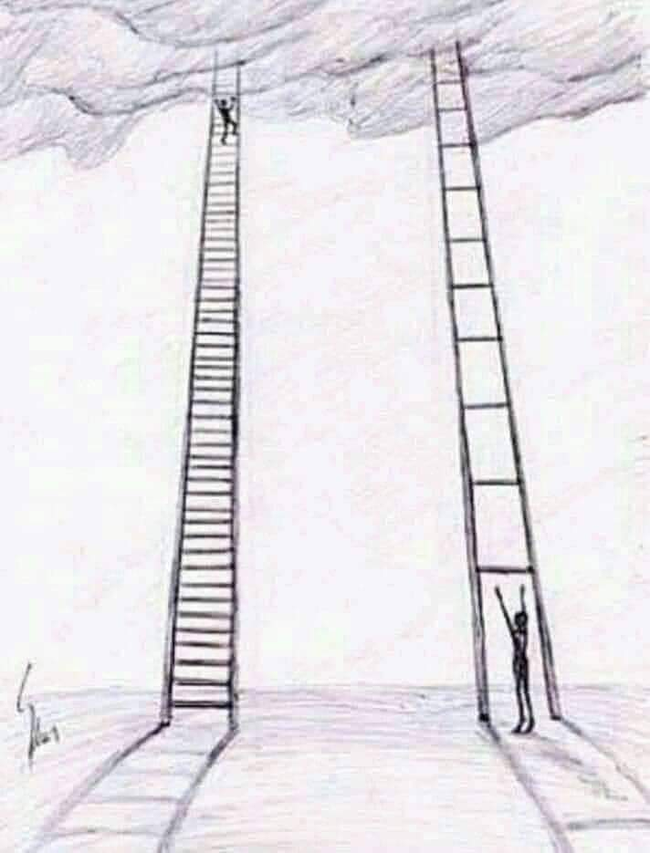
Having a go
Remember Ben?
Set a goal and use a ladder to support your child in reaching that goal.
Can you think of some steps to help Ben with his fear of being upstairs on his own?
Notes:
You can then use a goal and a ladder approach to help the child overcome that fear.
e.g goal to be able to go upstairs on his own
Start with you walking up the stairs and waiting while he goes in to his room for shoes
Next time walk half way up the stairs and wait while he goes up and get the shoes
Next time stay at the bottom of the stairs and ait while he fetches something……
Small steps will support the child in becoming more independent in a supported way.
Think about rewards for each step

Slide 30
SMART GOAL

Slide 31
SMART Goals
NOT a SMART goal:
For my child to be less anxious sleeping over at other people’s houses.
A SMART goal:
For my child to be able to go to a sleepover at their best friends house in the holidays
Work with a partner to think of a SMART goal for your child

Slide 32
Attention and Praise
Notes:
Sometimes we give a lot of attention to anxious behaviour- even if its negative attention!
Try and pay more attention to positive behaviours, steps towards goals and learning new skills

Slide 33
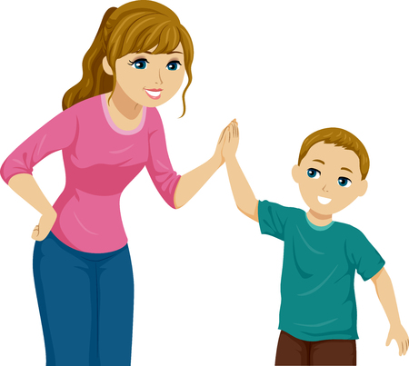
Make praise specific not general
General- well done!
Specific- You did a great job getting dressed for school this morning. I know that this can be a struggle for you and I am really proud that you made that effort.
General- Your teacher told me you did great at school today.
Specific- your teacher said that you asked a question in class today. I know that you can feel shy in class so I'm really impressed that you were able to do that today. Well done.
Notes:
This may sound strange at first and seem like a lot of work but you will get used to it !

Slide 34
We do not need to know our child's anxious thoughts?
Explore thoughts and feelings with curiosity and empathy.
Fears will be rational to the child
Use reassurance constructively when needed, encourage problem solving first.
Encourage every day independence.
Having a go- use goal setting and goal ladder.
Pay attention to positive steps and behaviours more than to anxiety behaviours.
Use specific praise and agreed rewards.

Slide 35
Useful Resources
Helping Your Child With Fears and Worries by Creswell and Willetts
https://www.combined.nhs.uk/our-services/children-and-young-people/
24 hr access team 0300 0328 728
http://changeshere4u.org.uk/stay-well-children-and-young-people-online-support-mental-health-mental-wellbeing-wellness-stoke-newcastle-staffordshire-every-mind-matters-self-isolate-stay-home-save-nhs/

Slide 37
References
American Psychological Association. (2019). Accessed via https://www.apa.org/topics/stress/anxiety-difference
Creswell. C & Willetts. L . (2019). Helping Your Child With Fears and Worries. London: Robinson.

