Slide 2
Notes:
The images show a marigold and a poppy. Invite pupils to suggest things the flowers might have in common.
They are both symbols of Remembrance.

Slide 3
Notes:
The poppy became a symbol of Remembrance after the First World War.
During WW1, much of the fighting took place in Western Europe. The countryside was blasted, bombed and fought over repeatedly. Previously beautiful landscapes turned to mud; bleak and barren scenes where little or nothing could grow. There was a notable and striking exception to the bleakness - the bright red Flanders poppies. These resilient flowers flourished in the middle of so much chaos and destruction, growing in the thousands upon thousands.
In the Spring of 1915, shortly after losing a friend in Ypres, a Canadian doctor, Lieutenant Colonel John McCrae, was moved by the sight of these poppies and that inspiration led him to write the now famous poem In Flanders Fields.
In the UK, people wear poppies in November to remember those who have served and sacrificed and as a sign of hope for a peaceful future.

Slide 4
Notes:
The marigold is also a symbol of Remembrance, helping us remember that the UK wasn’t alone. Millions of people from pre-partition India (including the areas that are now Pakistan and Bangladesh) served alongside Britain in WWI and WWII.
The marigold is particularly special in India, where it is often used at important occasions like weddings and religious festival. The saffron colour of the flowers has been described as ‘the colour of sacrifice’.
The extract is from The Gift of India by Sarojini Naidu in which she explores India’s contribution to the First World War.

Slide 5
Notes:
Although the tradition of Remembrance began after the First World War, it continued to include the service and sacrifice of people fighting for and alongside the UK and Commonwealth in every conflict since then.

Slide 7
Notes:
We remember the service and sacrifice of the armed forces from the UK, the Commonwealth and the countries who fought alongside us (our allies) in the First and Second World War, in the Falklands, Kosovo, Afghanistan, Iraq and more. We remember all those who supported them: those who worked in munitions factories, women who took on jobs to keep their country running, the men and women of the resistance.

Slide 8
Notes:
We also remember the families who have lost loved ones or who are caring for injured and recovering veterans.

Slide 9
Notes:
While we’re not at war, terrorist acts still take place and our emergency services are the first to arrive to help the victims.

Slide 10
Notes:
We remember the people who are not members of the armed forces but have lost their lives as a result of war and terrorism.

Slide 11
Notes:
There are lots of ways to remember.
The most popular form of Remembrance is to wear a poppy. Can pupils remember what the poppy symbolises?
It is a symbol of Remembrance and of hope for a peaceful future.

Slide 12
Notes:
People attend Remembrance services and events all over the country. The National Service of Remembrance at the Cenotaph in London is held on Remembrance Sunday, the closest Sunday to 11th November. The service is attended by senior members of the Royal Family, including Her Majesty the Queen, HM Government, representatives of the Commonwealth and features a march involving 10,000 veterans.
There are also local services held on Remembrance Sunday in places of worship and community services.

Slide 13
Notes:
Remembrance can take place at any time of year. In Staffordshire there is an arboretum (a special garden filled with trees) which welcomes people who want to remember in a peaceful environment.
There are also local memorials across the UK. Lots of people use these memorials and their local library to find out about the contribution their family members made to the First and Second World Wars.

Slide 14
Notes:
At 11am on the 11th November (Armistice Day), people across the country stop what they are doing and stay silent for two minutes to remember all the people affected by war and to hope for a peaceful future.

Slide 15
Notes:
Observe a moment of silence.
Extract from For the Fallen by Robert Laurence Binyon

Slide 17
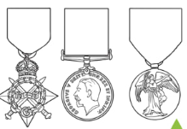
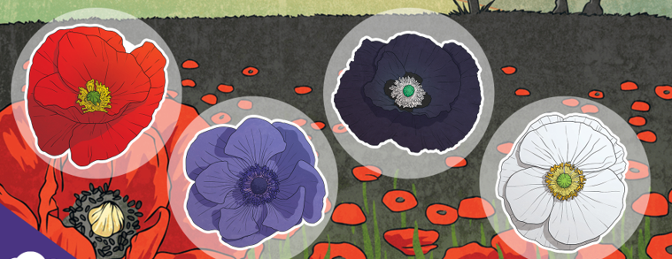
Your Homework
EYFS – Design a medal for a hero who has shown bravery.
KS1 – Design a thank you card for service men and women.
KS2 – Research why we wear poppies and find out what the different coloured poppies represent.

